Slide 1
Lakefront View Loft
845 Taughannock Blvd.
Ithaca, NY 14850
Location Scouters: Caitlyn Castillo Remy Litvin

Slide 2
General Information
Location Measurements
1440 Square Feet
Upstairs
Living Room - 20’ x 13’
Main Bedroom - 13’8” x 9’9” (with 2’ Closet)
Bathroom - 6’6” x 6’6”
Small Office - 9’11” x 9’9”
Kitchen - 10’ x 10’
Downstairs
Living Room - 20’ x 23’ (going to the back of the floor) & 13’ (where the closet is)
Bedroom - 9’ x 16’
Bathroom - 6’6” x 6’6”

Slide 3
General Information (Cont.)
Exterior w/ Amenities
Two Part House (Restricted only on one part)
Lake Dock
Fire Pit
Table and Chairs
Extras
Hammock
Wild Life

Slide 4
General Information (Cont.)
Interior - Two Floors
2 Bedrooms
2 Bathrooms
2 Living Rooms
Full Kitchen
Storage Room
Small Office (With Restrictions)
Available as a place to shoot in (for kitchen scenes), or place equipment
May NOT shoot this room

Slide 5
Exterior Photos -House

Slide 6
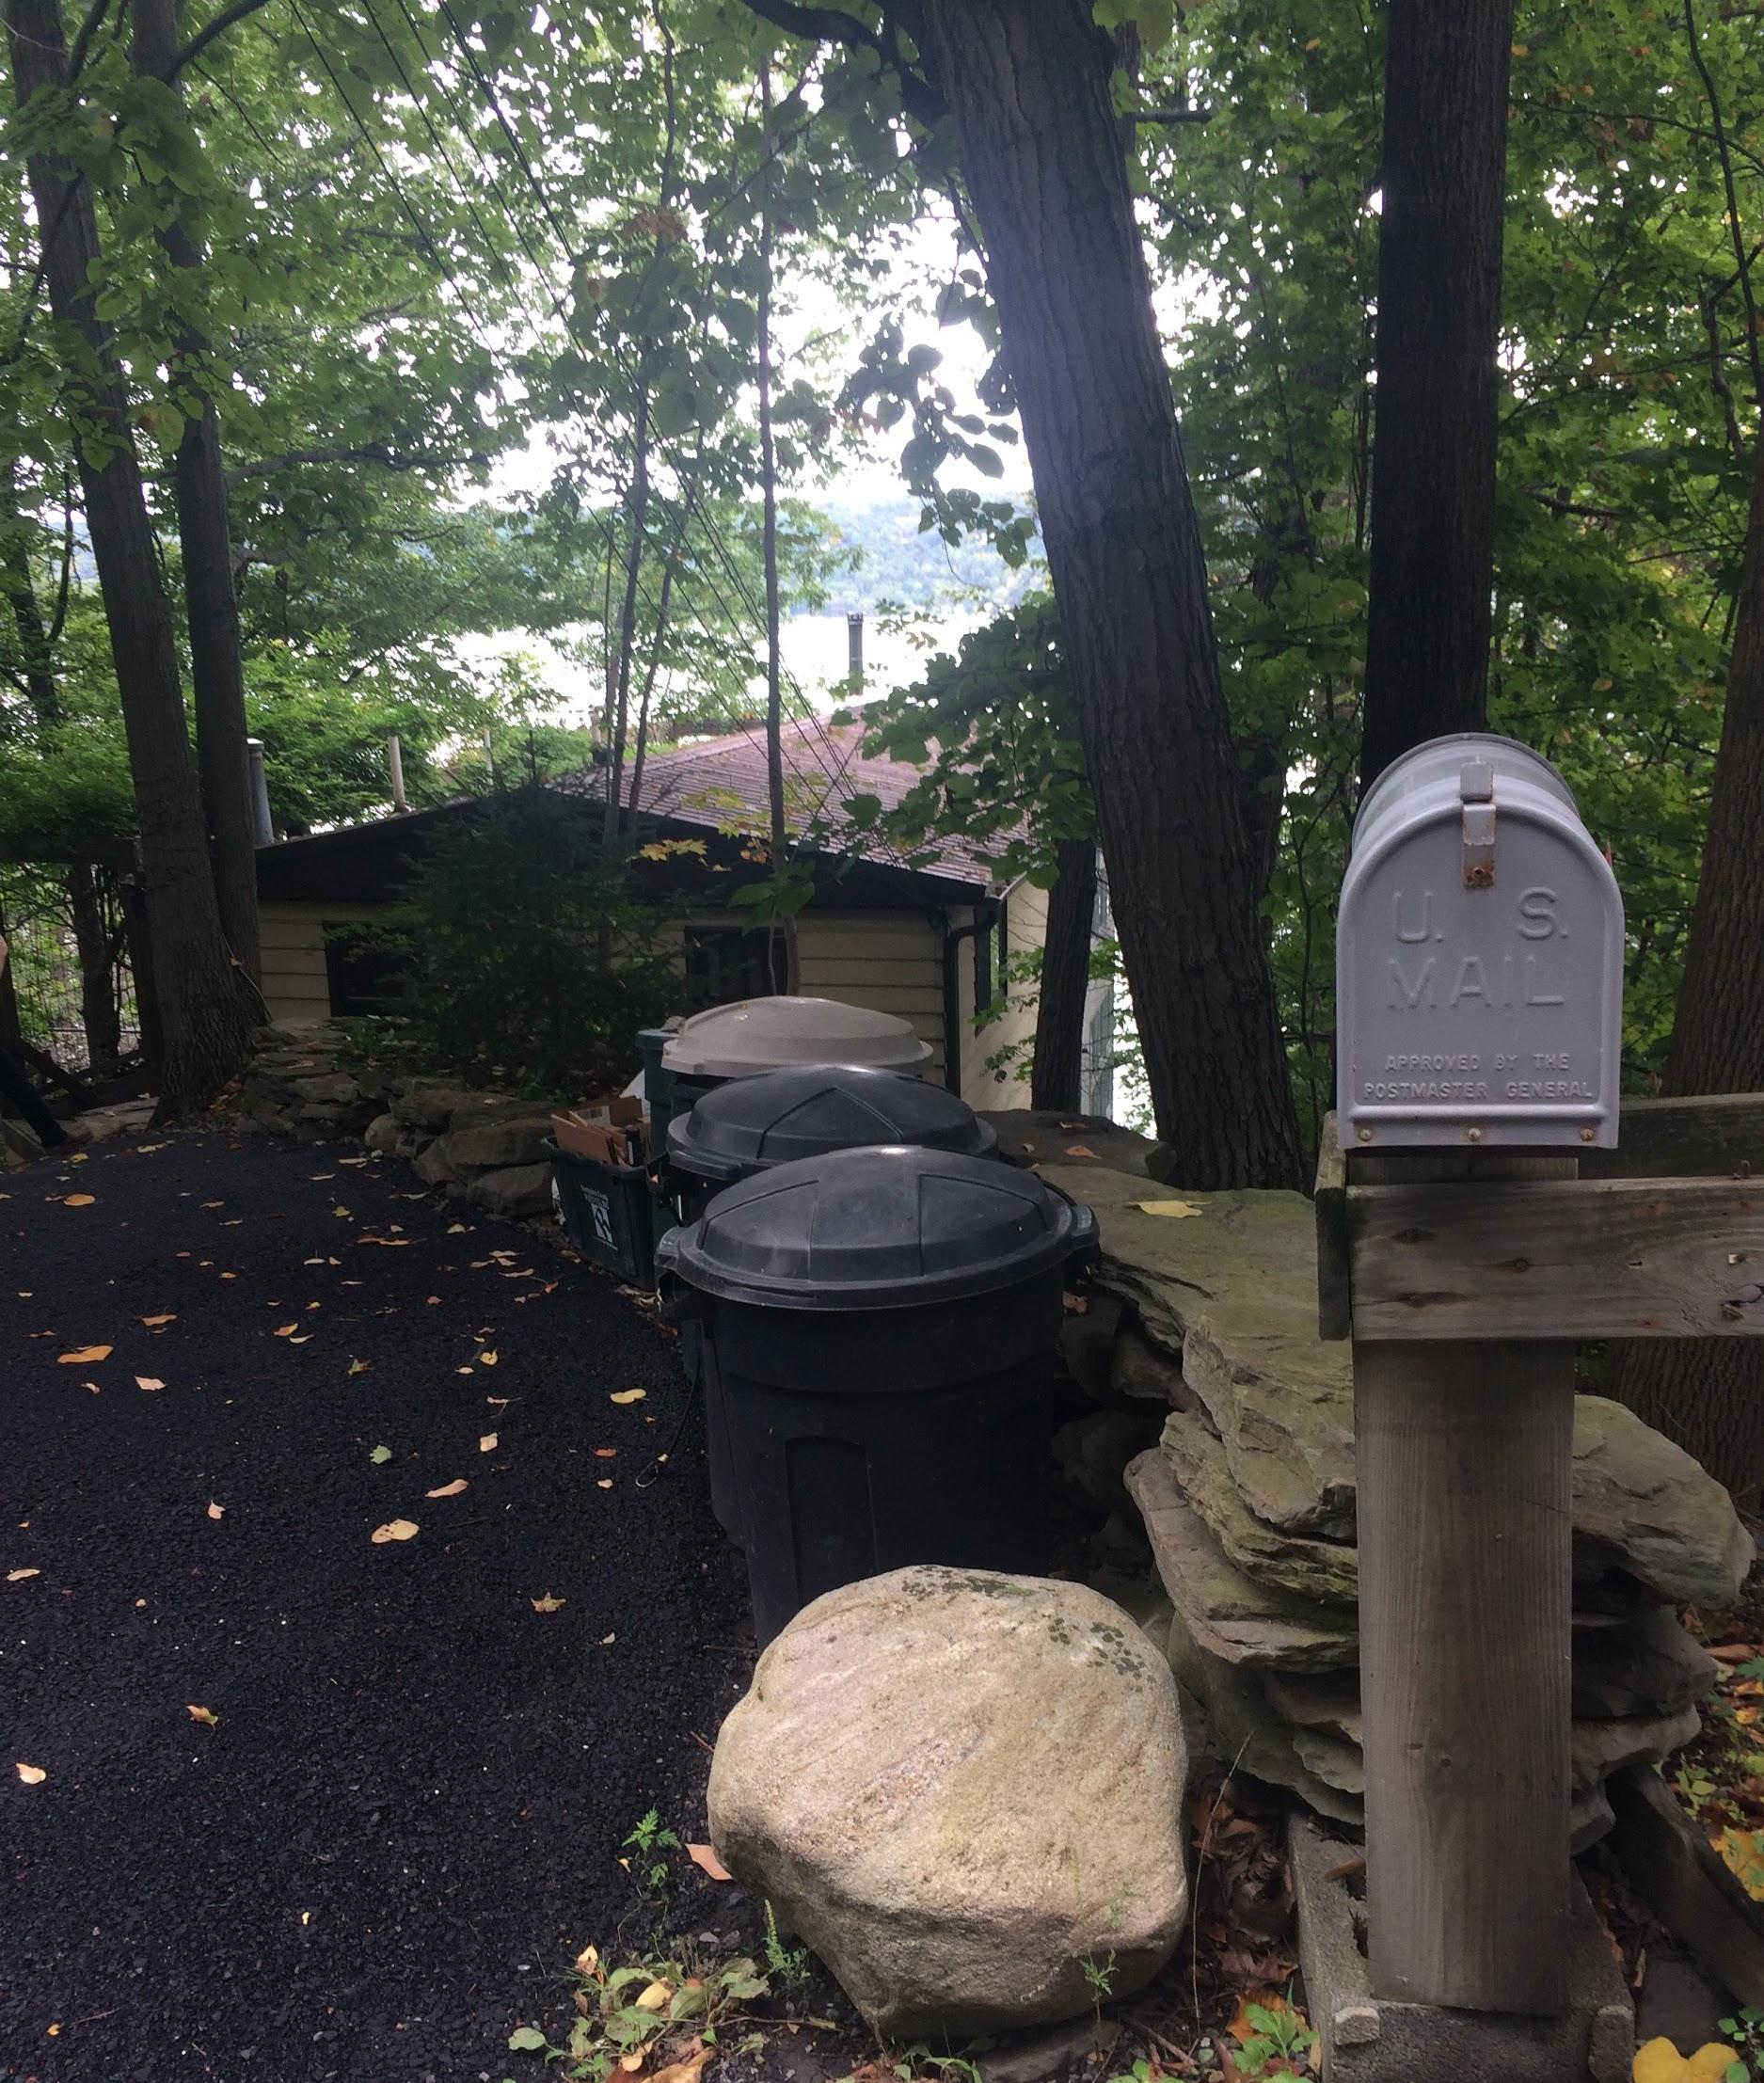
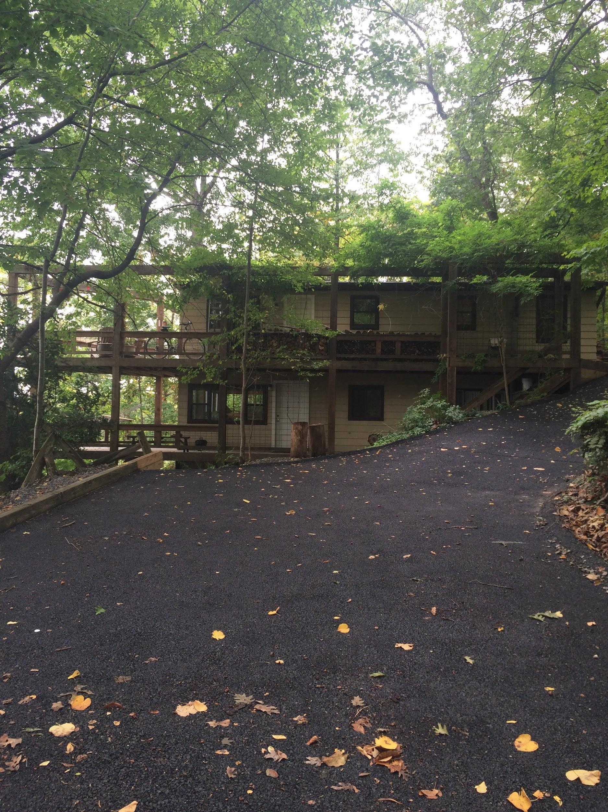

Slide 7
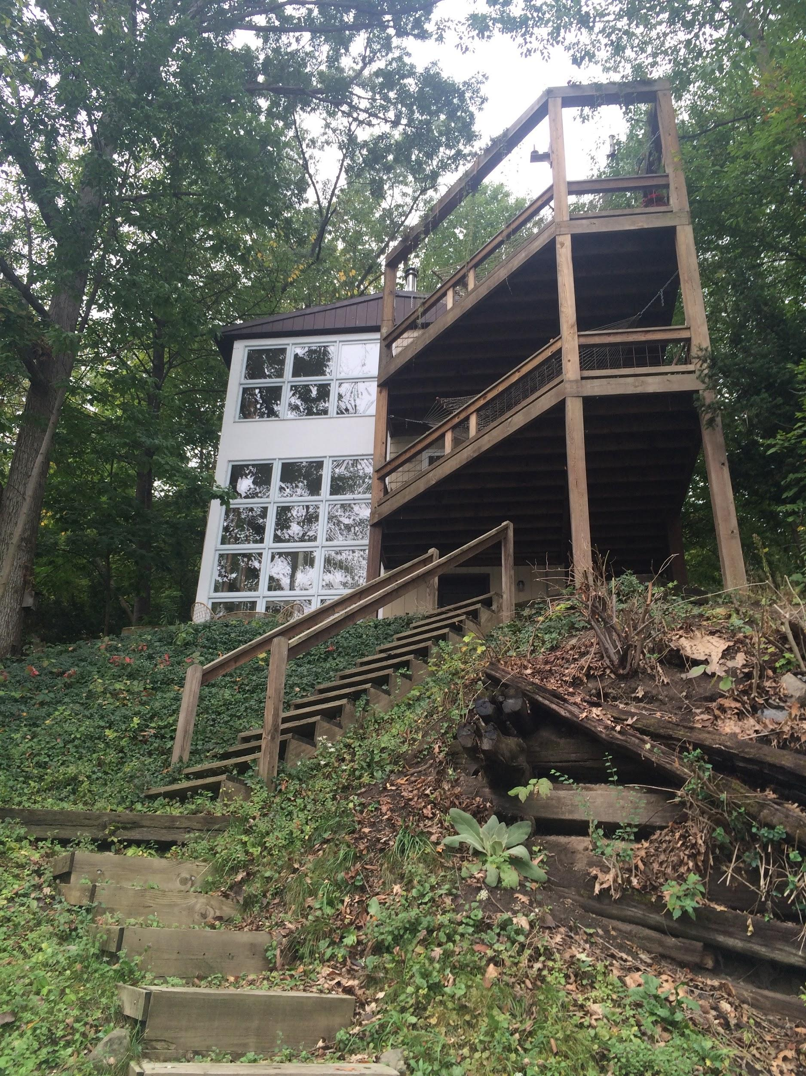
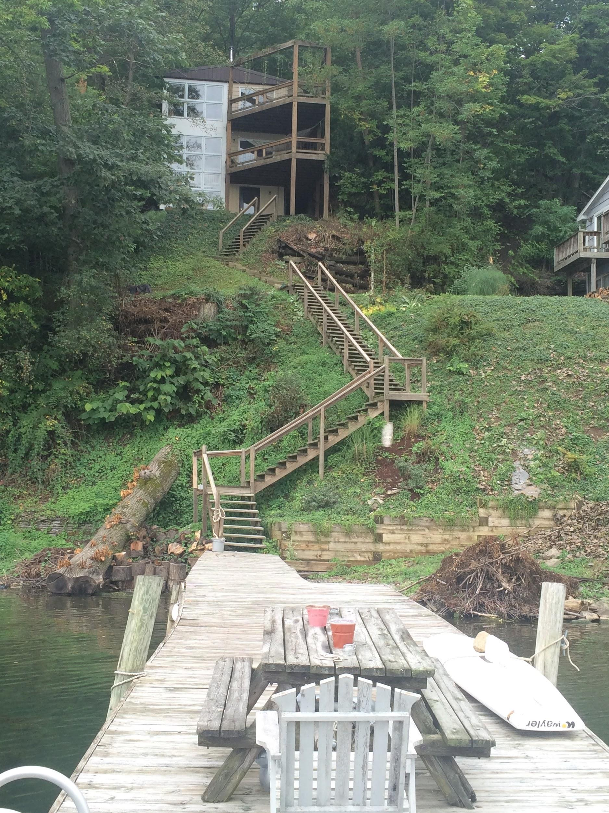

Slide 8
Exterior Photos - Amenities

Slide 9
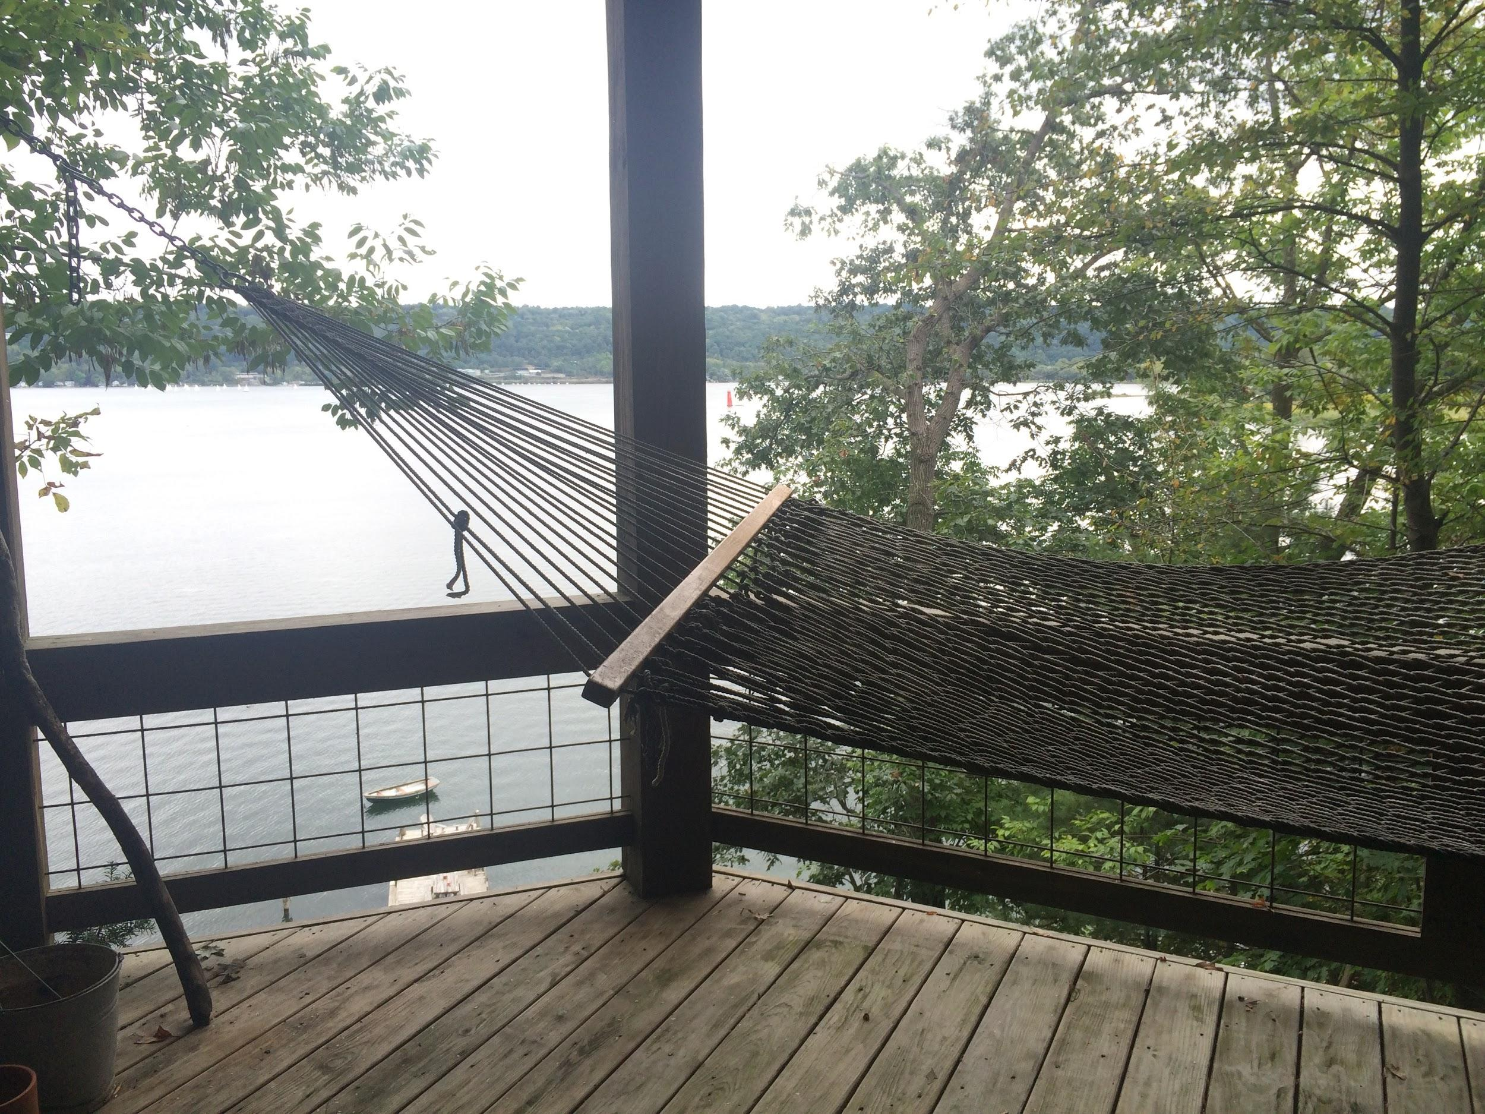
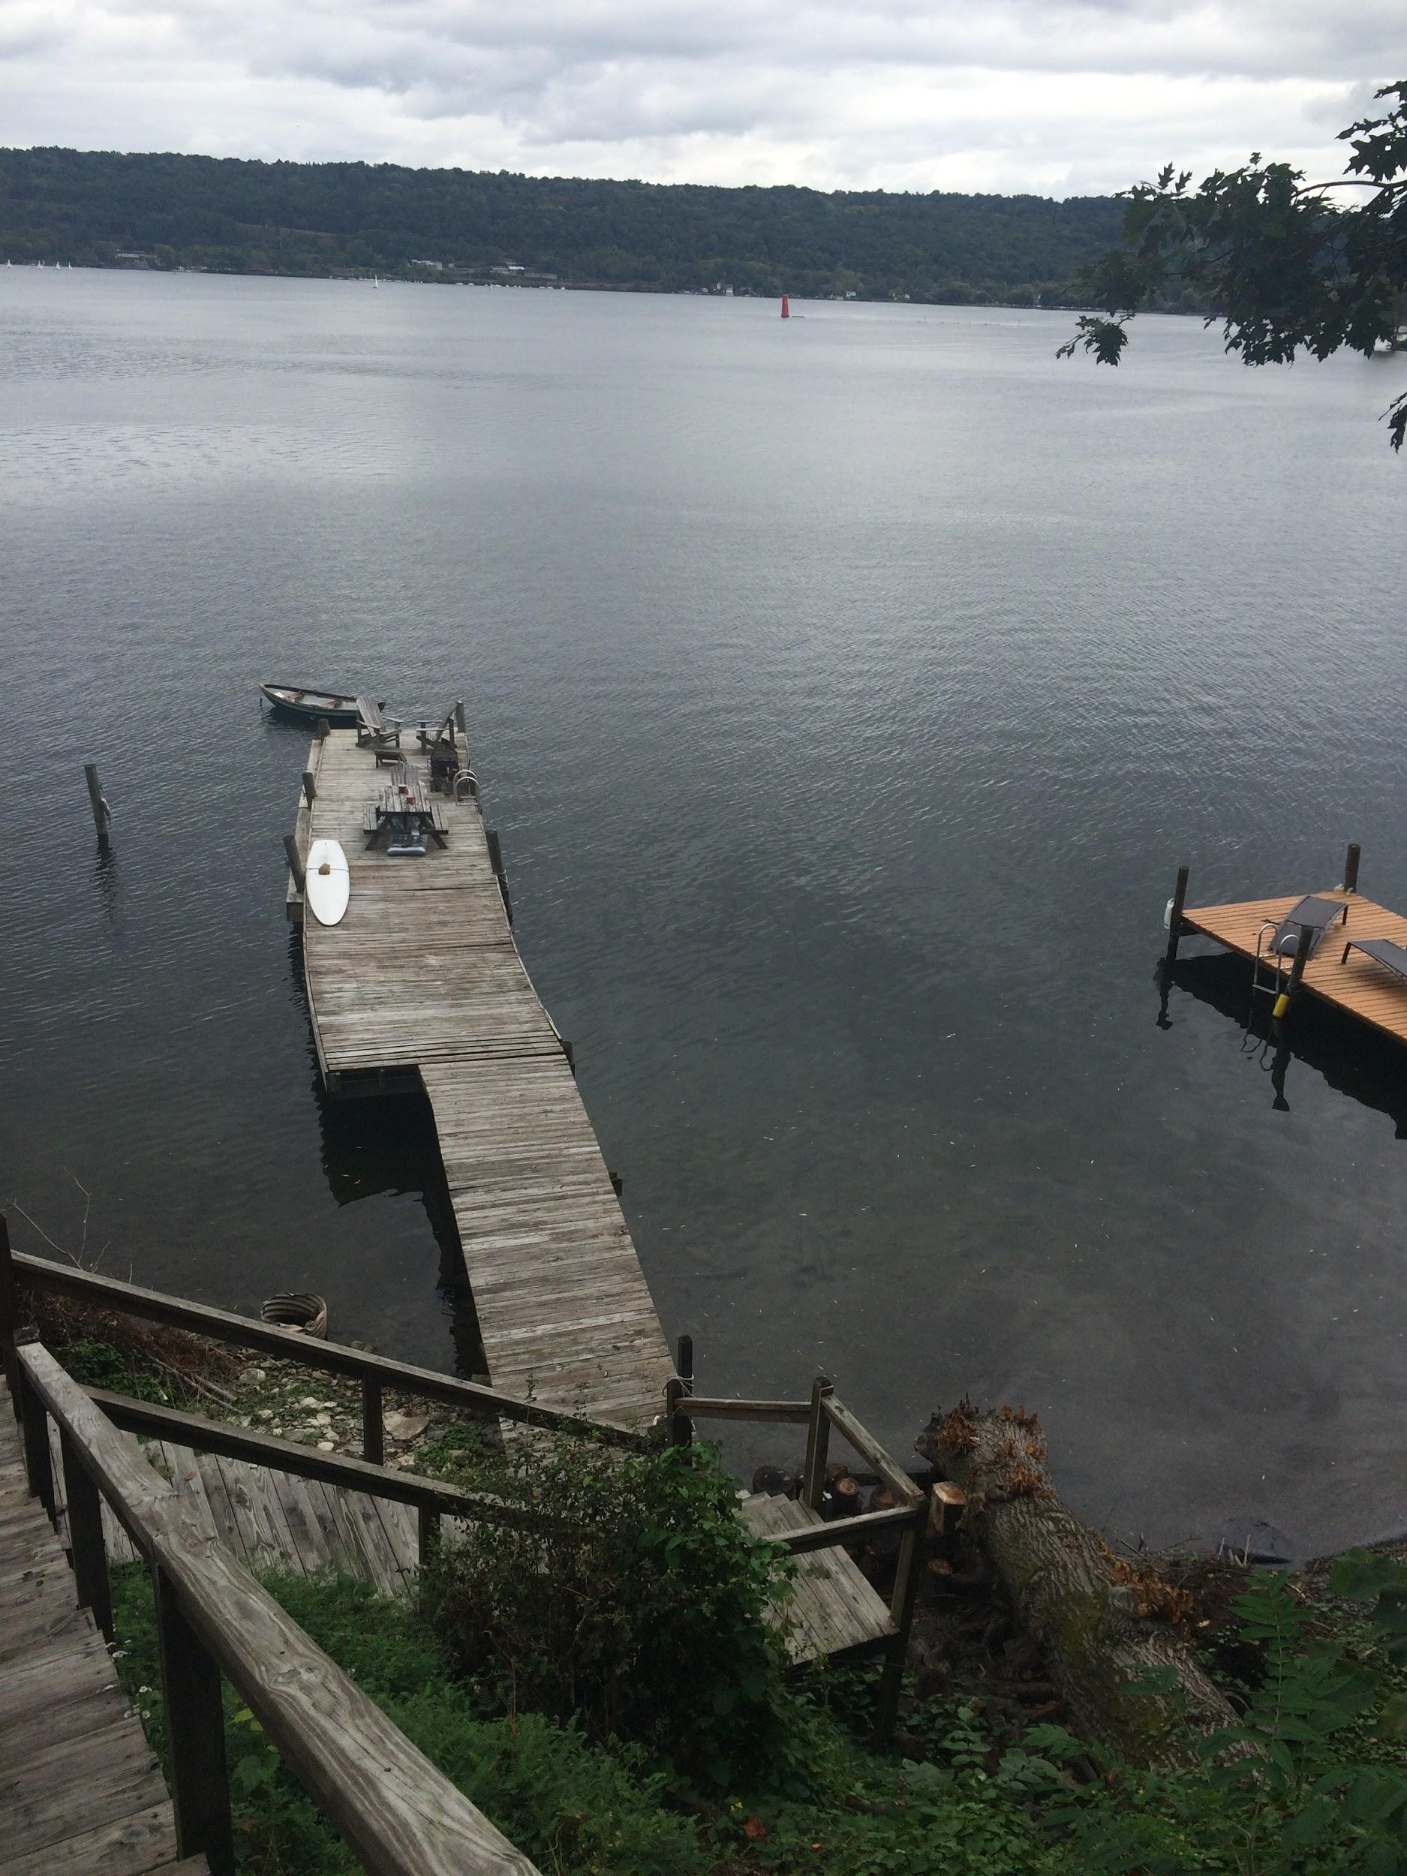

Slide 10
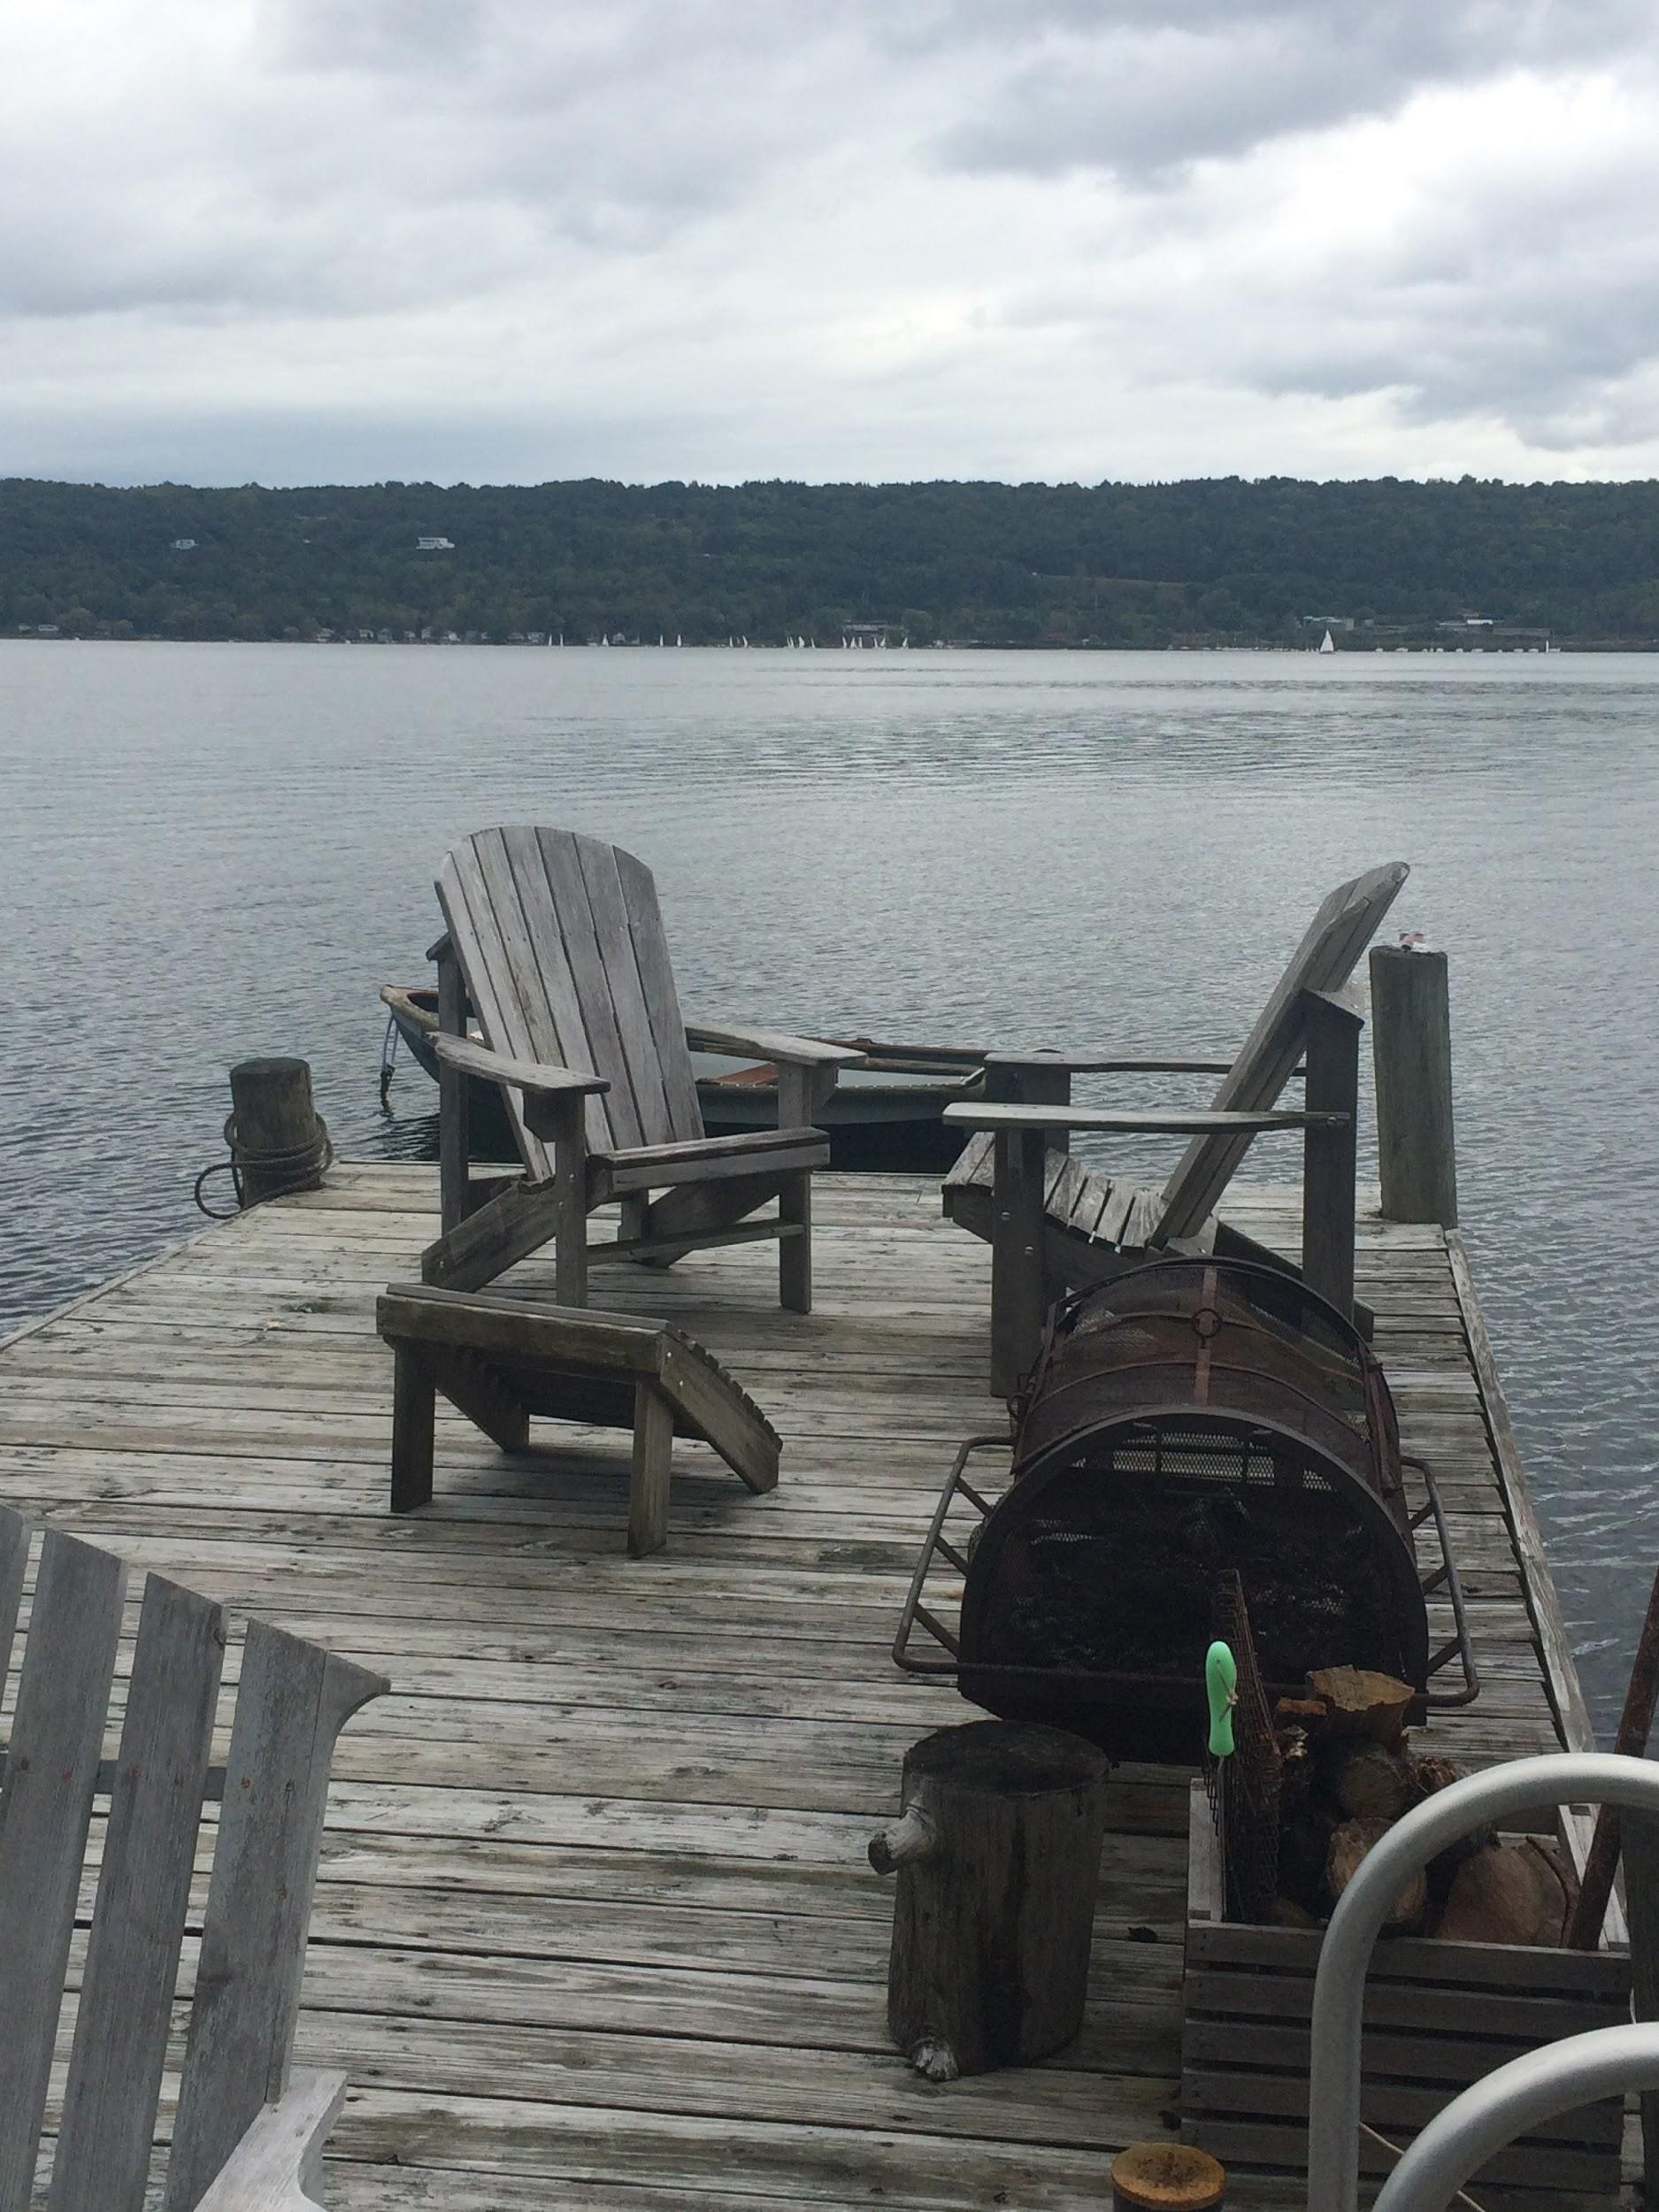
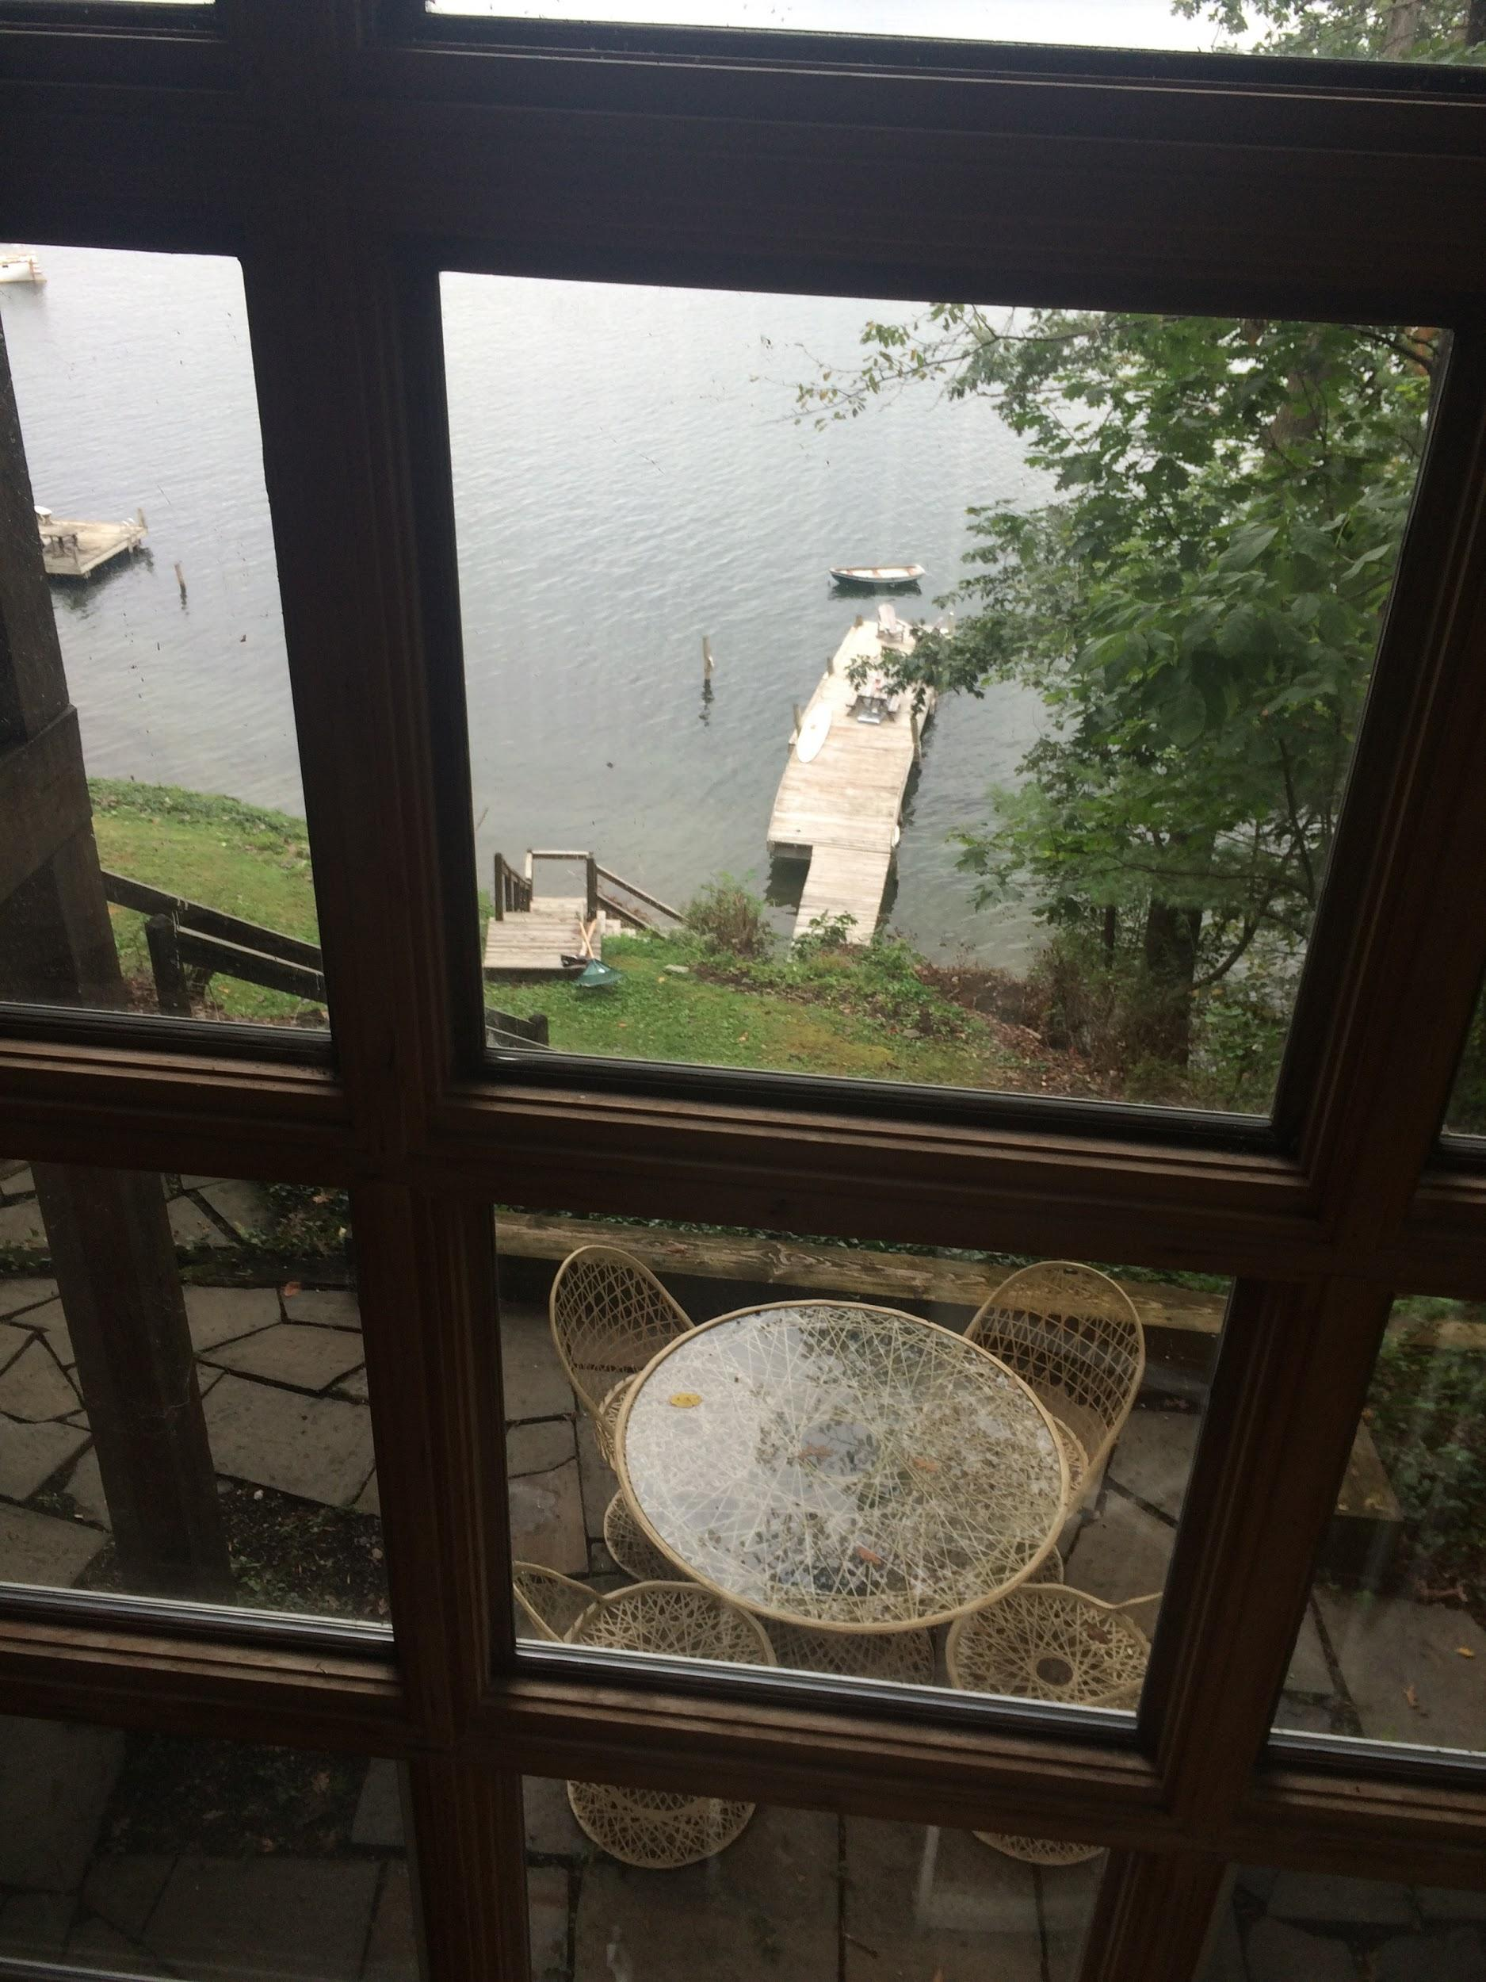

Slide 11
Interior Photos - Downstairs Living Room

Slide 12
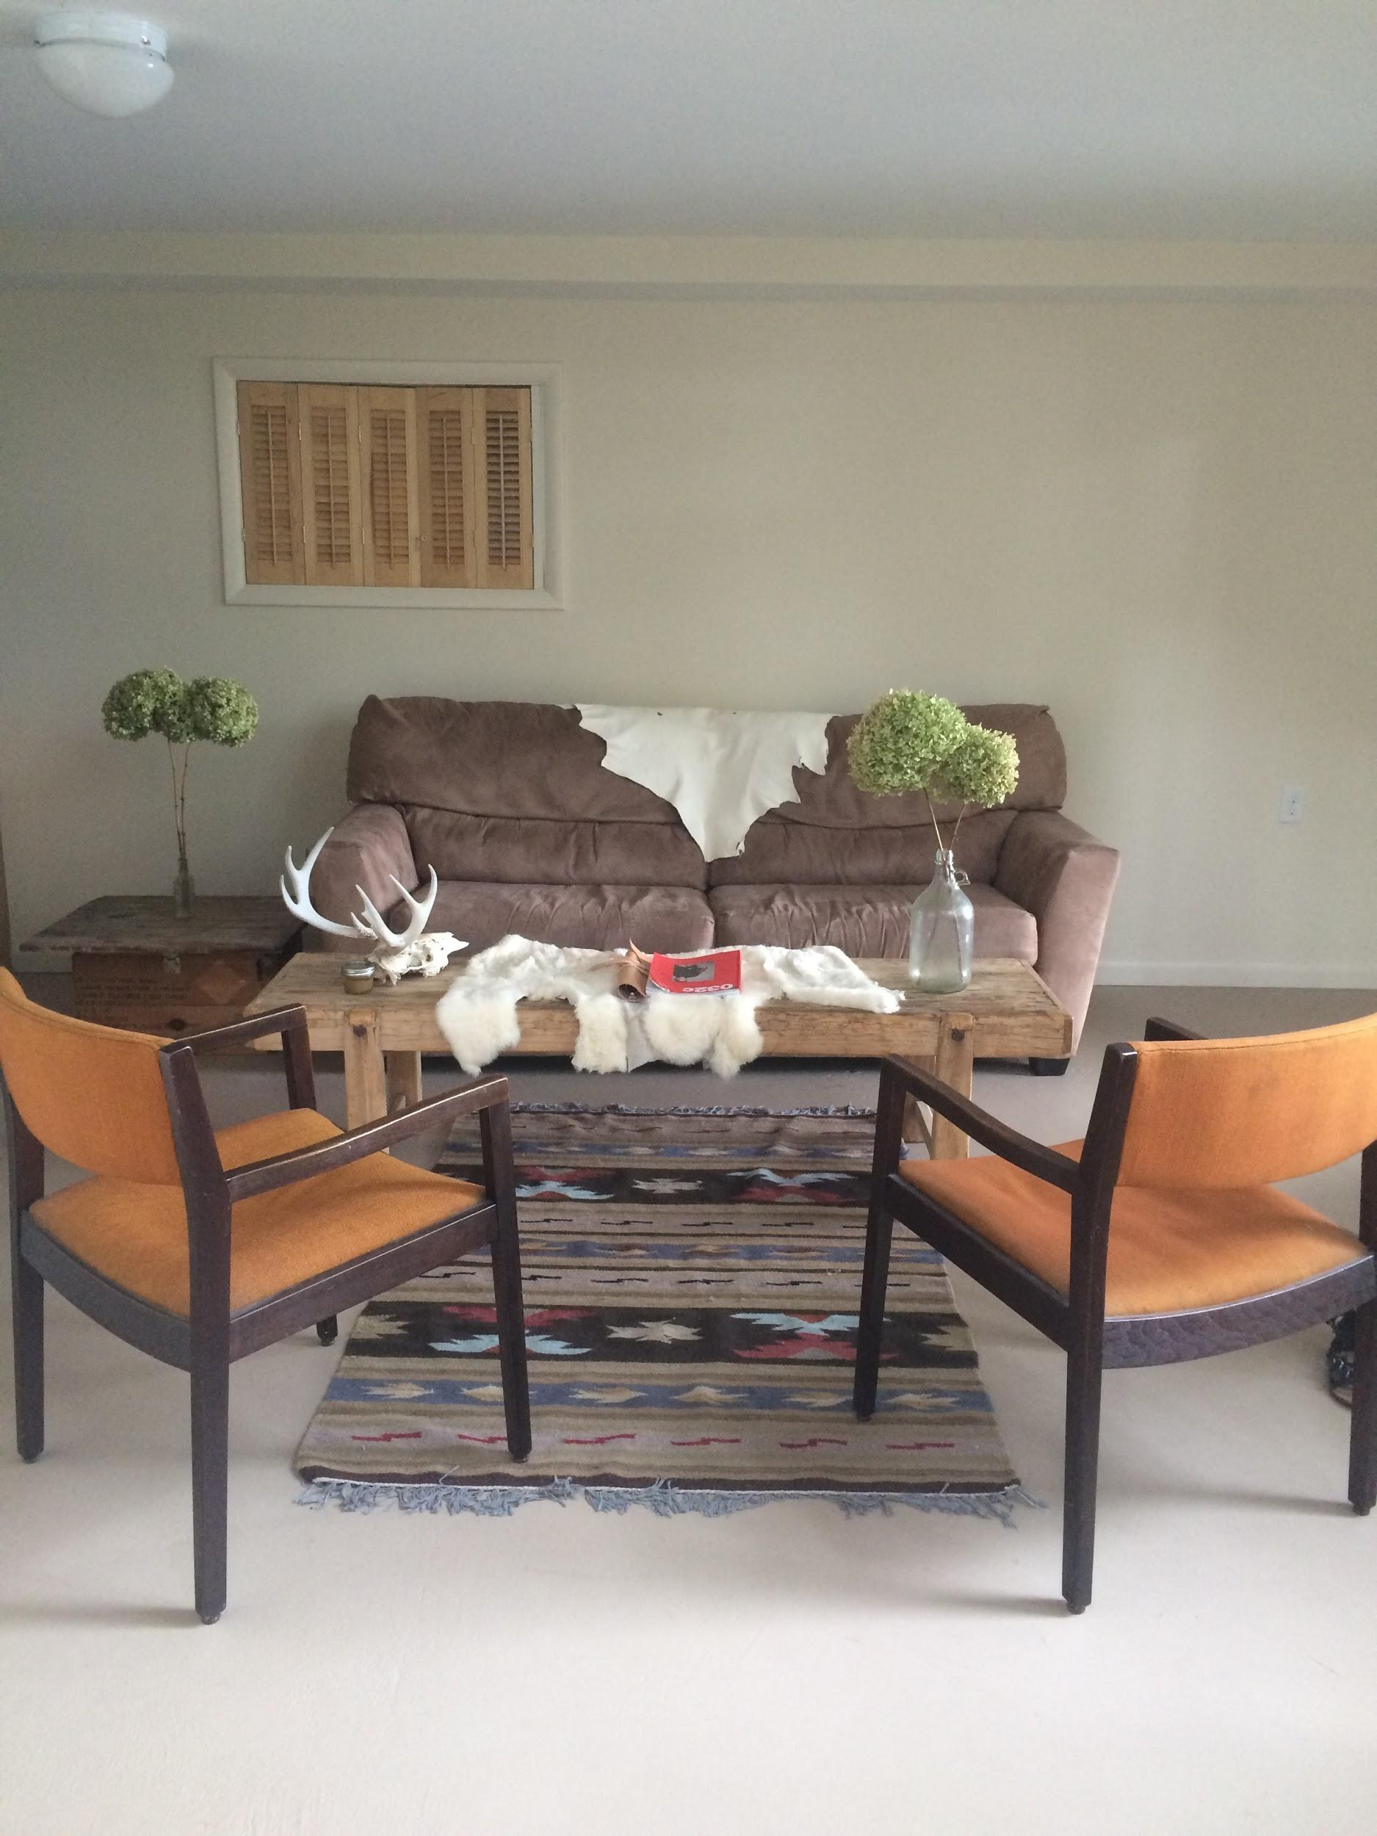
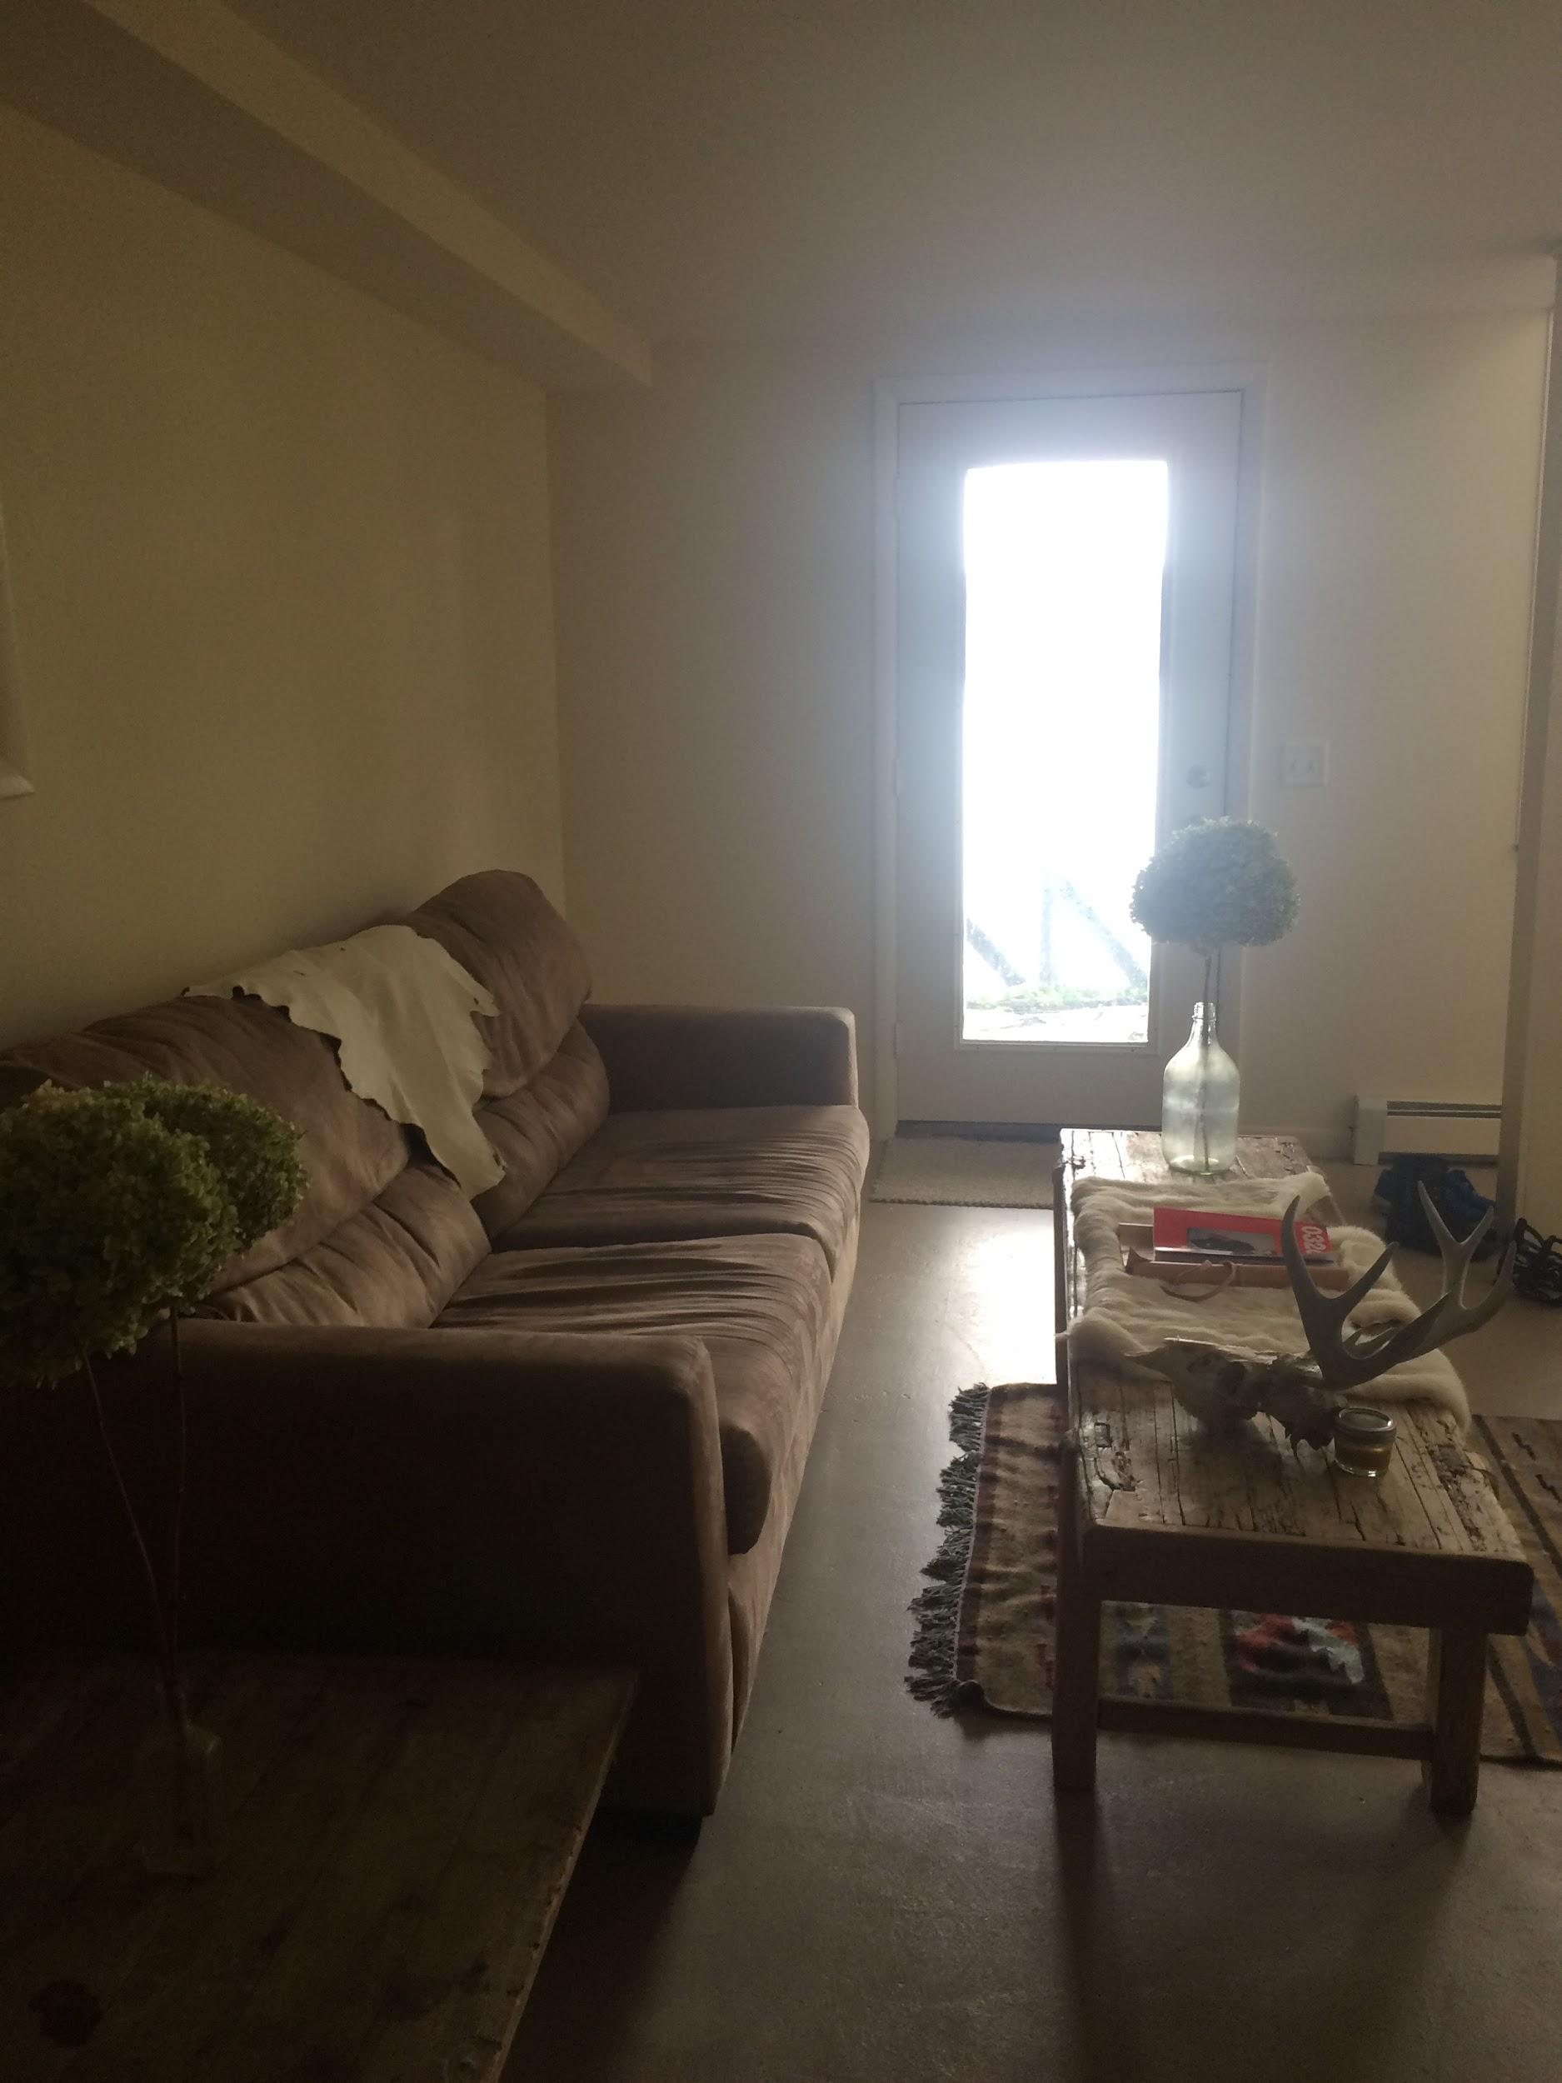

Slide 13
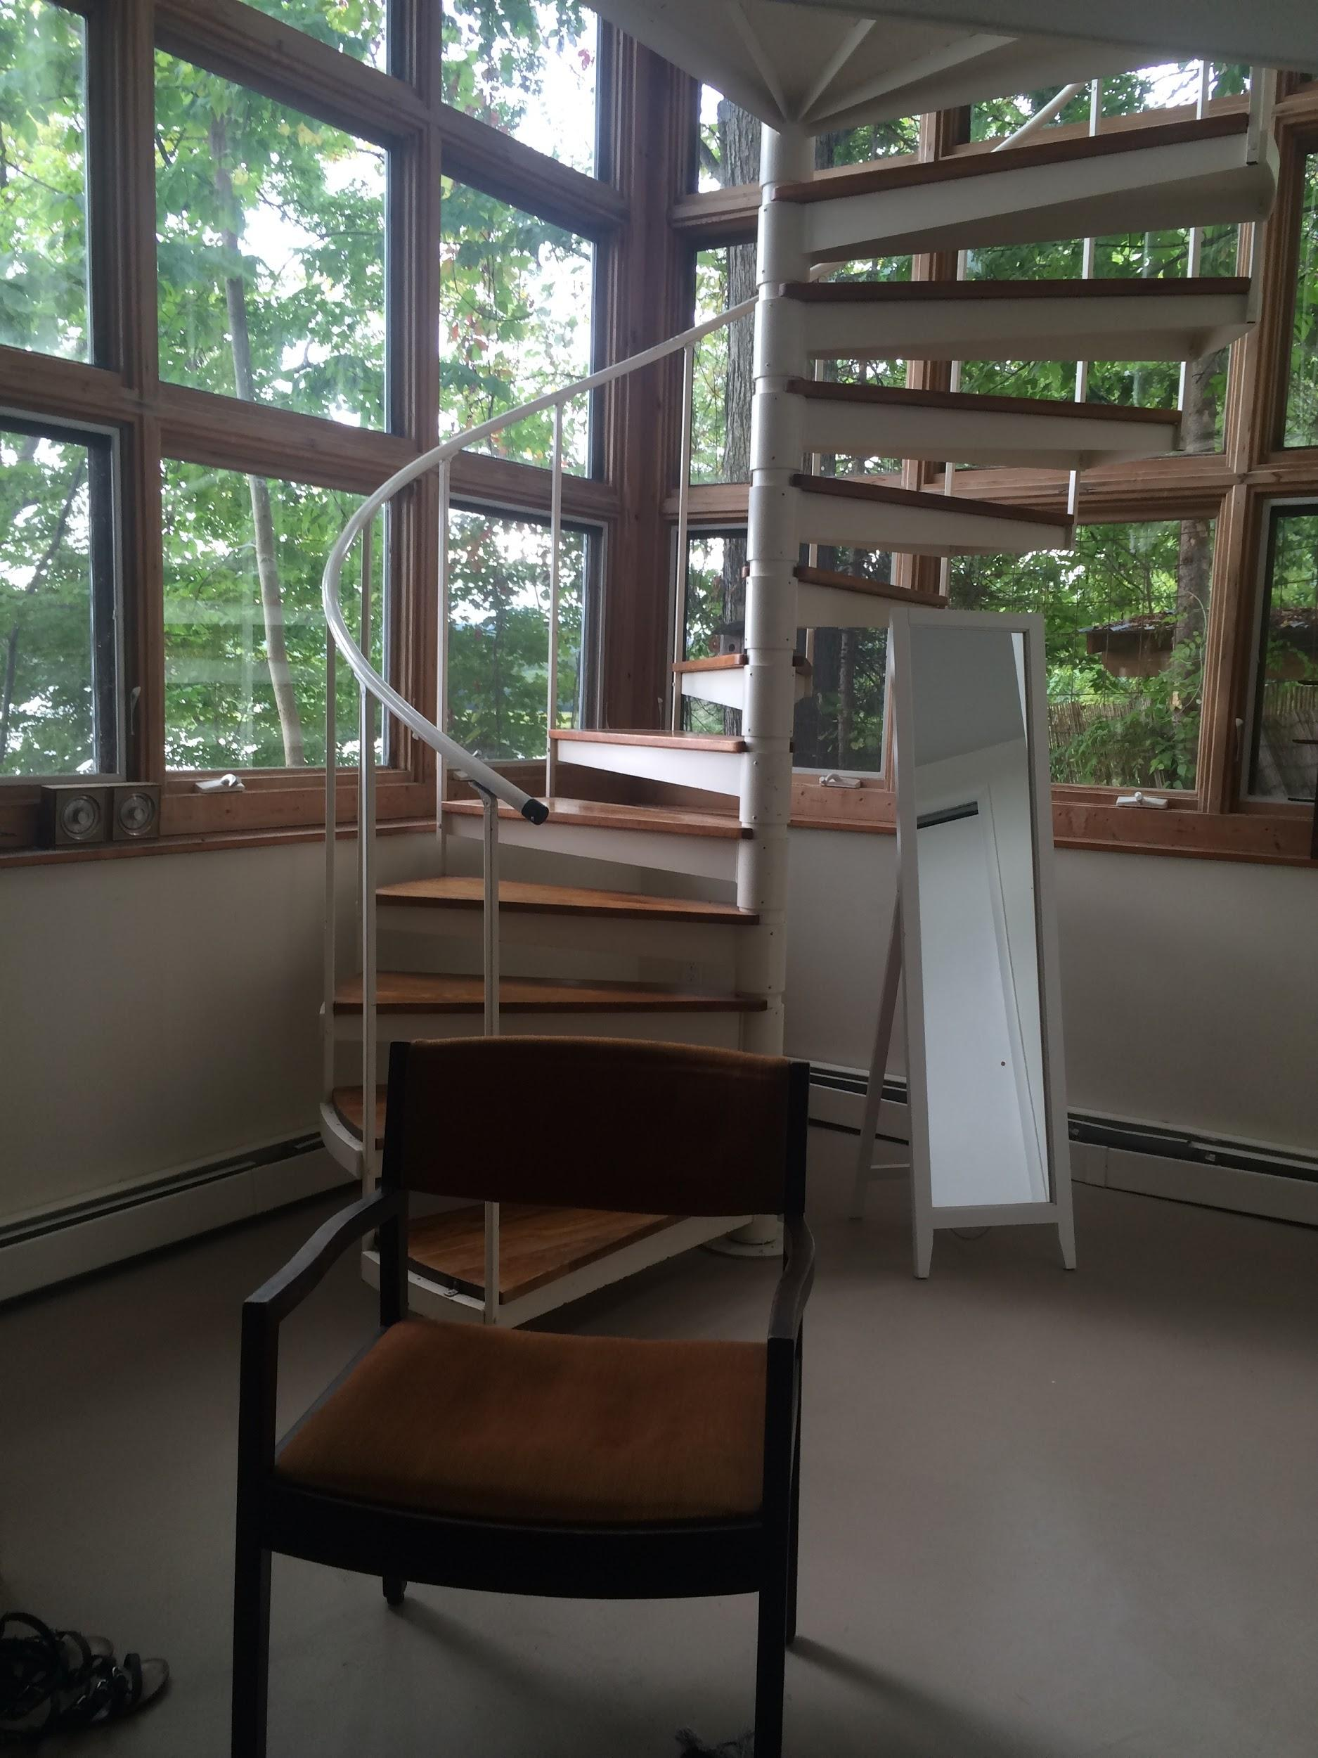
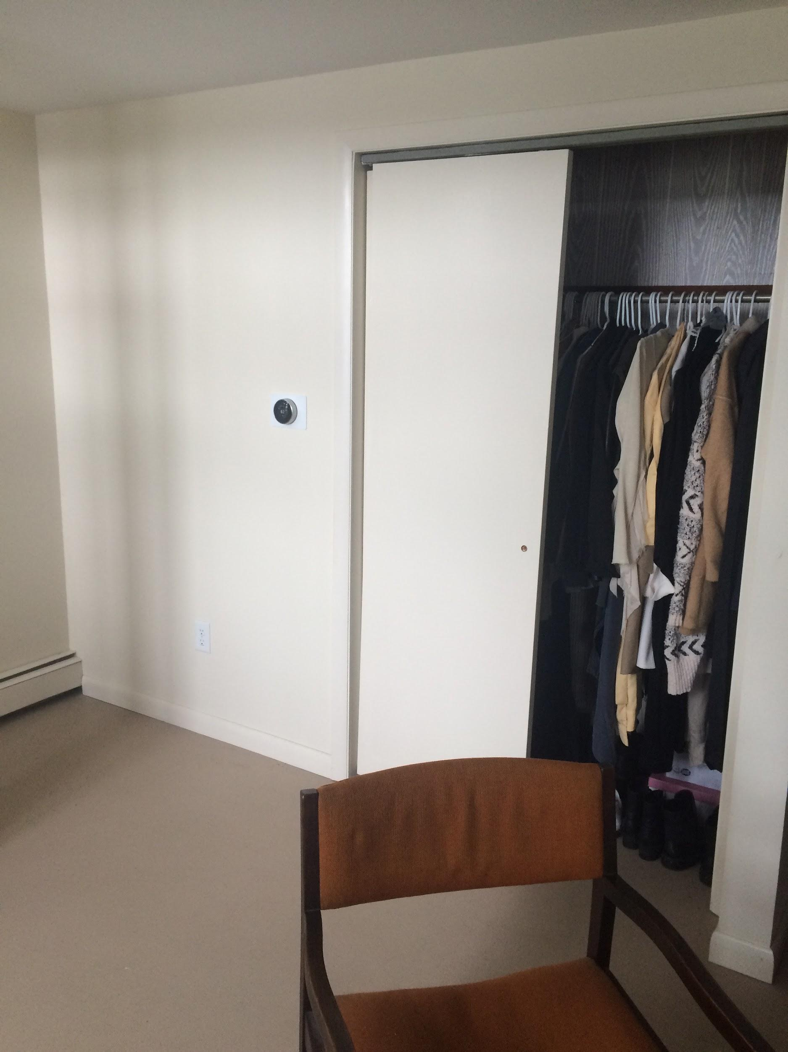

Slide 14
Interior Photos - Downstairs Bedroom

Slide 16
Interior Photos - Downstairs Bathroom/Storage

Slide 17
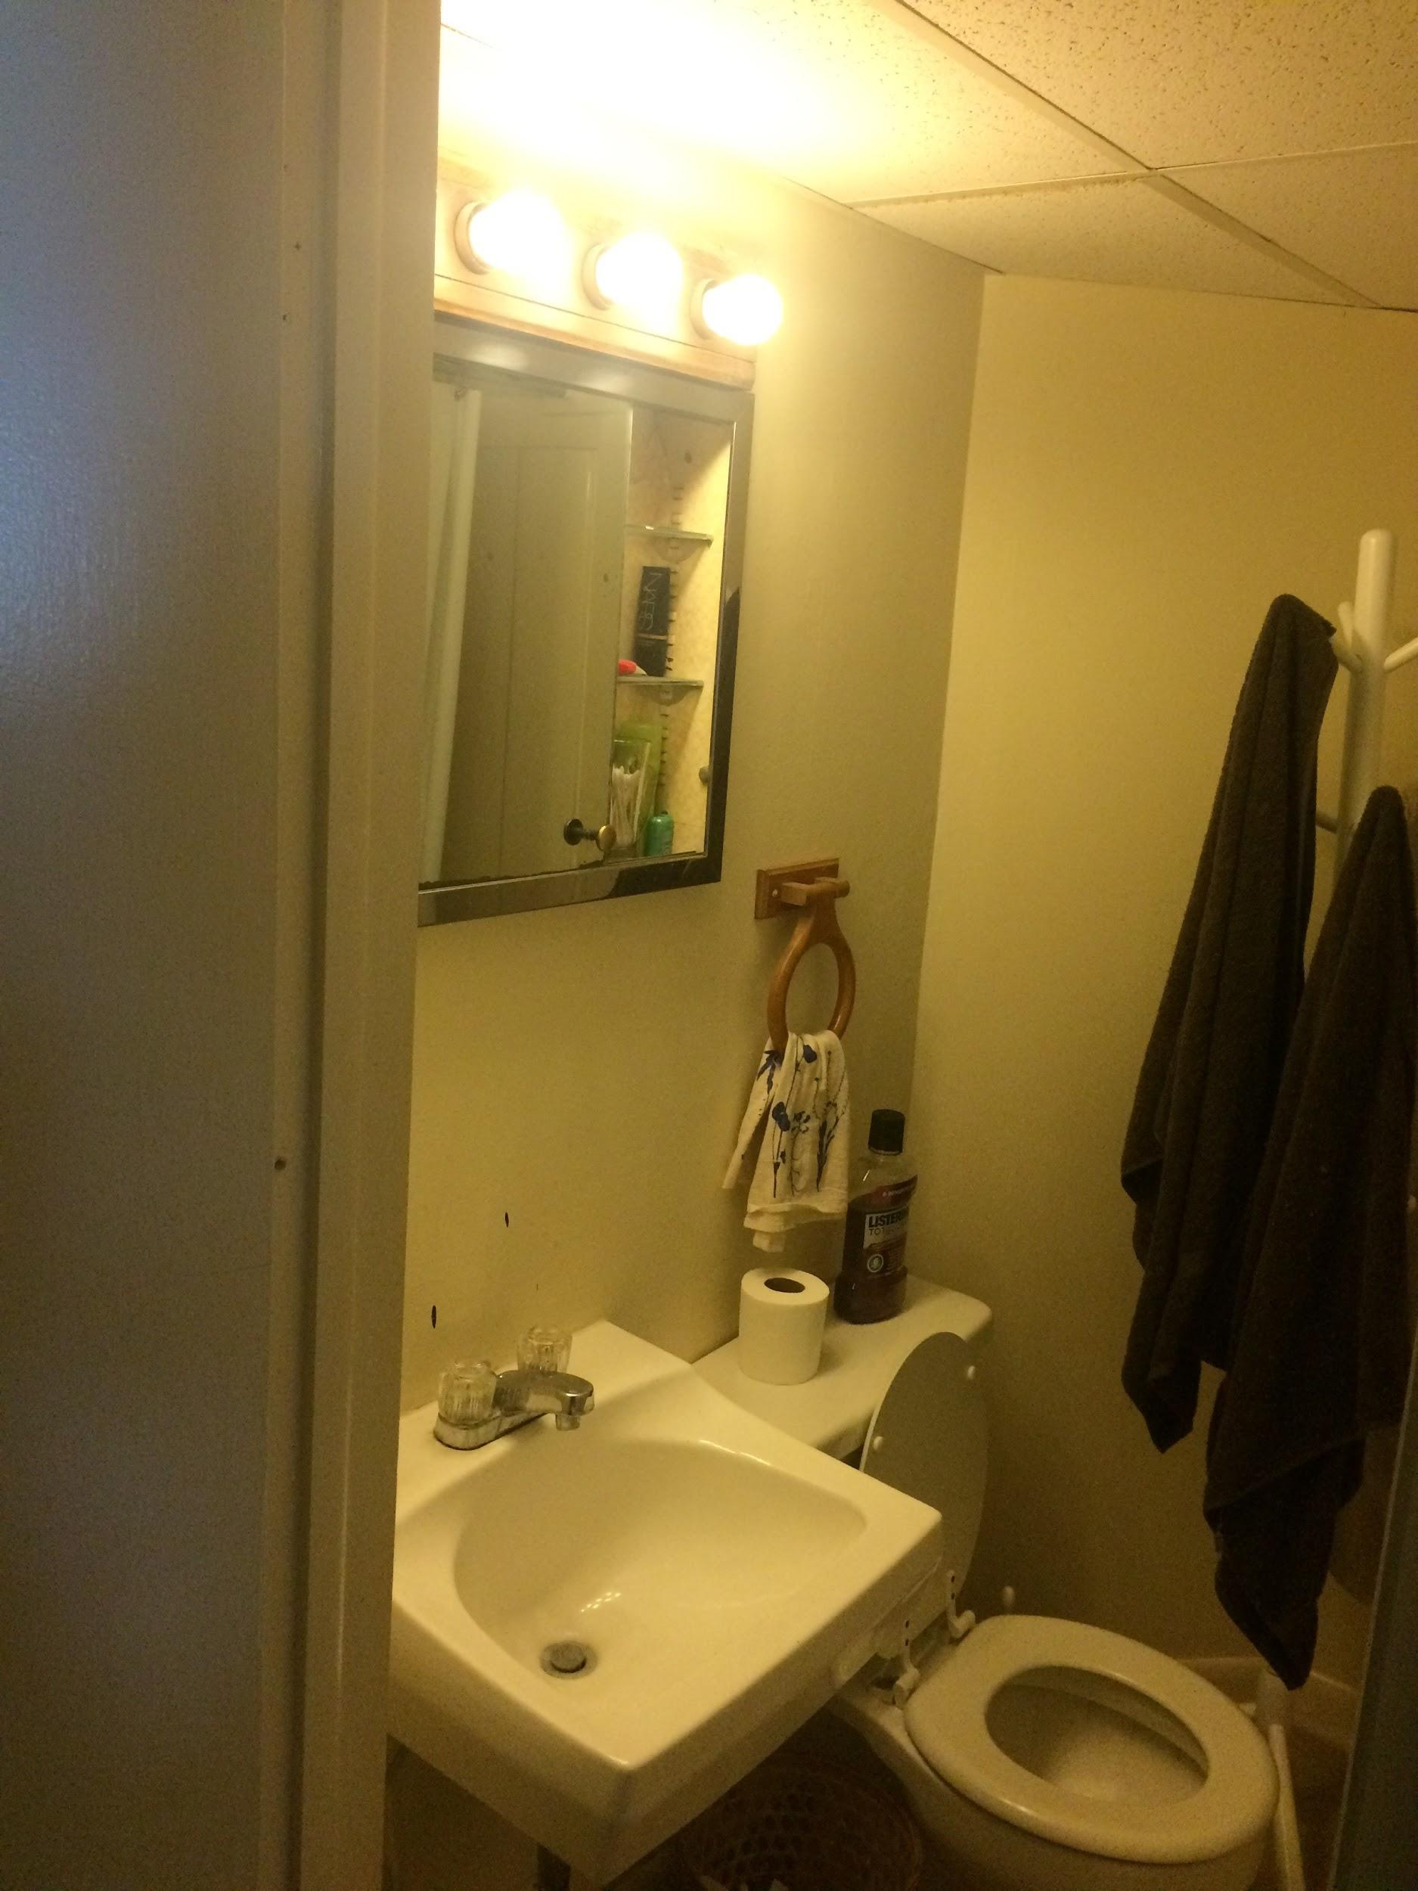
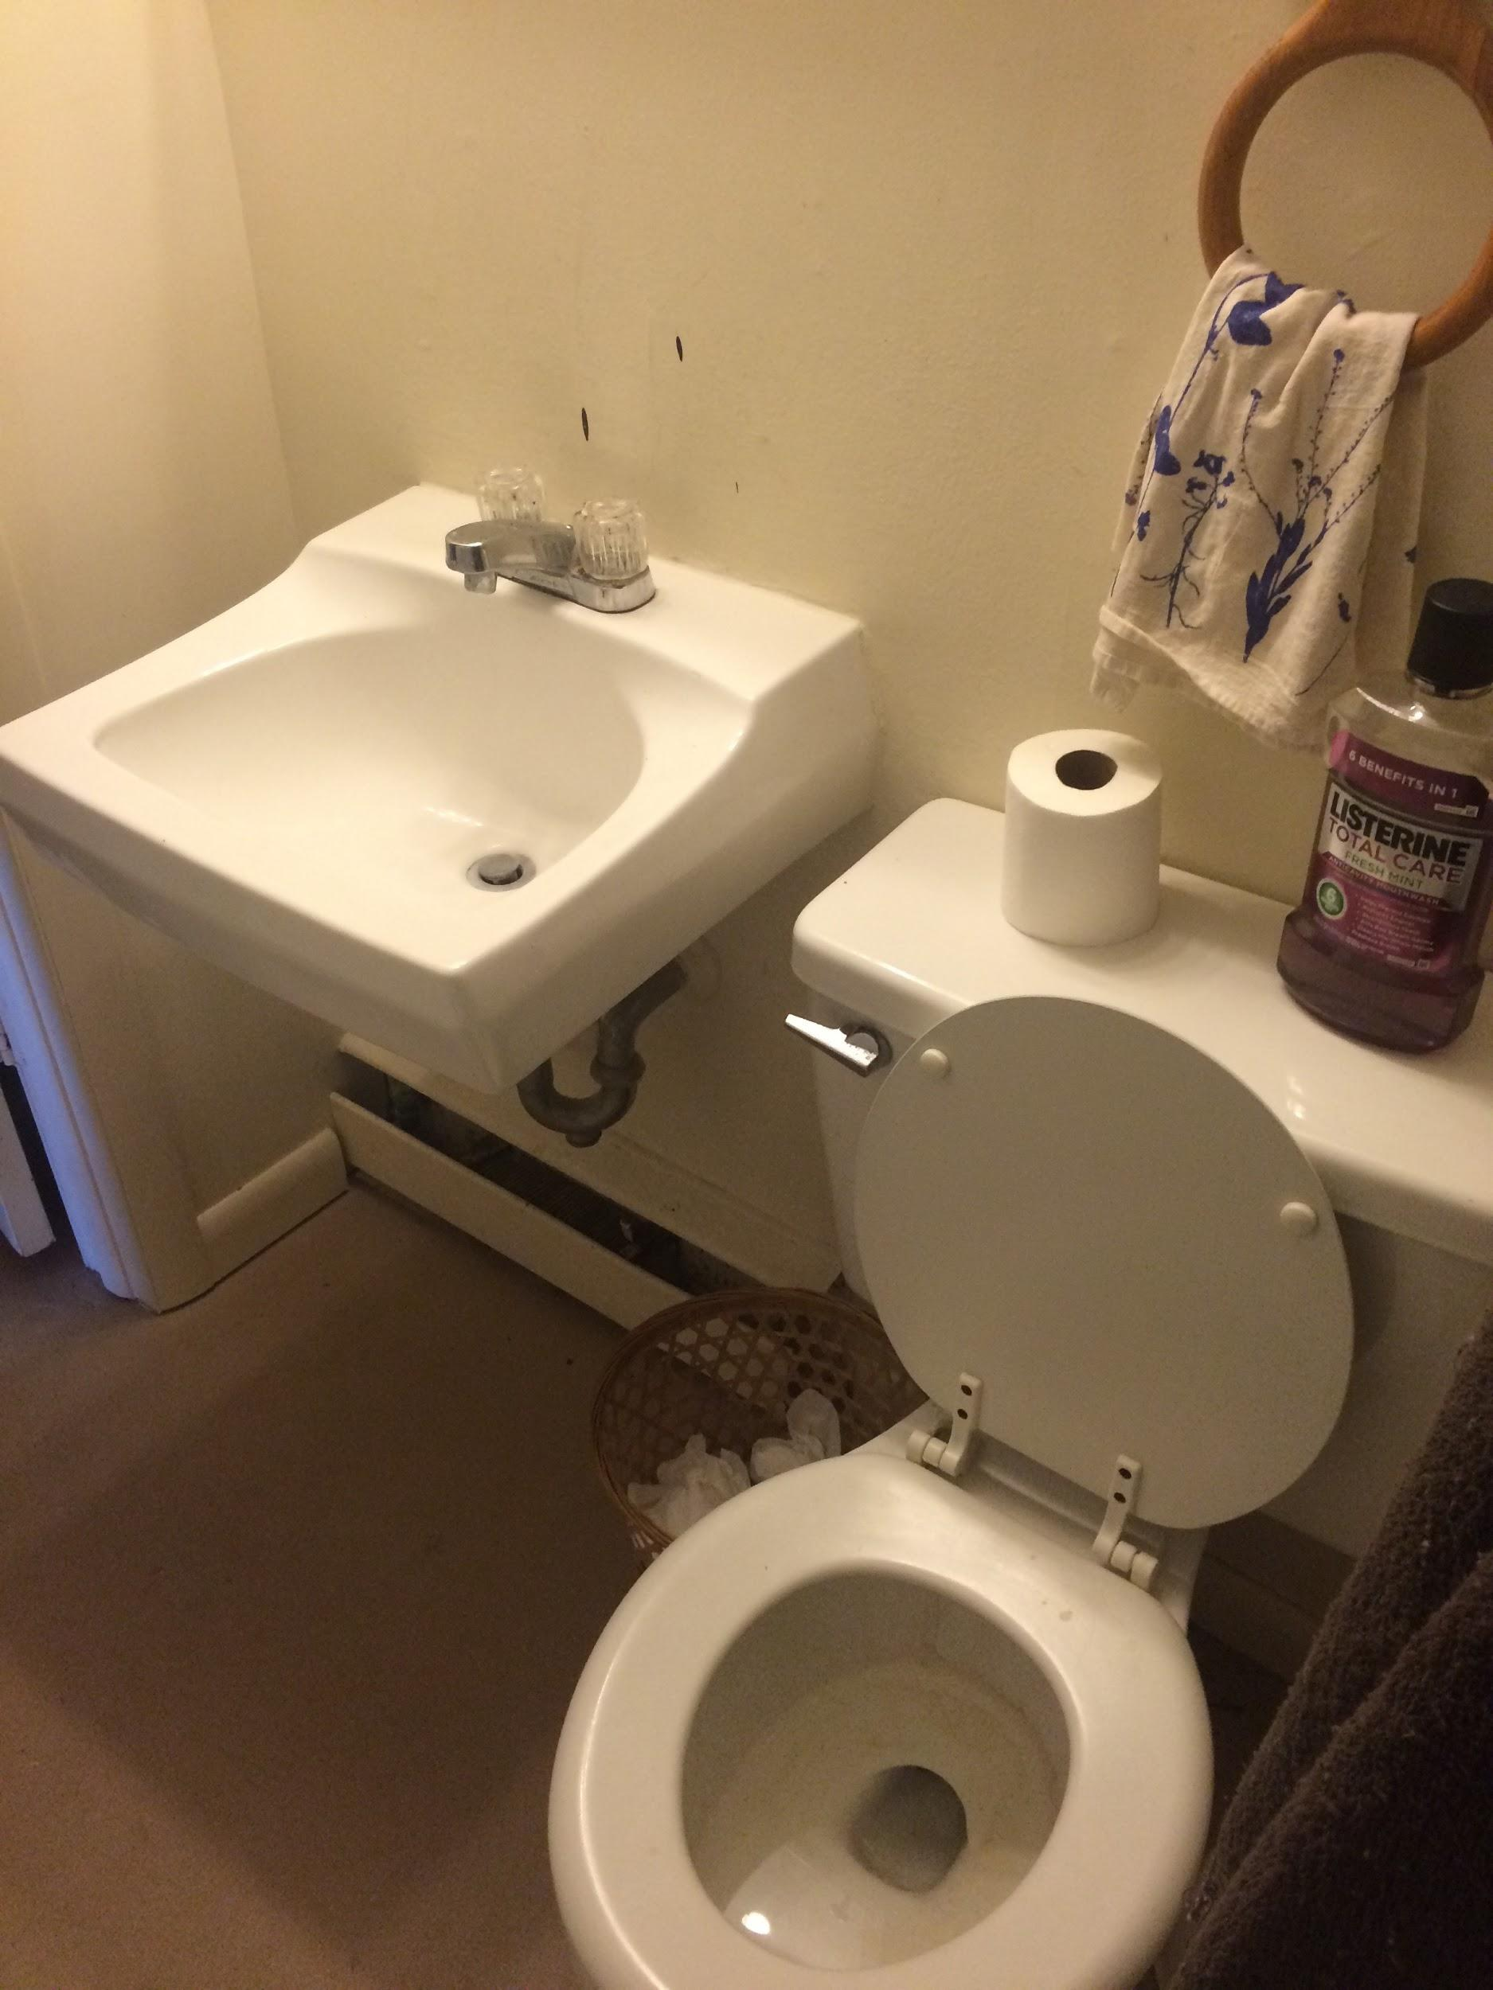

Slide 18
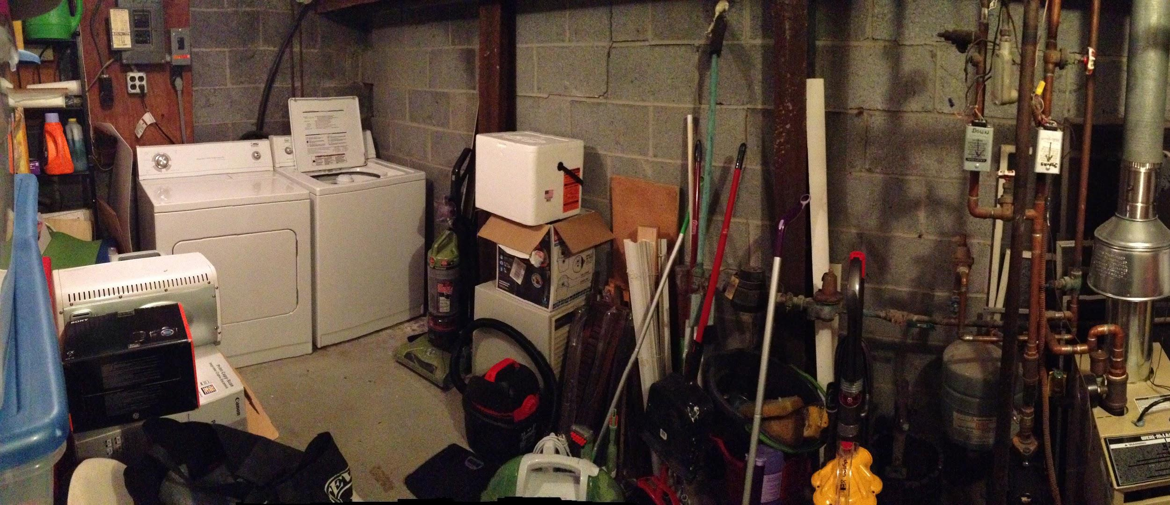
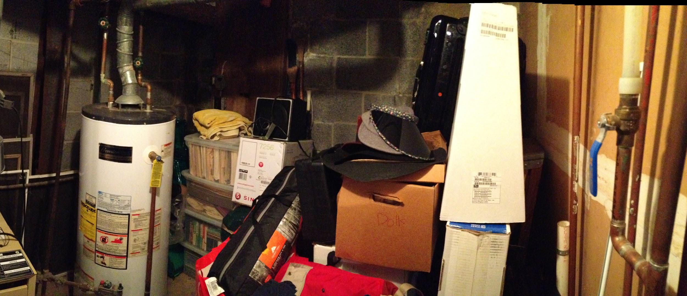

Slide 19
Interior Photos - Upstairs Living Room

Slide 20
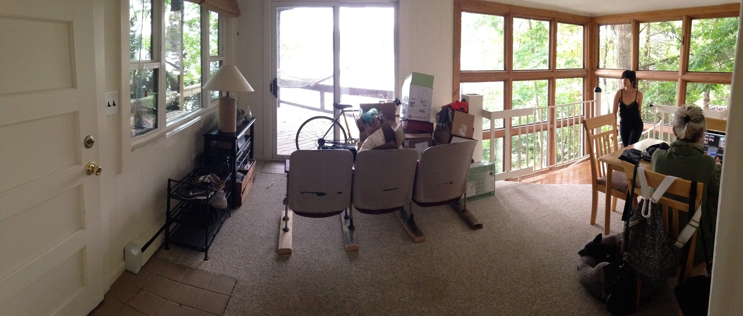

Slide 21
Interior Photos - Upstairs Bedroom

Slide 22
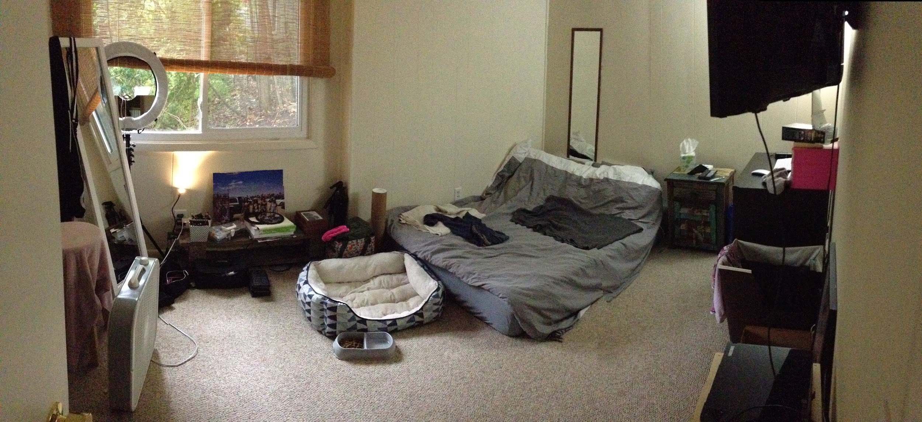

Slide 23
Interior Photos - Kitchen

Slide 24
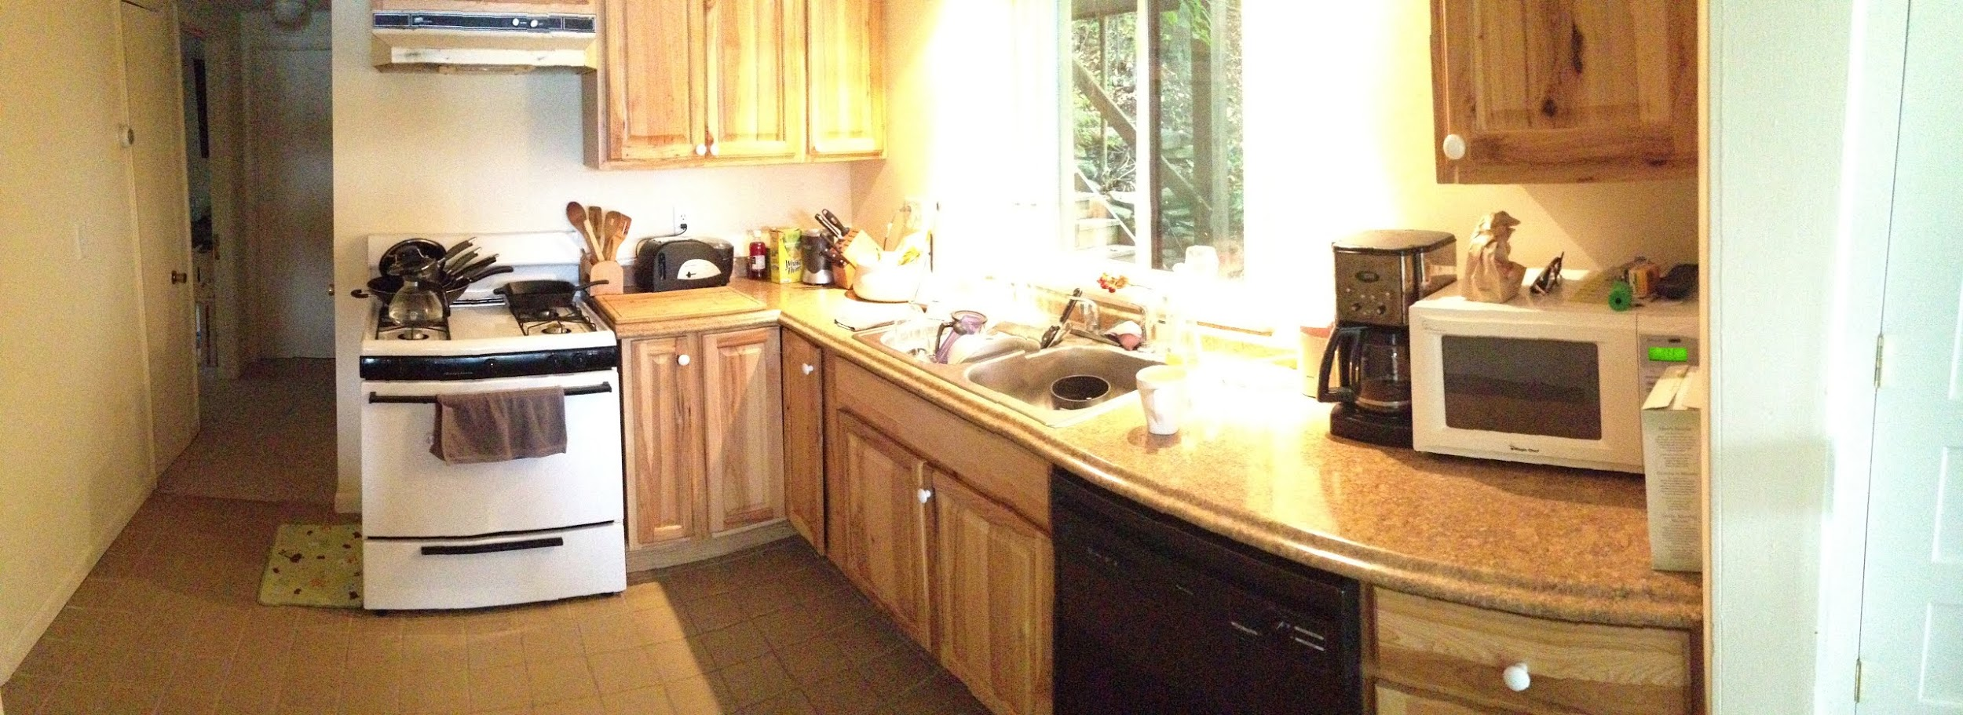

Slide 25
Interior Photos - Upstairs Bathroom/Office

Slide 26
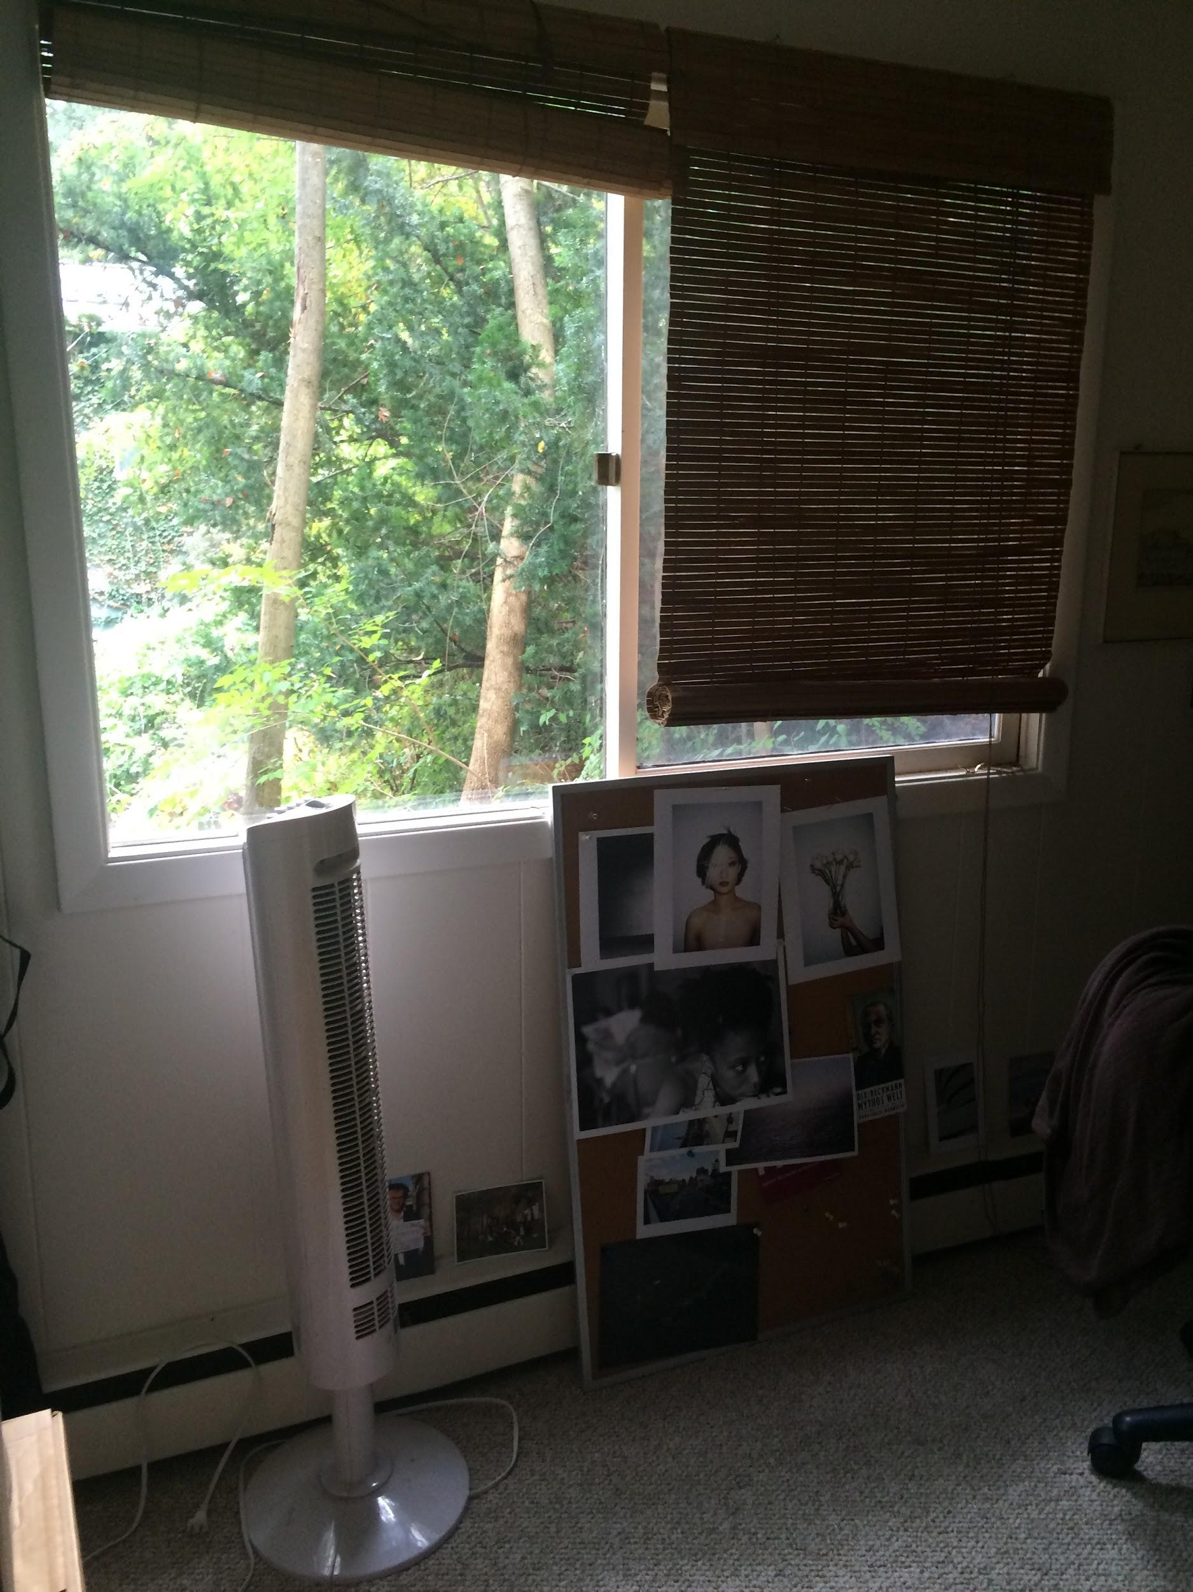
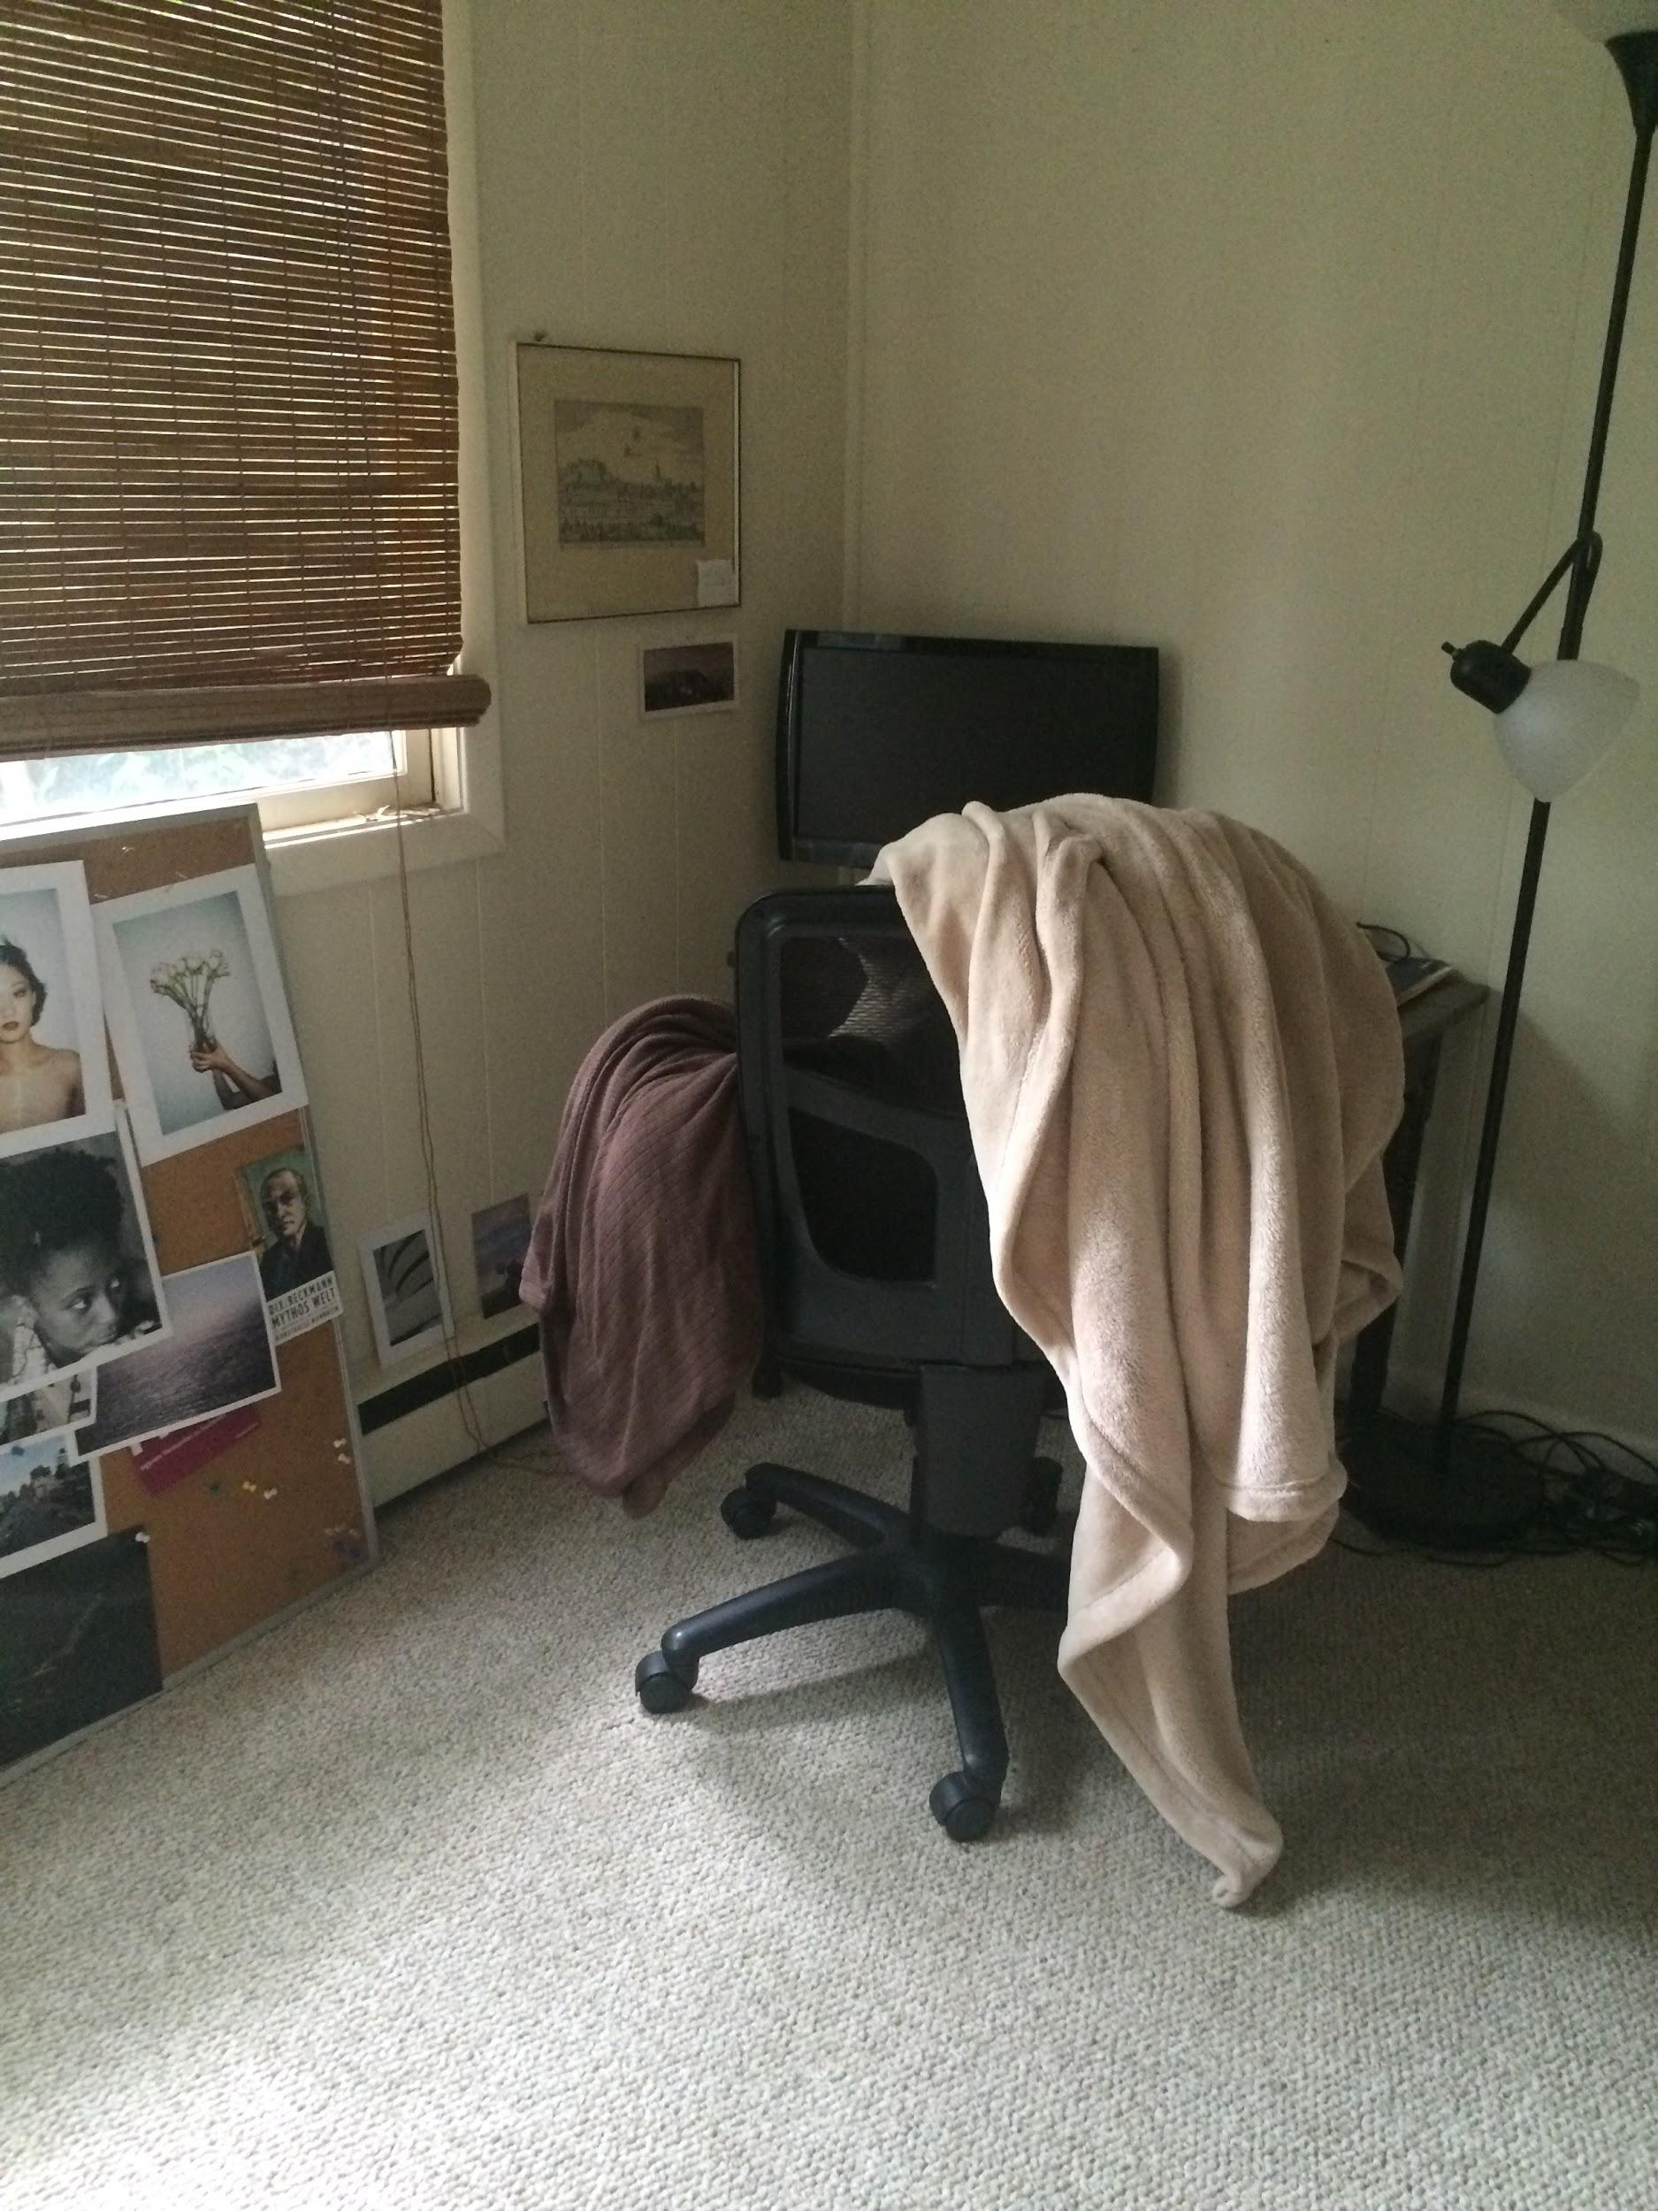
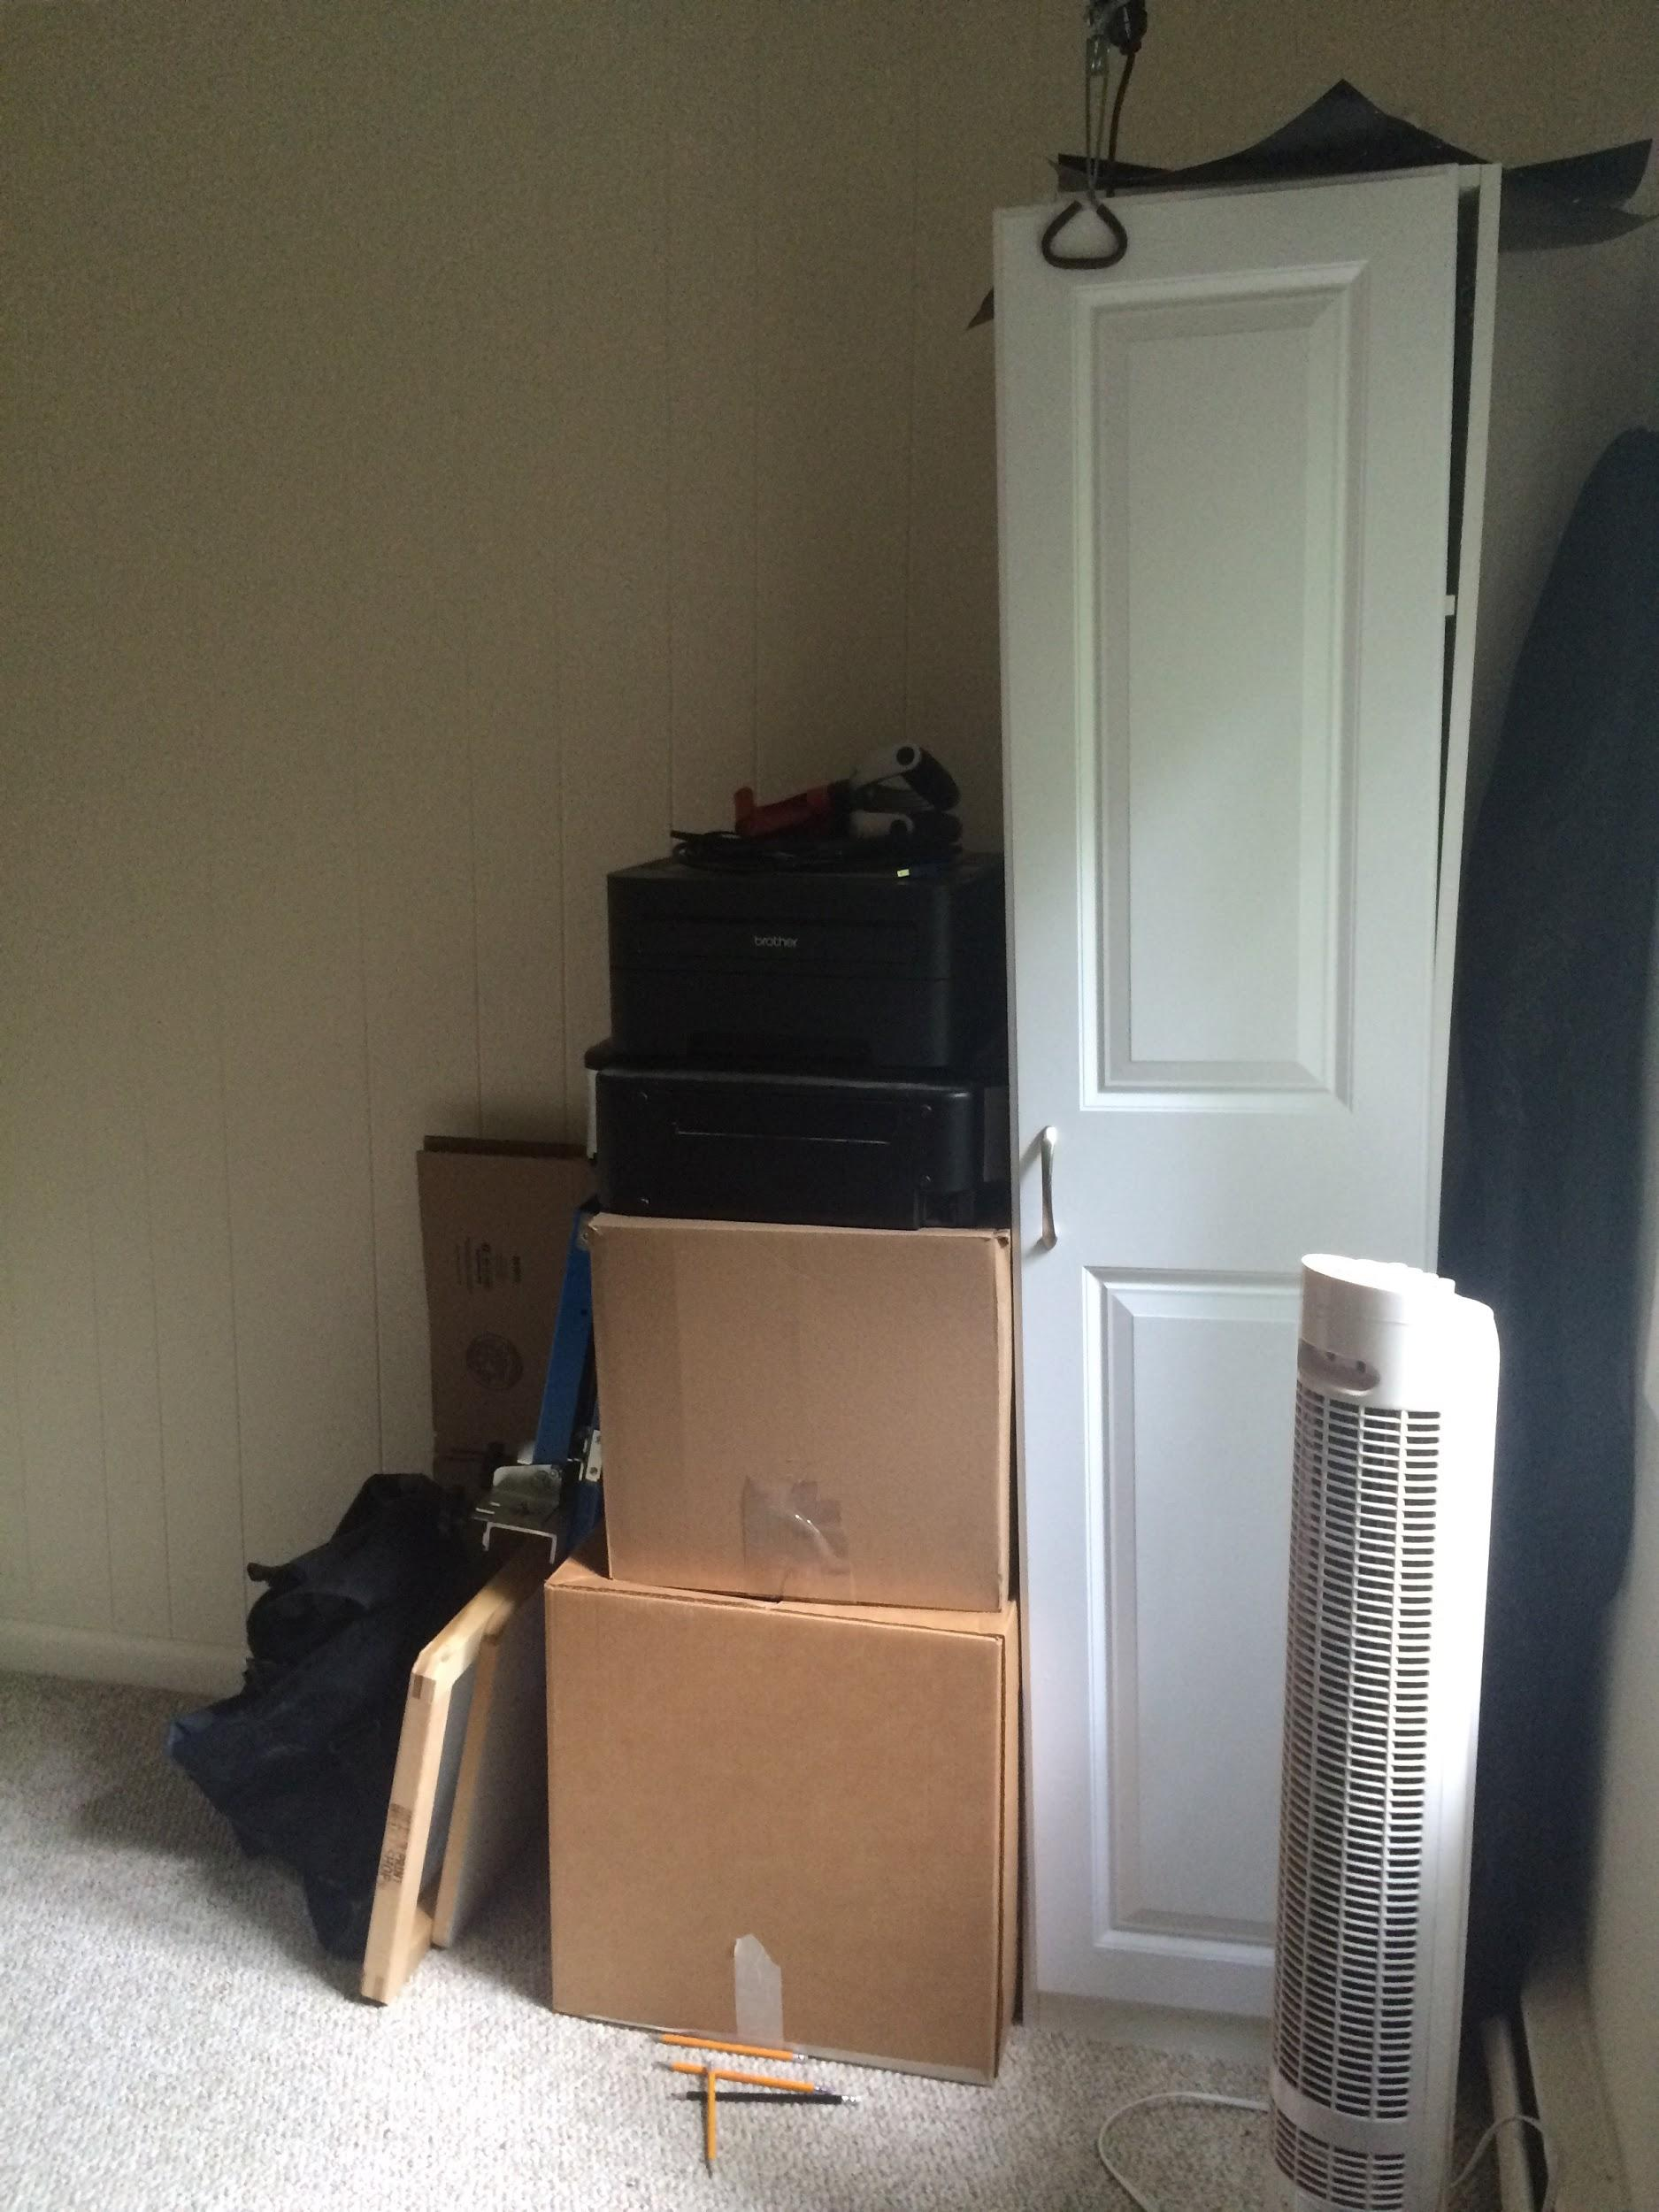

Slide 27
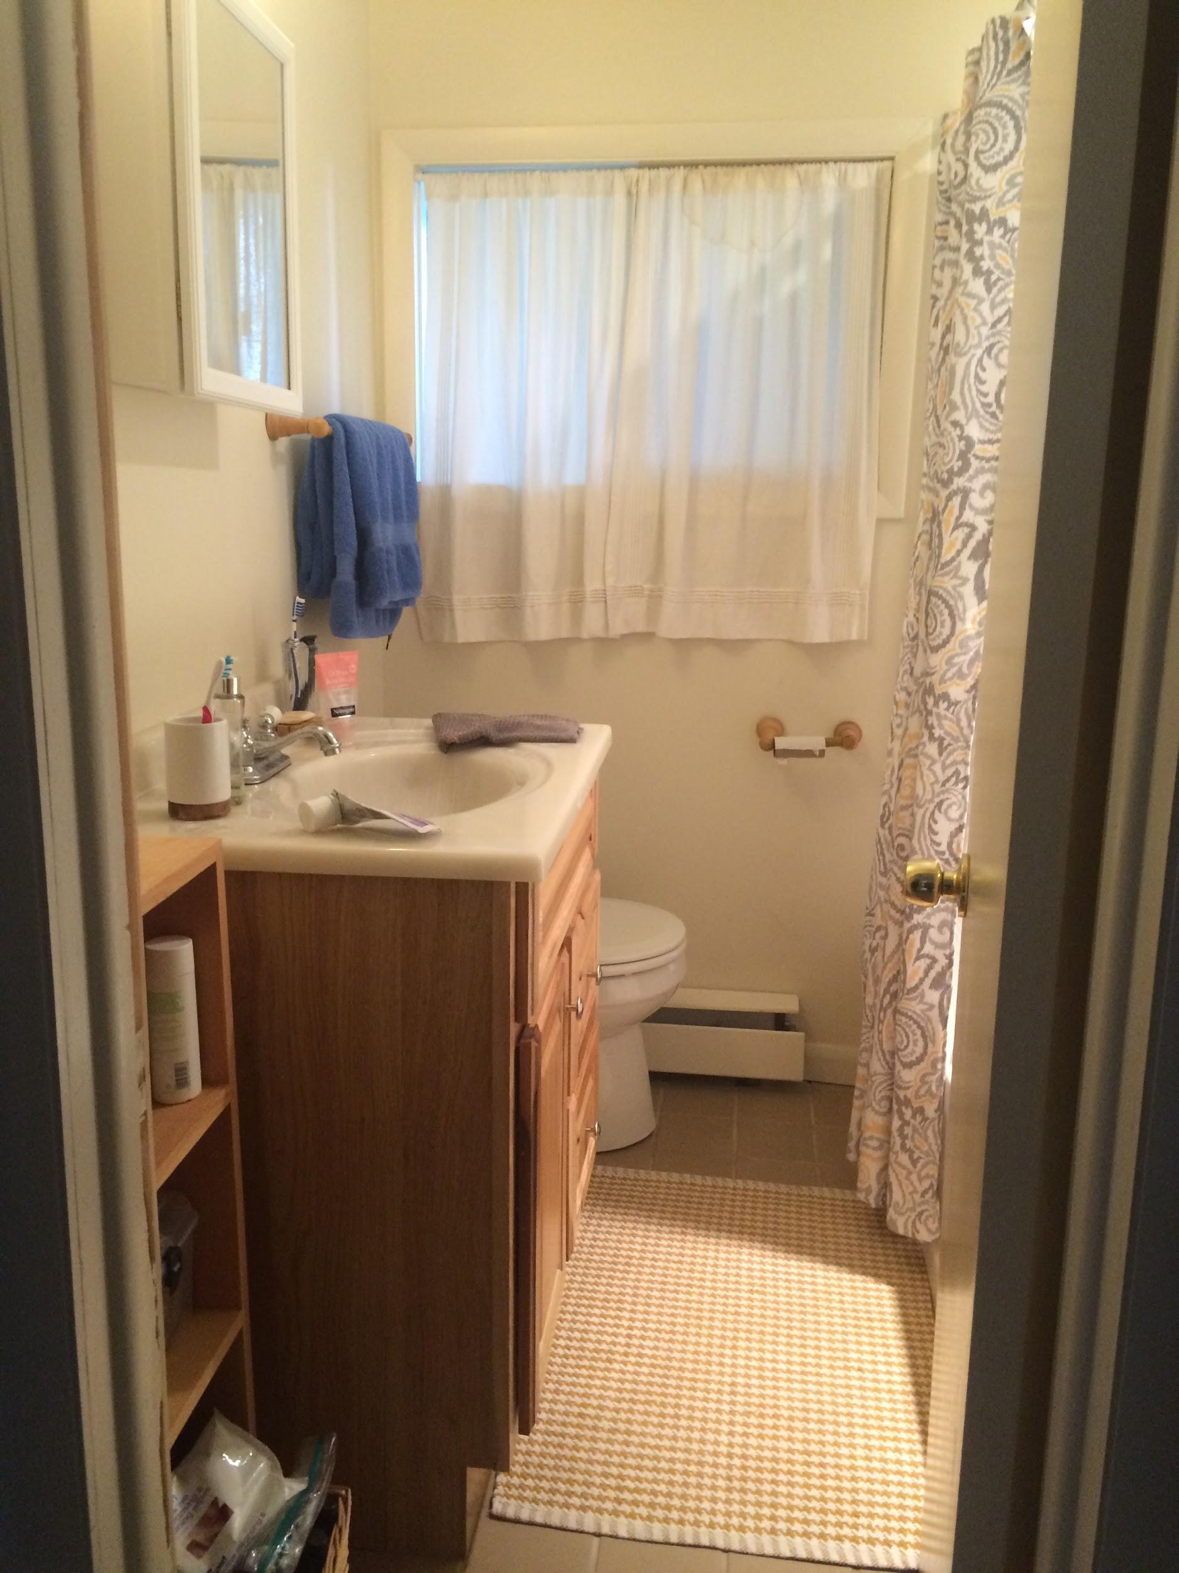
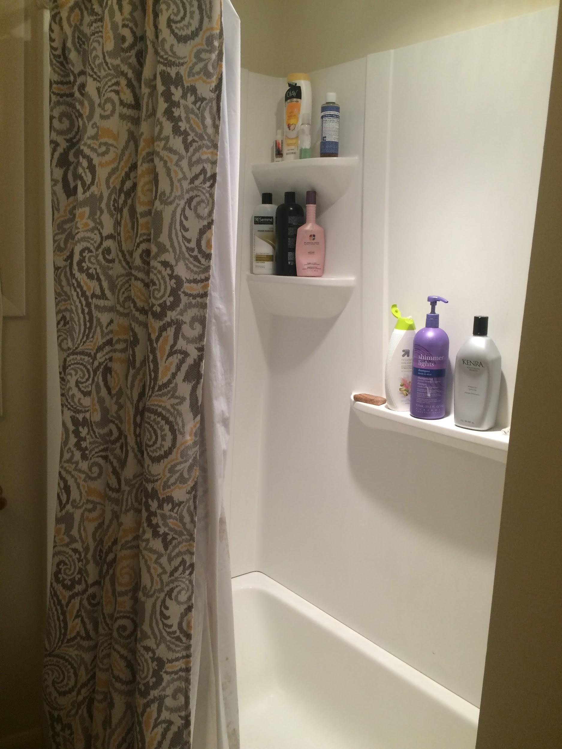

Slide 28
Loft Layout/Floor Plan

Slide 29
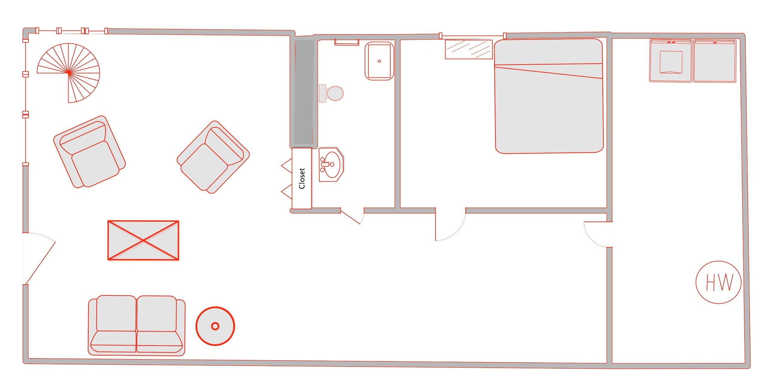
Downstairs

Slide 30
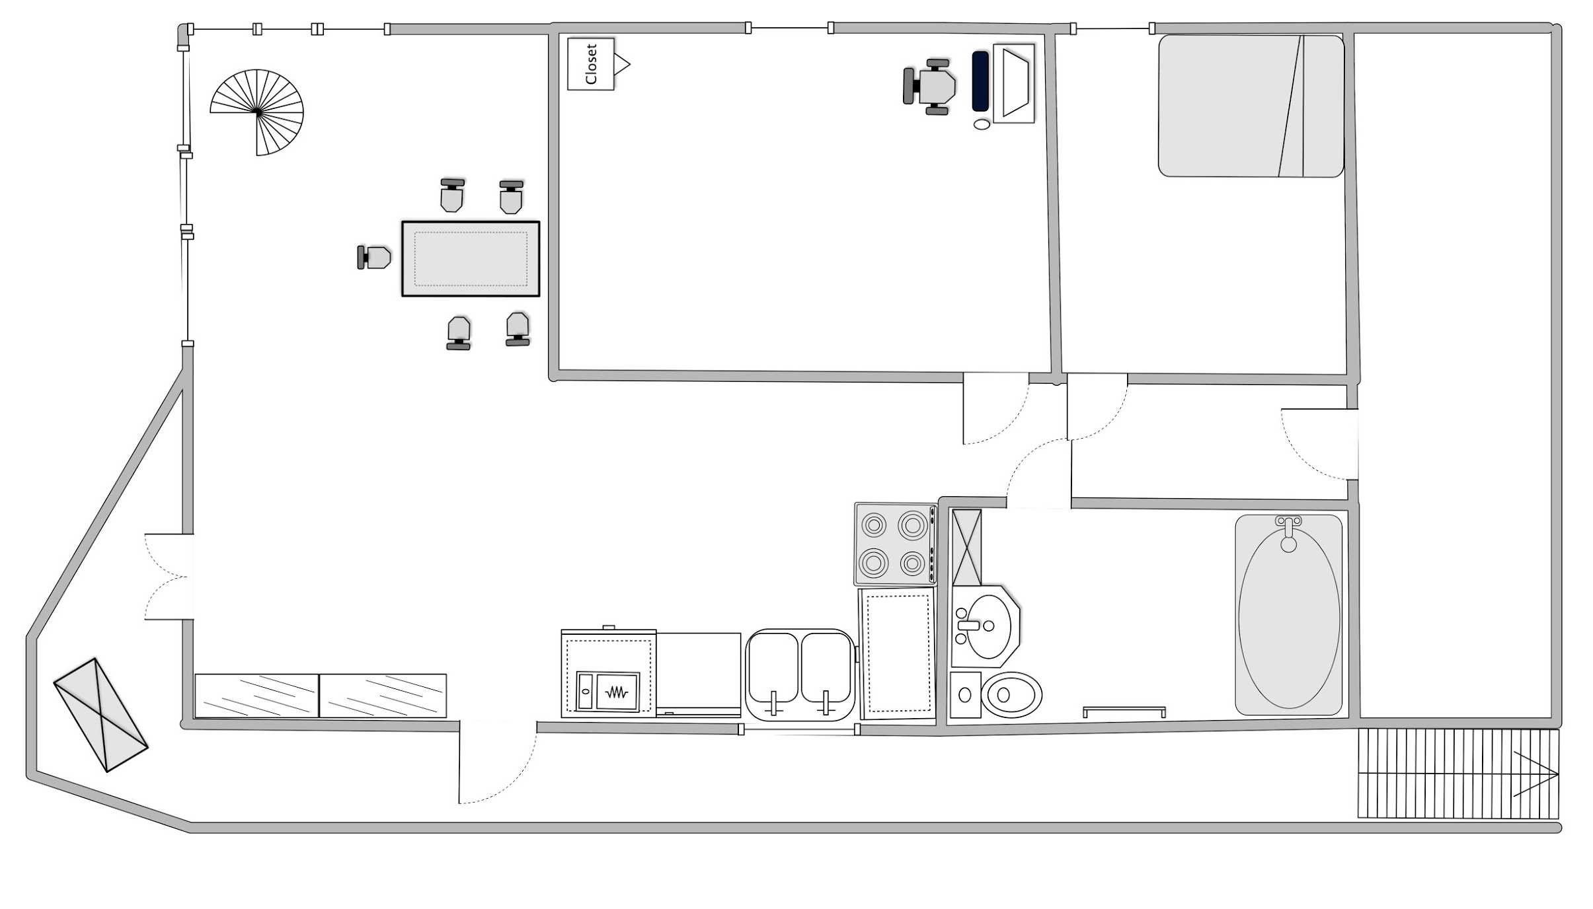
Upstairs

Slide 31
Directions From Ithaca College
About a 12 Minute Drive

Slide 32
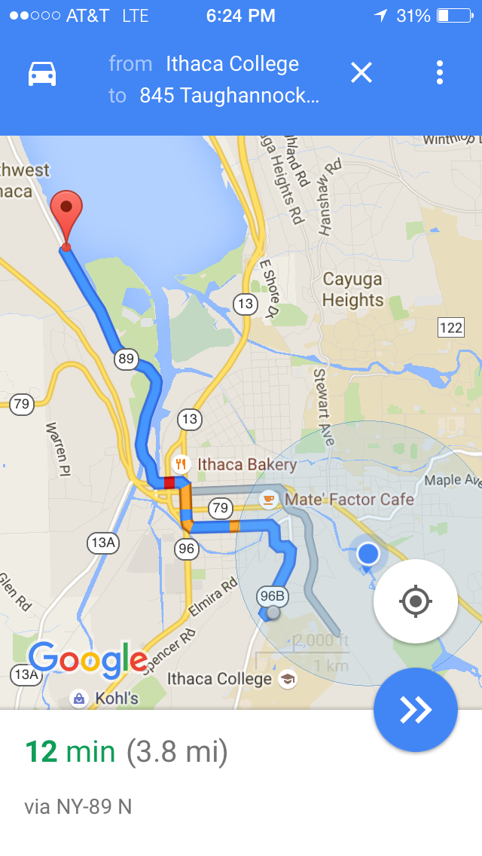
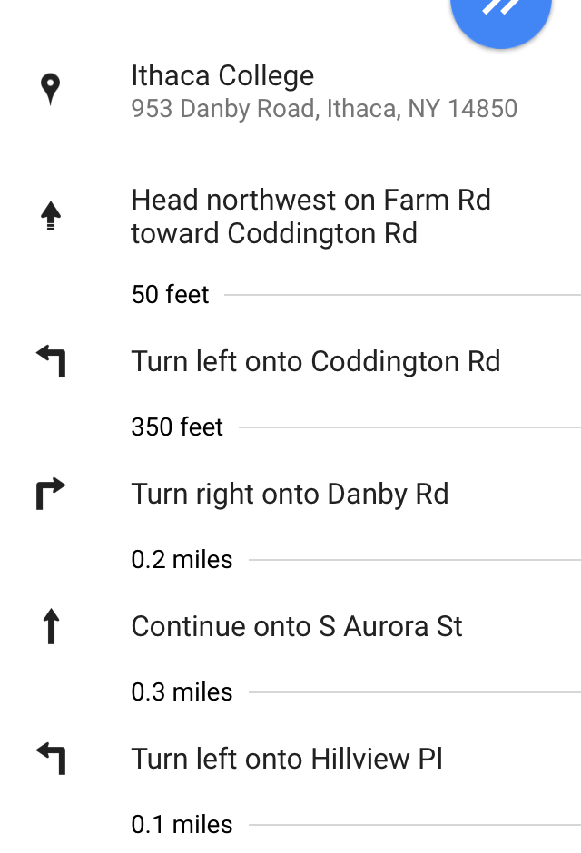
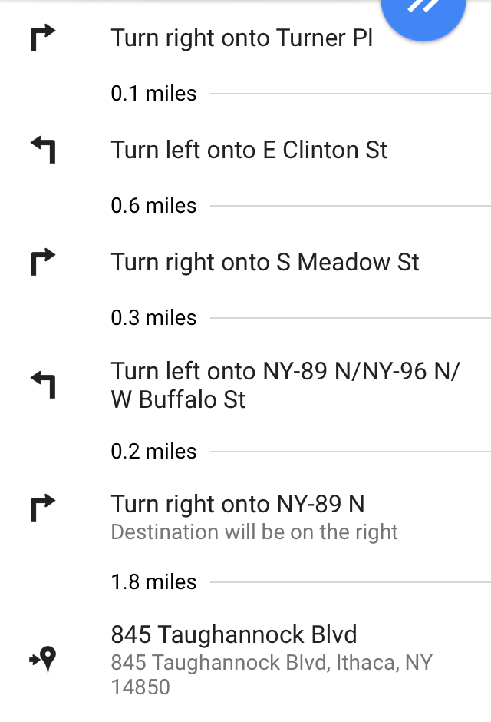

Slide 33
Location Uses/Use Information
This location could be used for many different purposes even though it may be smaller in size. With its hipster-like feeling, it could serve as the home to characters who may not be totally grown adults, but for those who may not be in college anymore either. It could also serve well for a character that may enjoy seclusion from the outside world, or the beauty of the outdoors in general.
The rooms within the house can be decorated simply due to their size, which means they could be reused many times for different purposes throughout the film.
The storage room in the downstairs of the loft could be used as a place where crew initially places equipment and craft services due to the fact that it is a room that has a closing door and is out of the way.

Slide 34
Location Uses/Use Information (Cont.)
In addition to parking on the spaces that are available in front of the loft, there is an opportunity to park on across the driveway on the street as well. Just cross over with caution, especially on weekends, because of ongoing traffic.
This location is open for any type of filming as long as it is understood that there is supervision by the tenant. This means that they will be around in the backgrounds, not getting in the way, just in case if the crew needs help with anything that deals with the household. Also, to shoot at this location would cost a certain fee per night with standard rate starting from 2pm of the check in date to 12pm the next day.
The refrigerator sounds may cause an issue with audio, however, it may be unplugged if needed be with advanced notice. It is asked please to plug back in when the shoot has been completed.

Slide 35
Location Uses/Use Information (Cont.)
The Dock outside and any other amenities are free to use as well for shooting. The tables set outside could be used to eat during break times if weather and time of day permits. If weather and time of day does not permit, eating downstairs is permitted as well, just remember to clean after yourselves.
To find availability, use the website link listed on the contact slide. There will be a calendar on the webpage that shows blackout dates (in grey) and the available days. It is best to email the tent (the email on the contact slide) in order to make lockdown this location.
This loft is a no-shoe-zone; therefore, please remove your shoes when entering into the space. A suggestion could be to bring slippers to switch in and out of when dealing with both indoor and outdoor scenes at the same time.

Slide 36
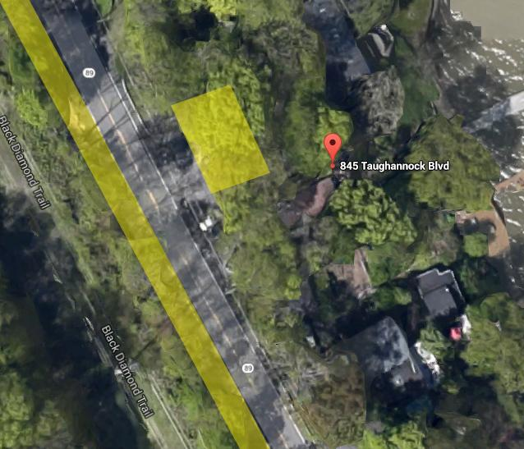
Key:
Yellow Sections = Available Parking
The entire left side of road extending beyond the above image is also available for parking.

Slide 37
Location Benefits & Drawbacks
Benefits
House is relatively secluded
Amazing natural lake view
Appealing modern architecture
Has a young-type of feeling to the space which could be used rather than using a dorm room/on campus apartment
Drawbacks
Steep and uneven stairs pose potential risks to crew members
Crossing the road from street parking can be dangerous
Sounds of wildlife may interfere with certain types of films trying to be shot
Small rooms within loft which means advanced planning needed when thinking of number of crew needed

Slide 38
Contact Information
Contact Kris at maria.sugatan@gmail.com
https://www.airbnb.com/rooms/7948022

