Slide 1
Office SpaceLocation Scouting
by Bridget Moore and Brando Benetton

Slide 2
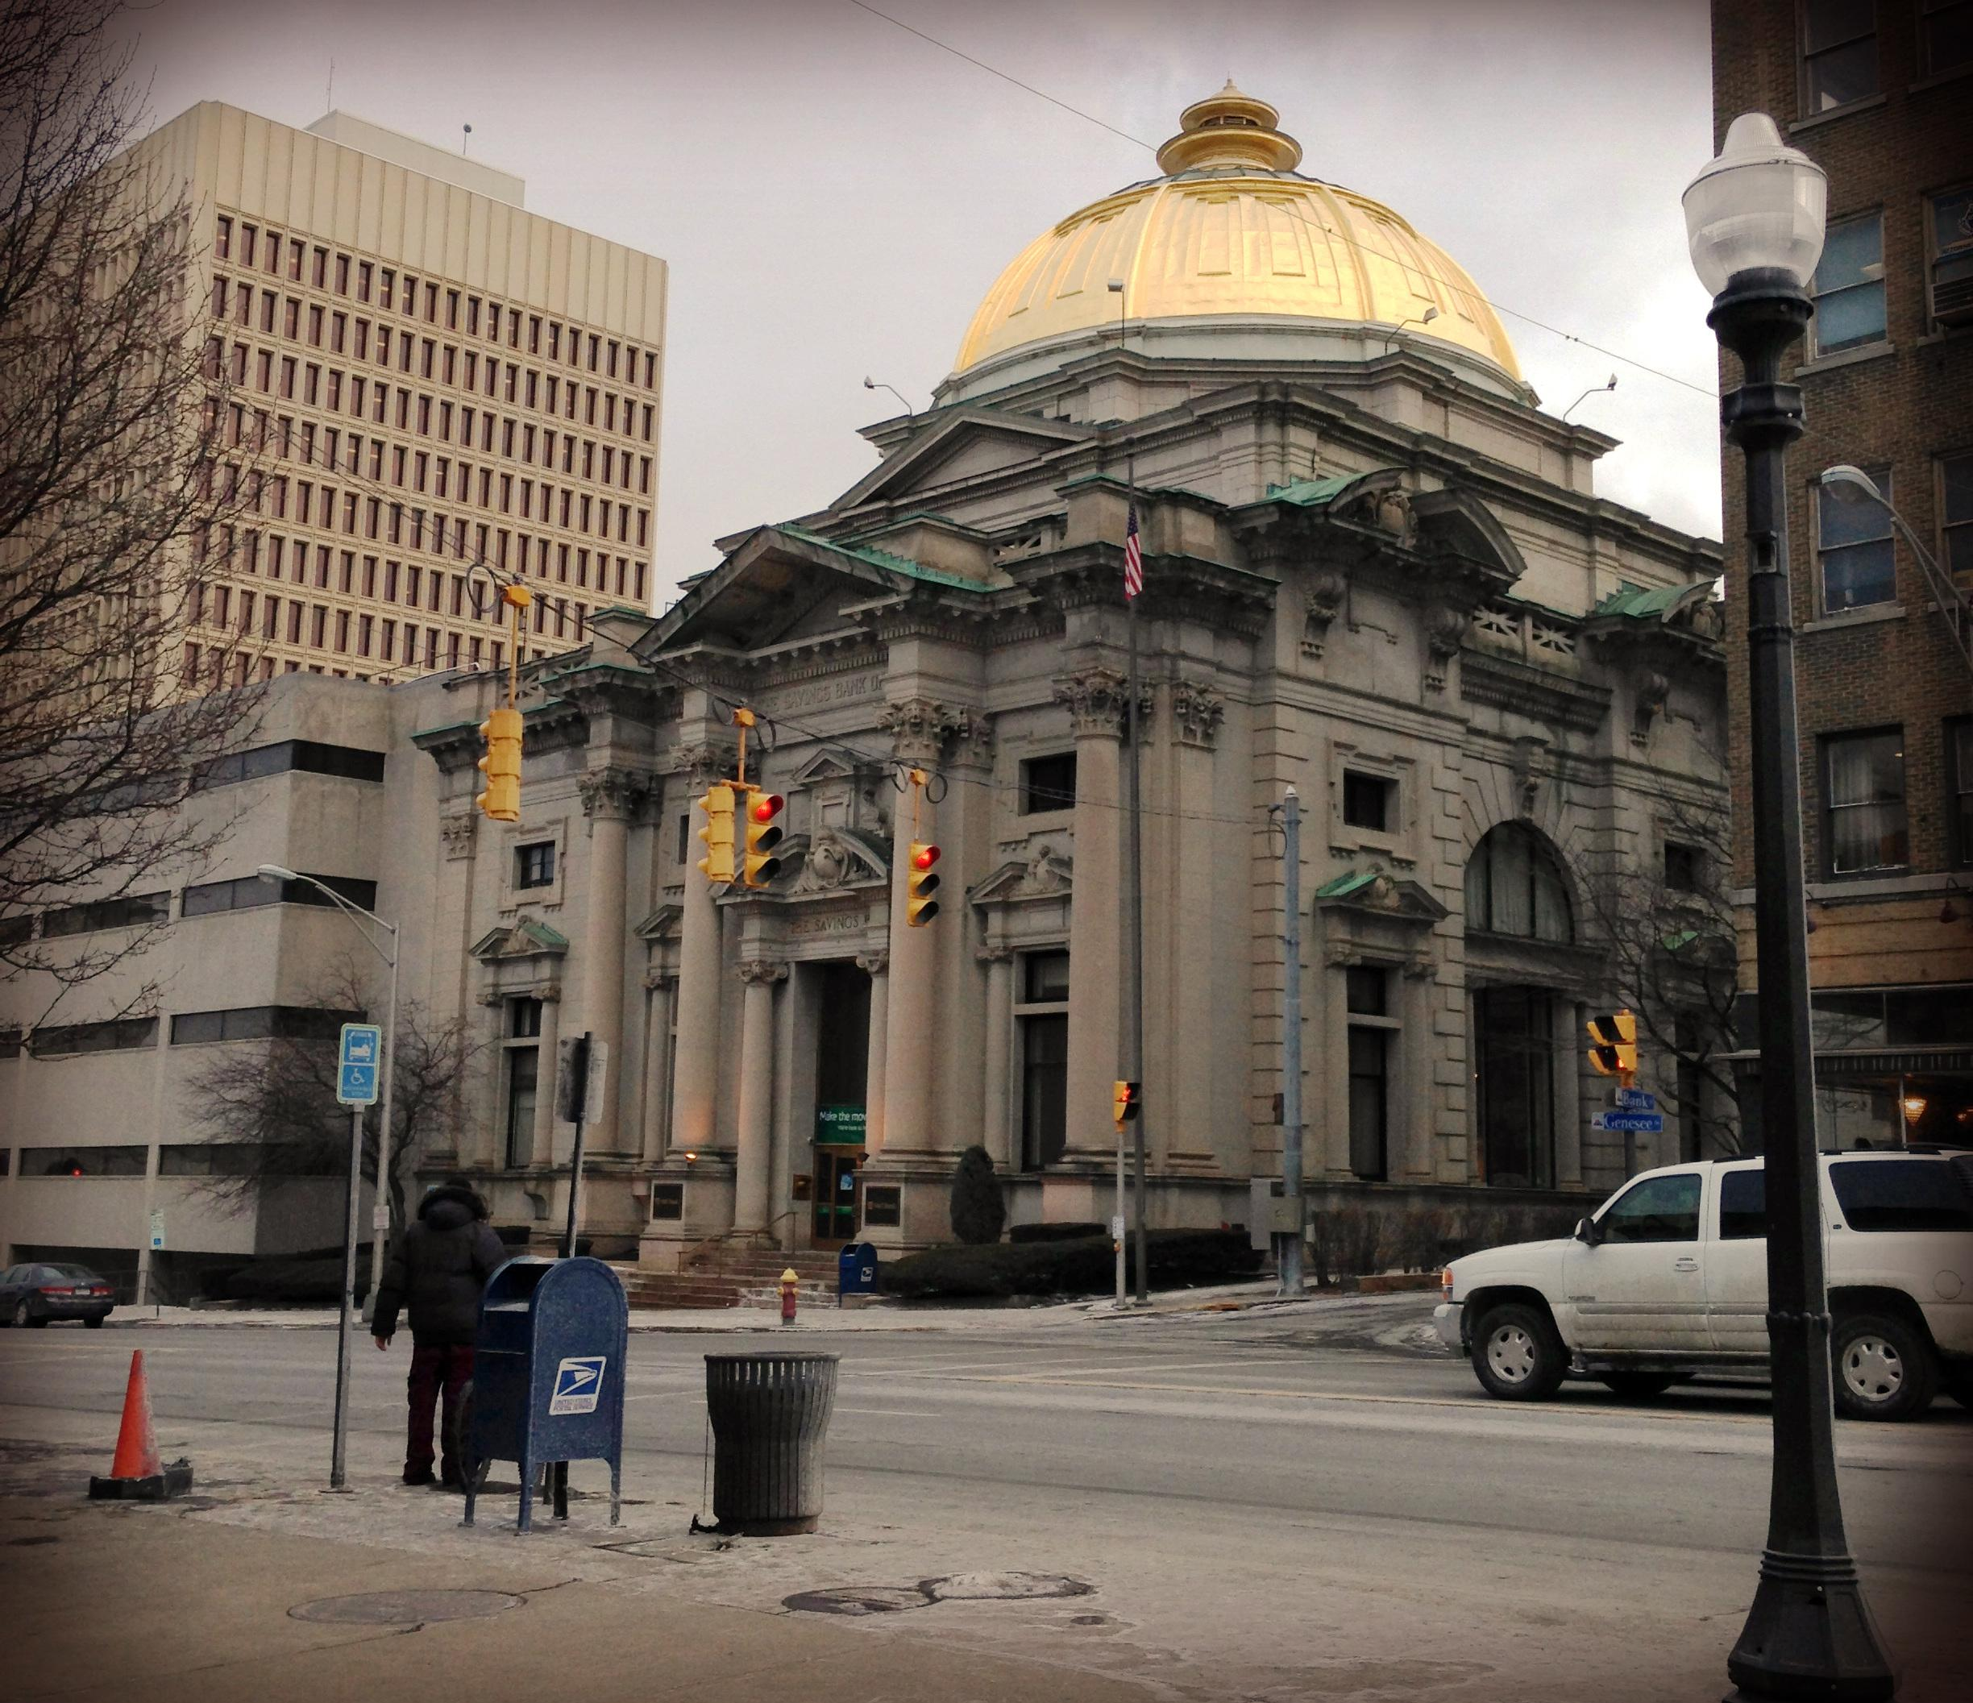
EXT. DAY - BANK ENTRANCE
M&T Bank
233 Genesse St Utica, NY 13501 (315)-738-4818

Slide 3
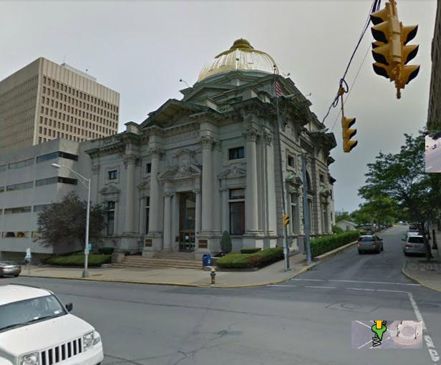

Slide 4
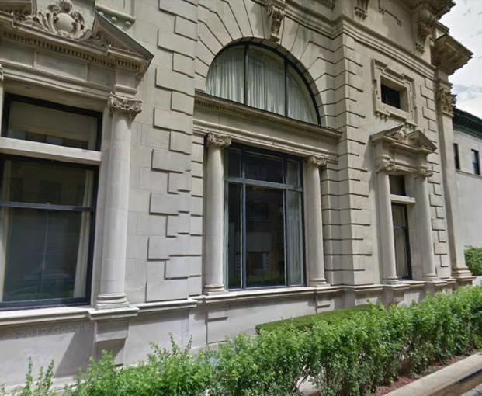

Slide 5
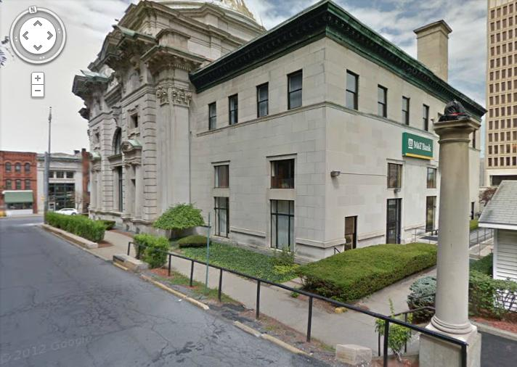

Slide 6
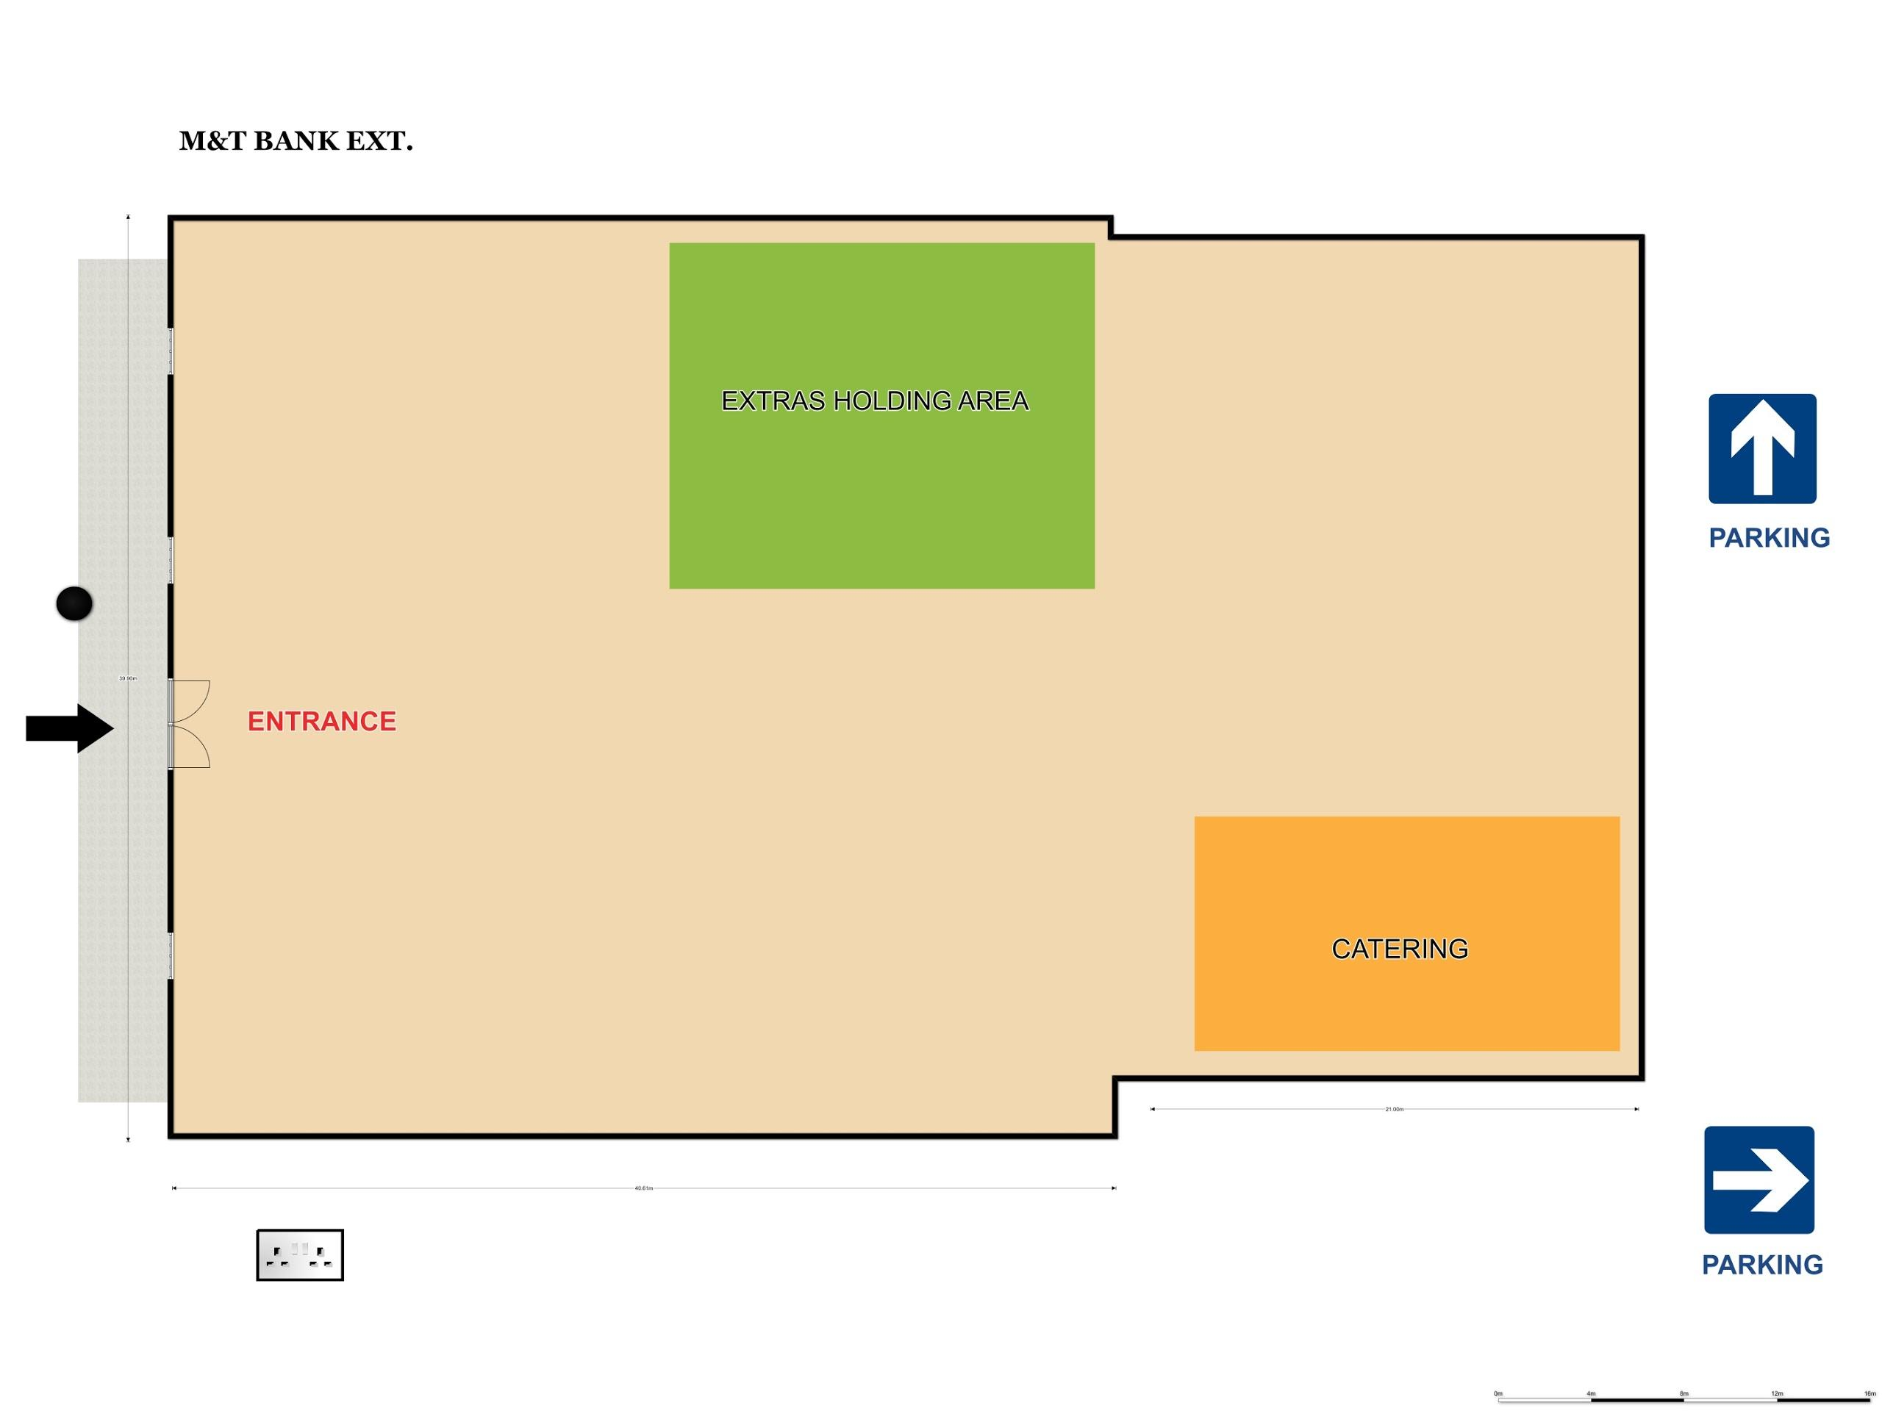

Slide 7
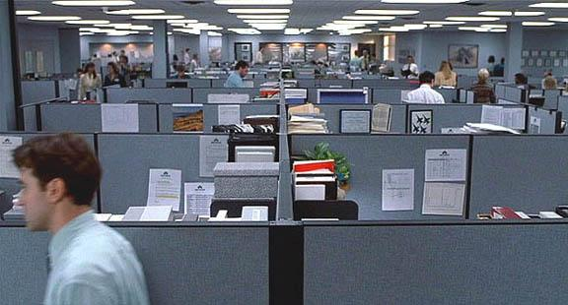
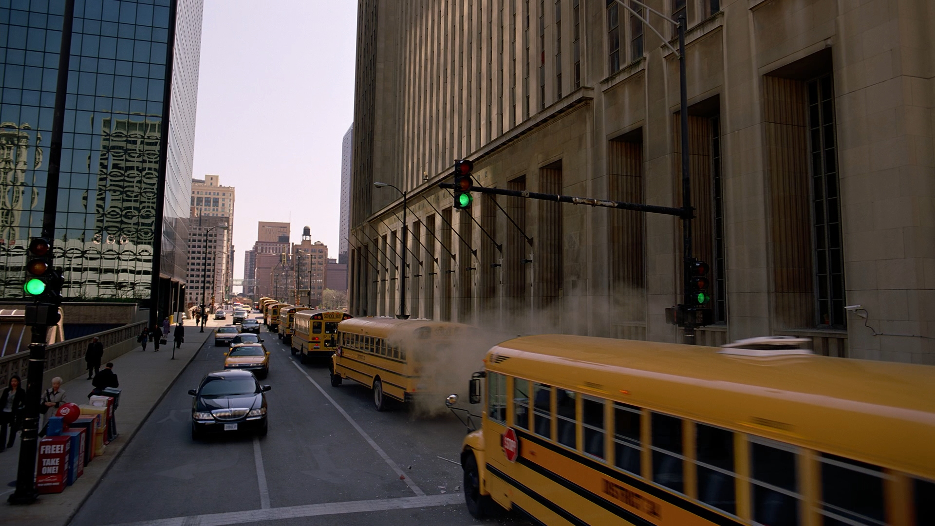
Genre: Action/Thriller
Less than 3 minutes! The entrance of a prestigious bank is perfect to double as a renown city building, or the perfect location for the beginning of a heist movie!
The M&T building hosts two large parking lots in the back side (one on Bank Pl and one on Blandina St), and is available to be occupied by a large crew and equipment trucks by contacting the Utica Mayor’s Office. Make sure your shooting date ends up on a Sunday, when the businesses and main street are pretty empty!

Slide 8
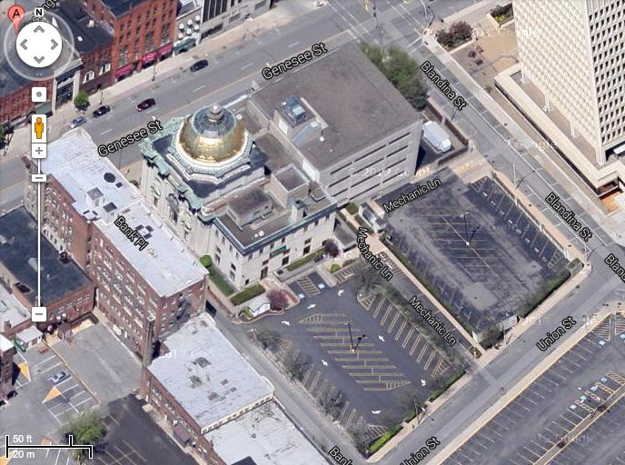

Slide 9
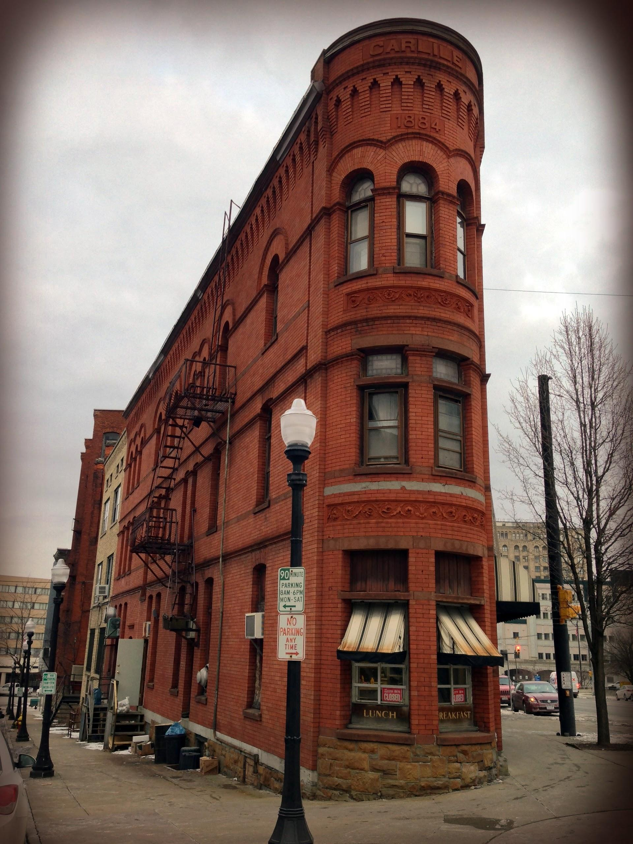
EXT. DAY - OLD OFFICE
Triangle Coffee Shop(Flat Iron Building look)244 Genesse St Utica, NY 13501 (315)-738-4818

Slide 10
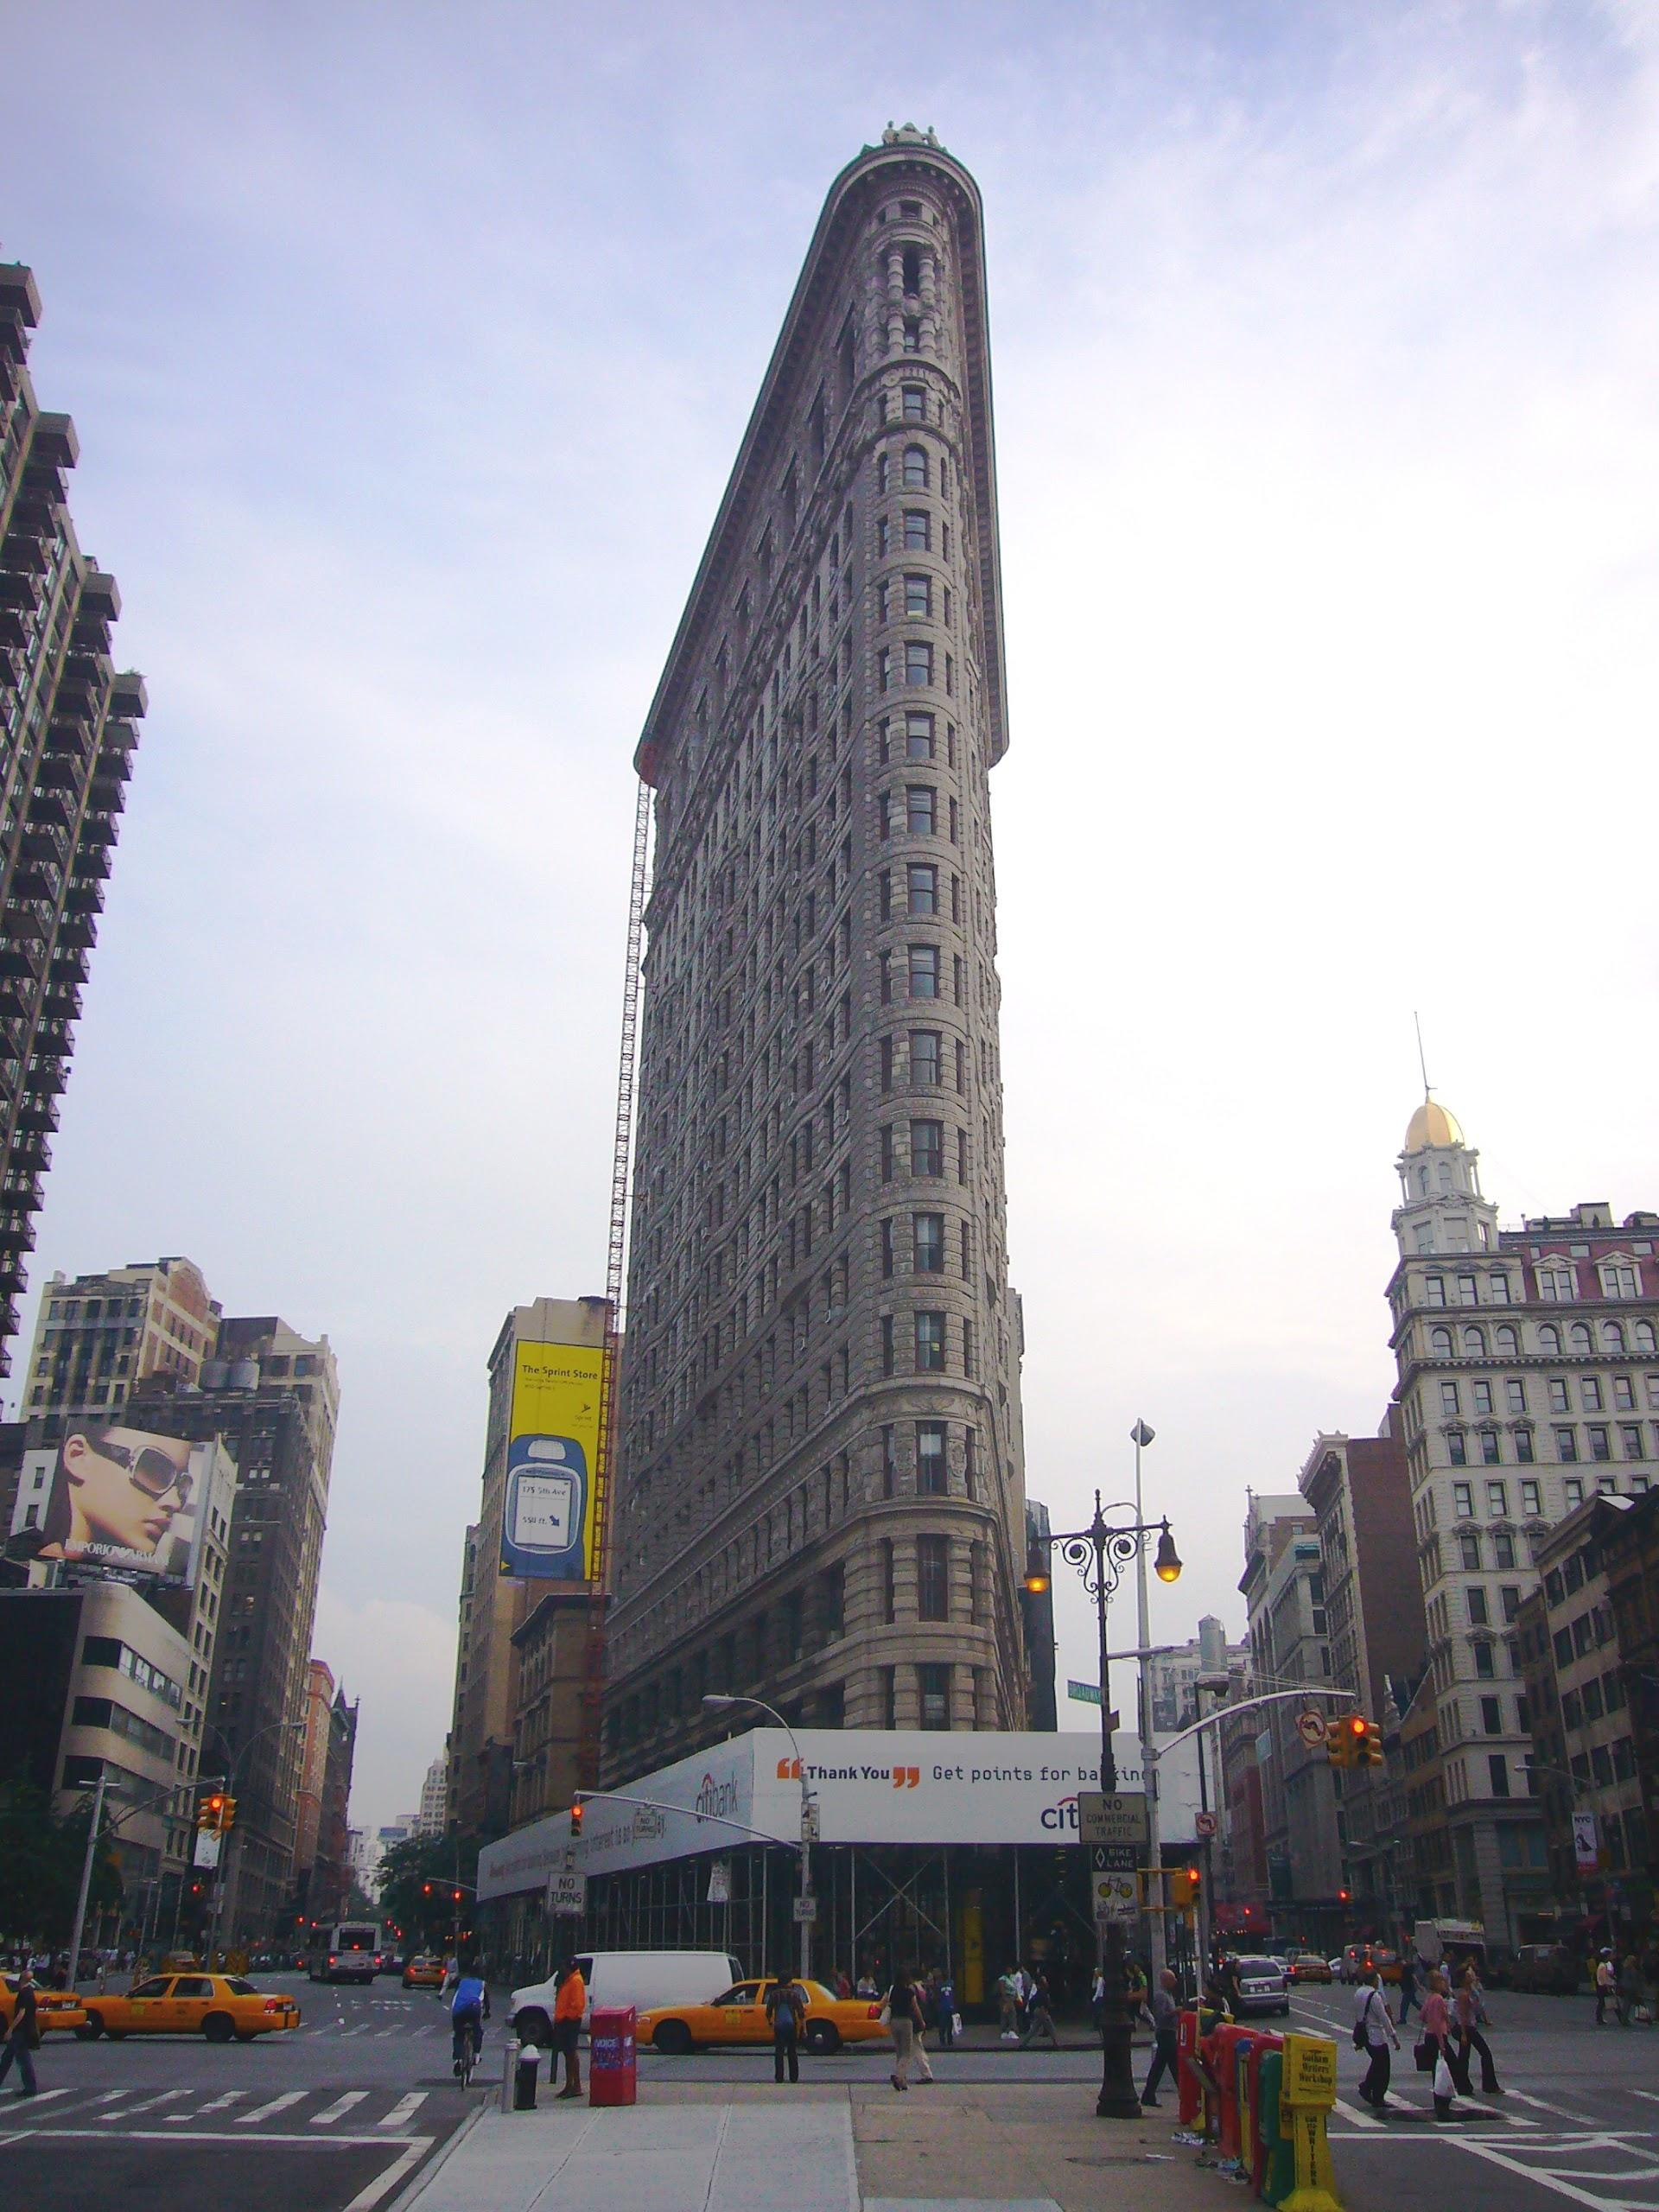
175 Fifth Avenue New York, NY 10010
Teenage Mutant Ninja Turtles (1987, TV Series)
Godzilla (1998)
Spider-man (2002)
Hitch (2005)
I Am Legend (2007)
Mr. Popper’s Penguins (2011)

Slide 11
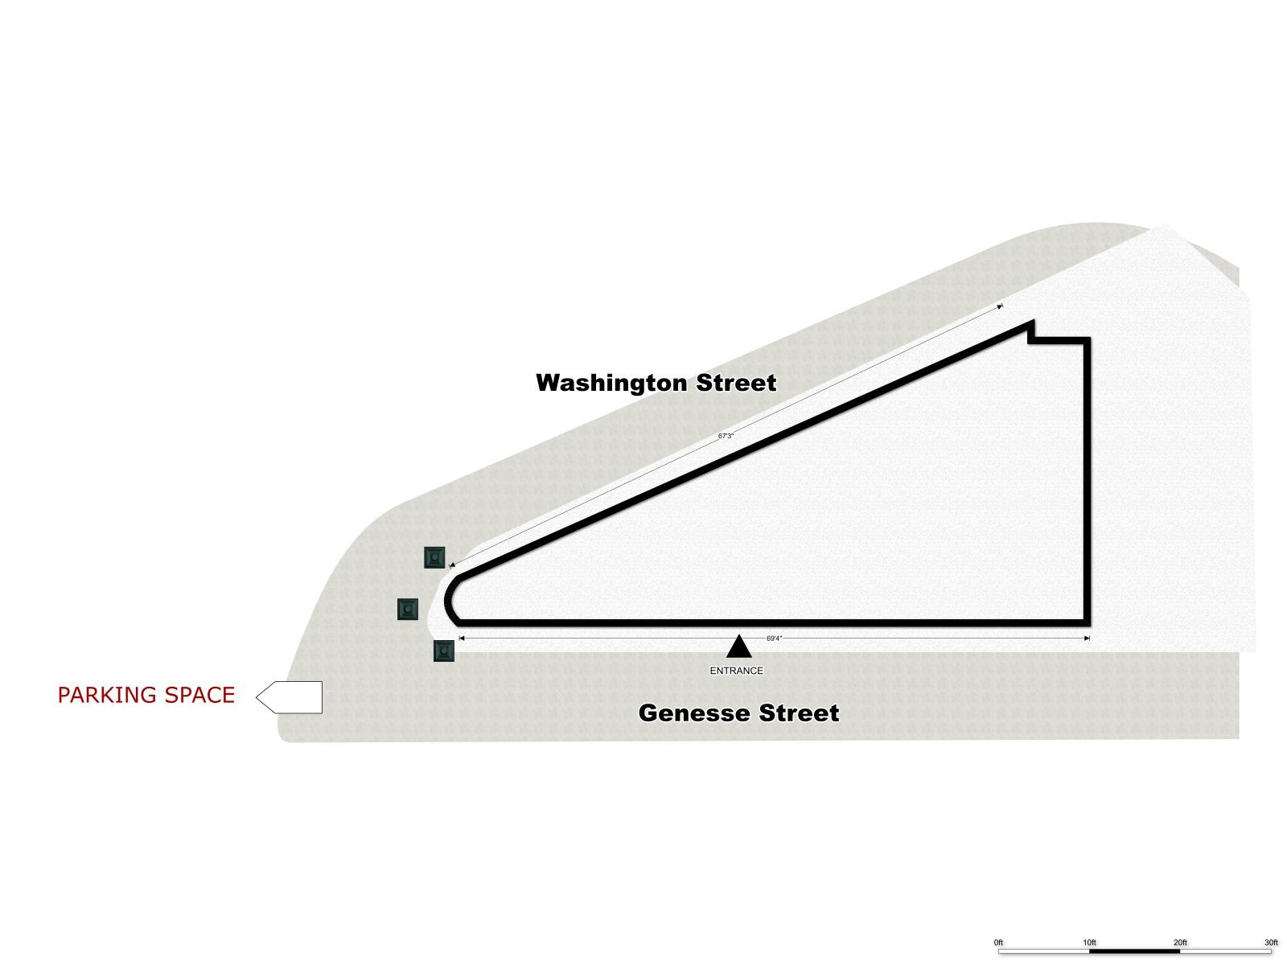

Slide 12
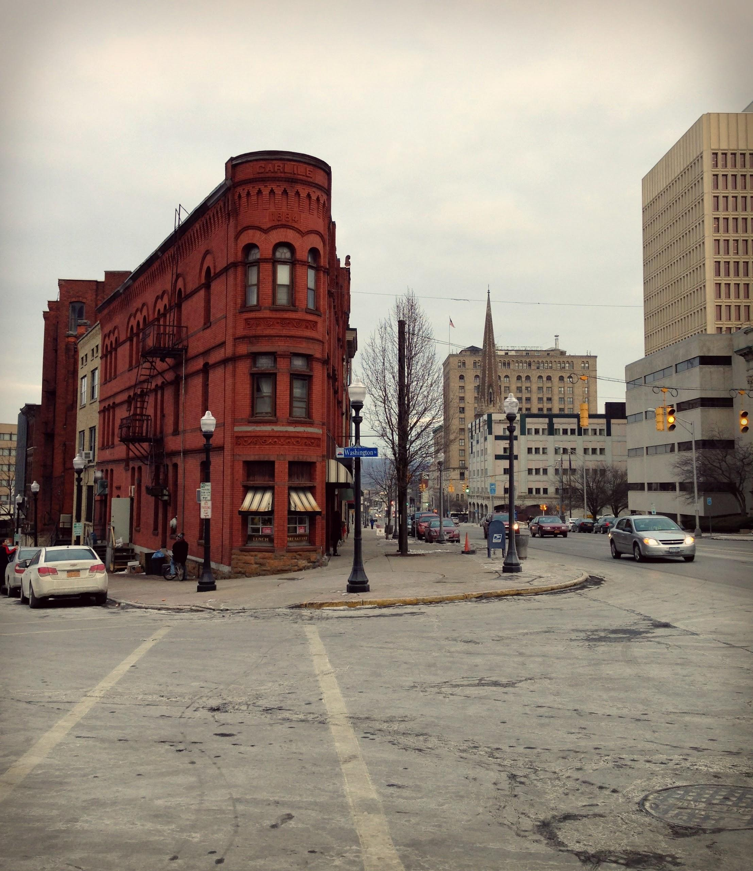
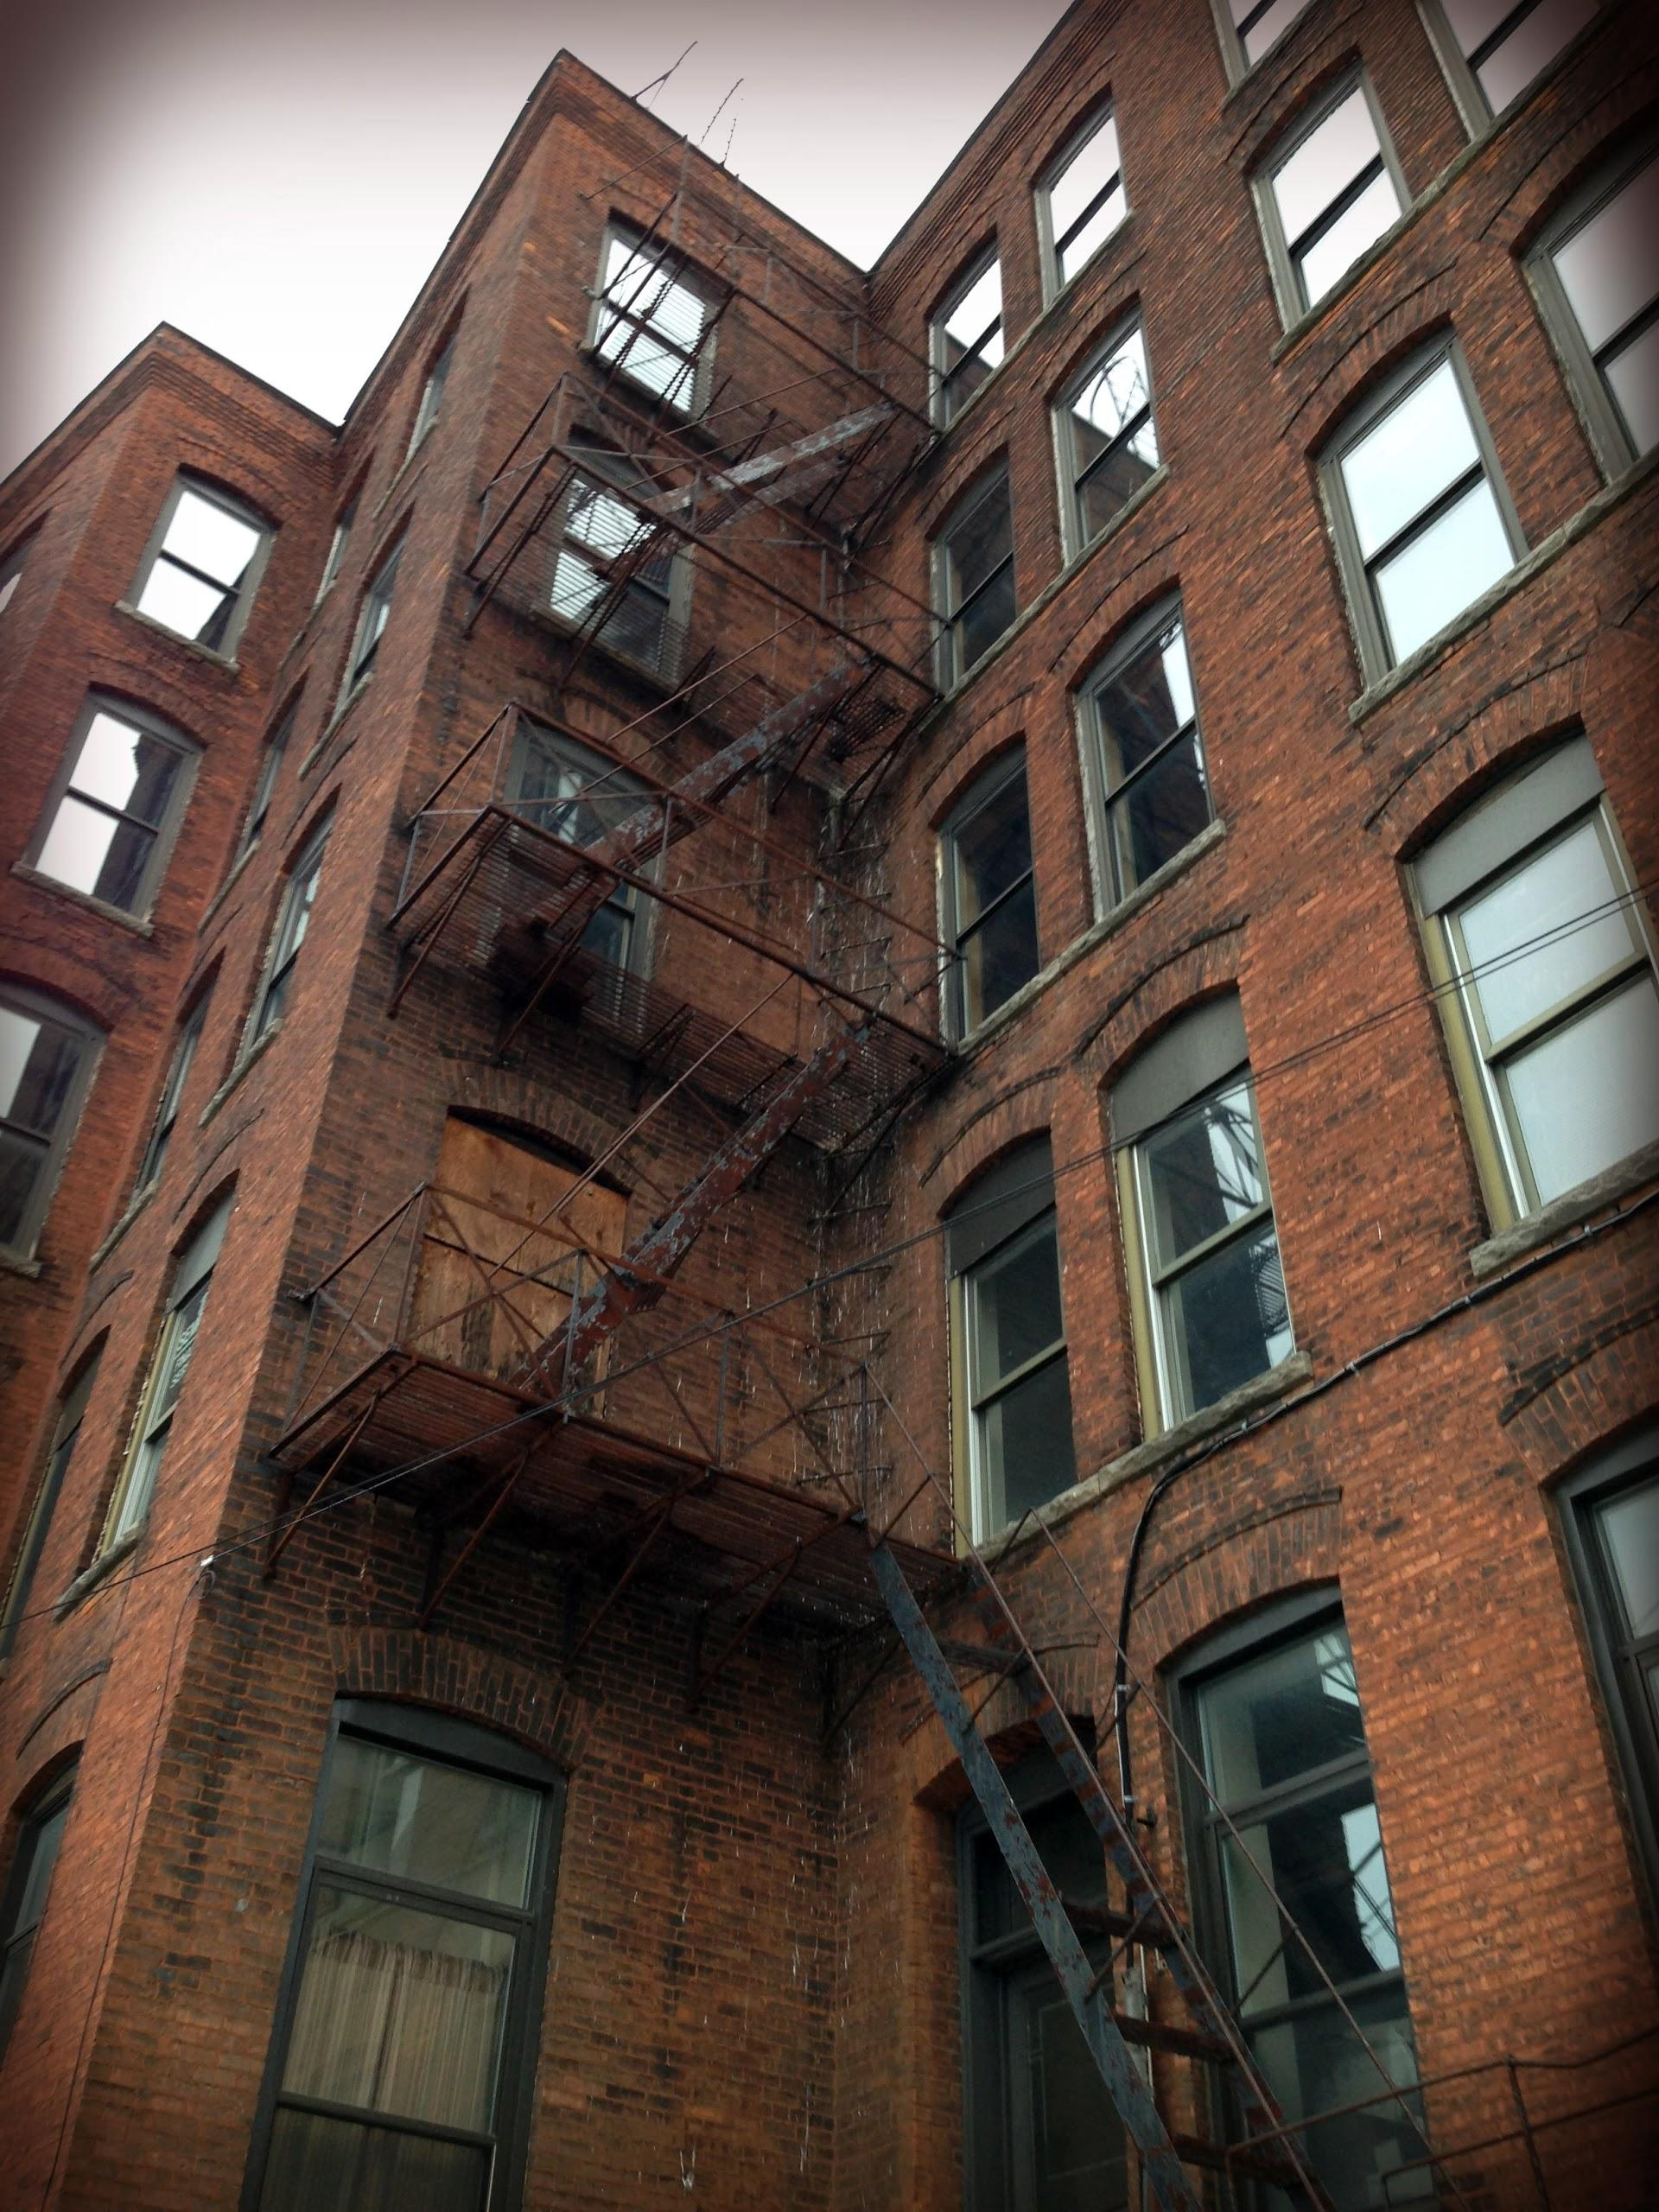

Slide 13
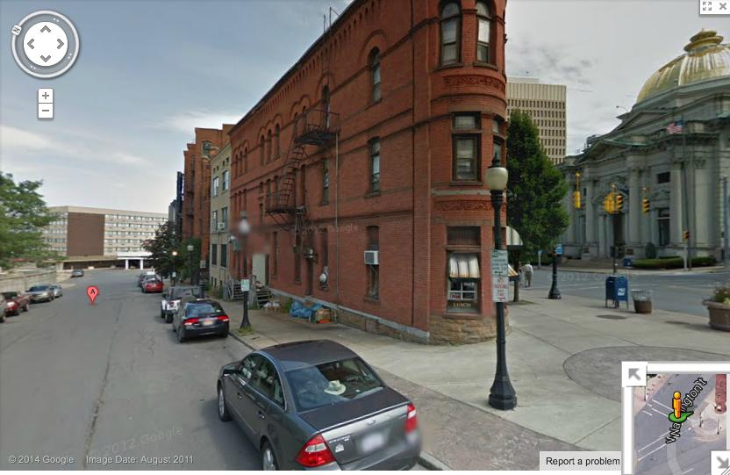

Slide 14
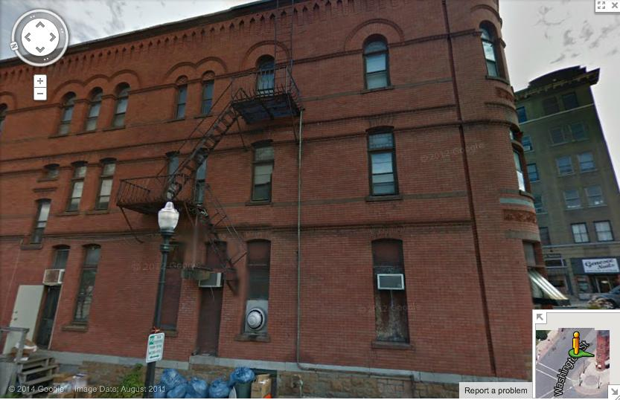

Slide 15
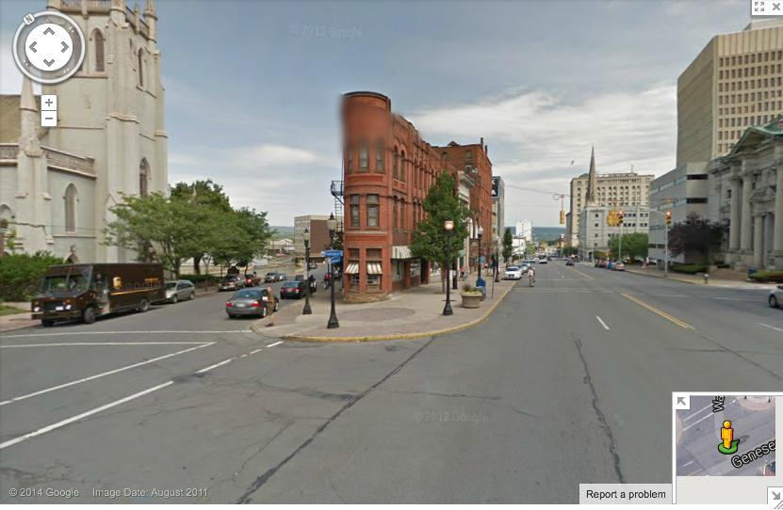

Slide 16
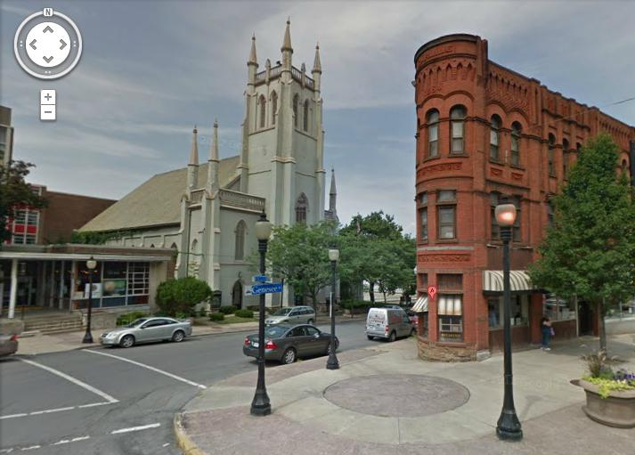

Slide 17
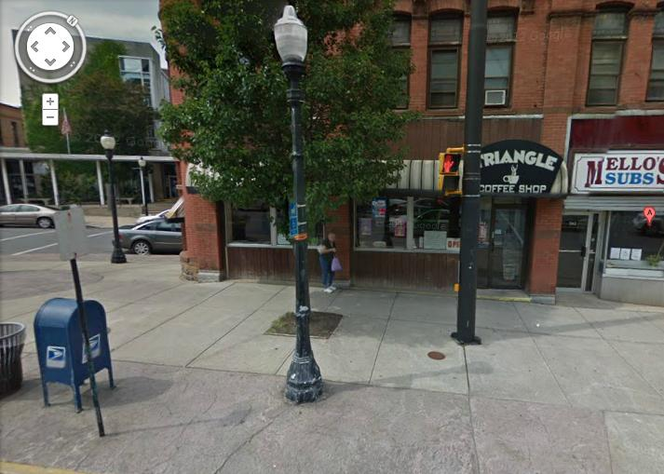

Slide 18
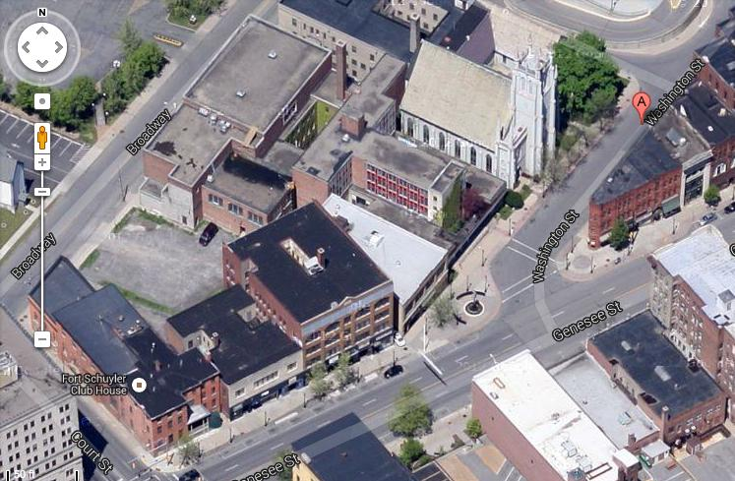
PARKING
SET LOCATION

Slide 19
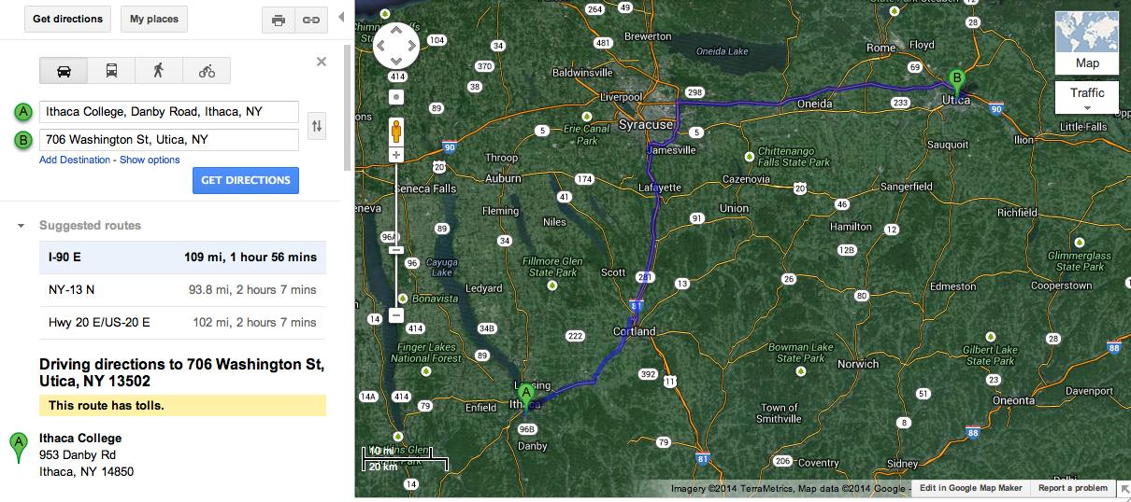

Slide 20
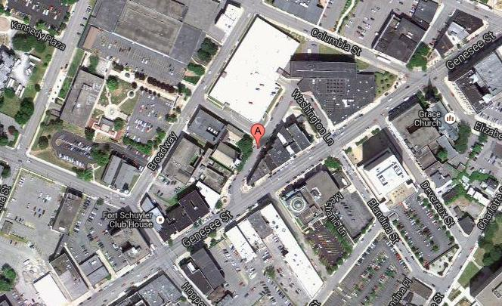

Slide 21
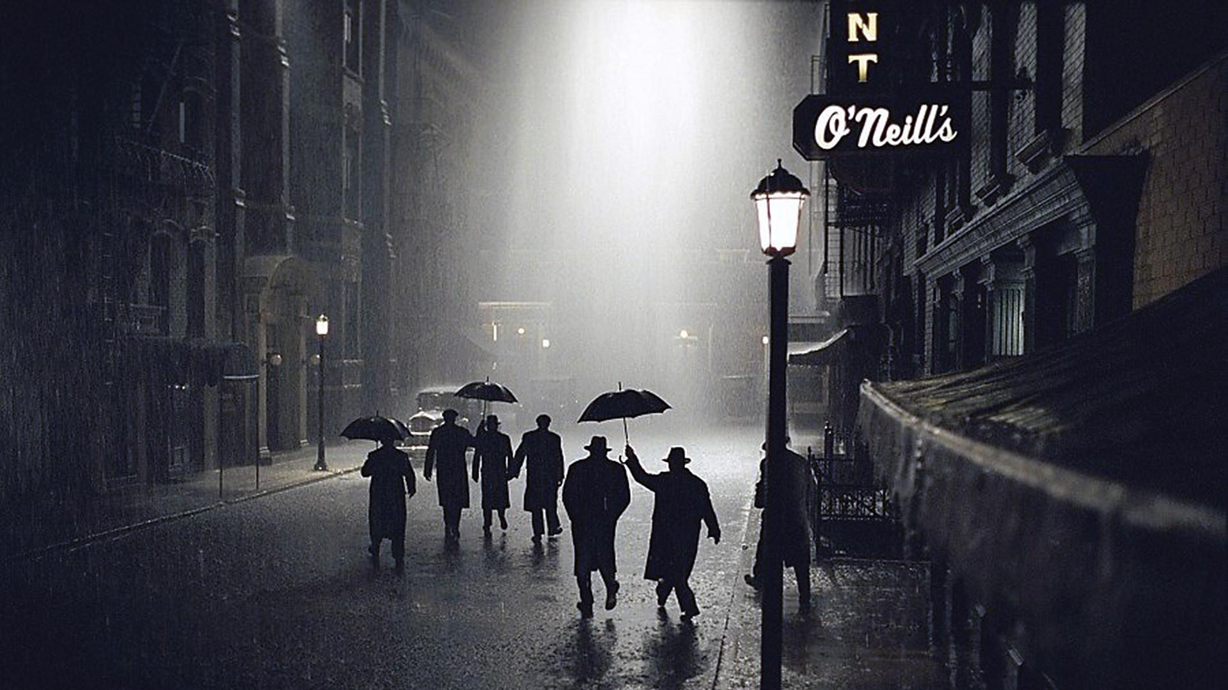
Genre: Gangster
Load your weapons! The Carlile’s front side of this 1884 brick building blends perfectly in the Gangster style, possibly doubling as Chicago or old Los Angeles or the setting of a thrilling shoot-out exterior!
The triangular corner faces both Genesse and Washington Street, with limitless space in side alleys (as well as the north side of Genesse St) where equipment, car parking, and crew holding can be located.

Slide 22
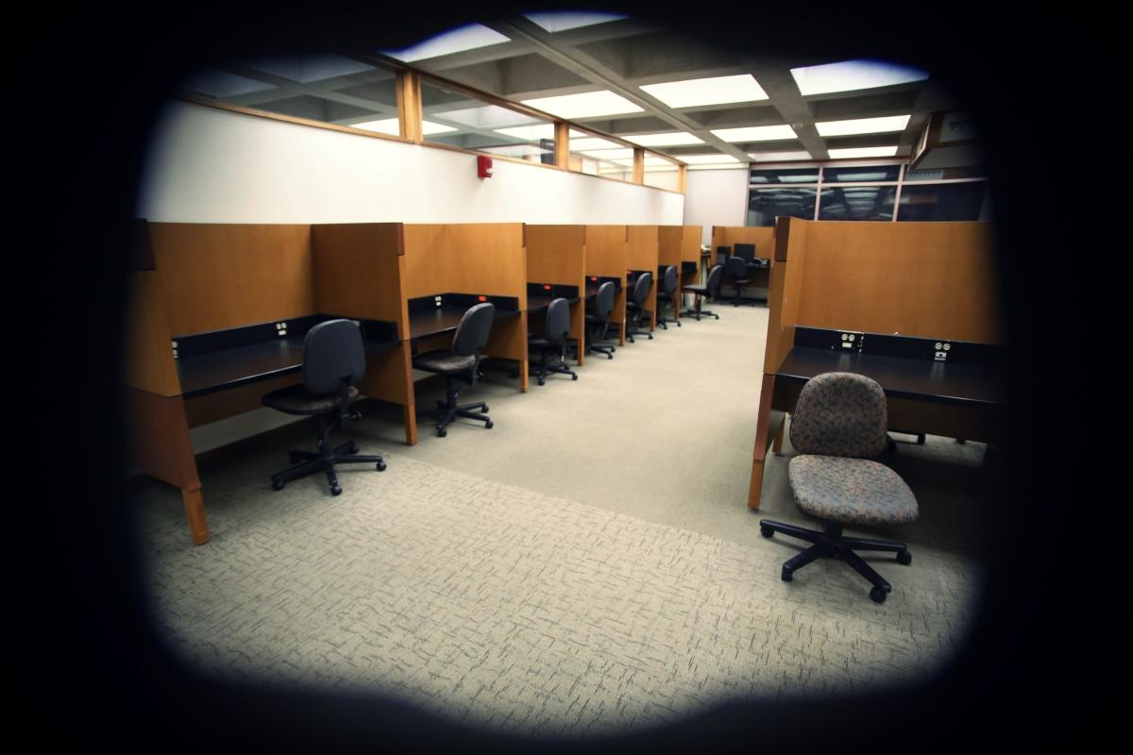
INT. DAY - OFFICE SPACE
Computer Station Area #8 Gannett Center Ithaca College 953 Danby Road Ithaca, NY 14850

Slide 23
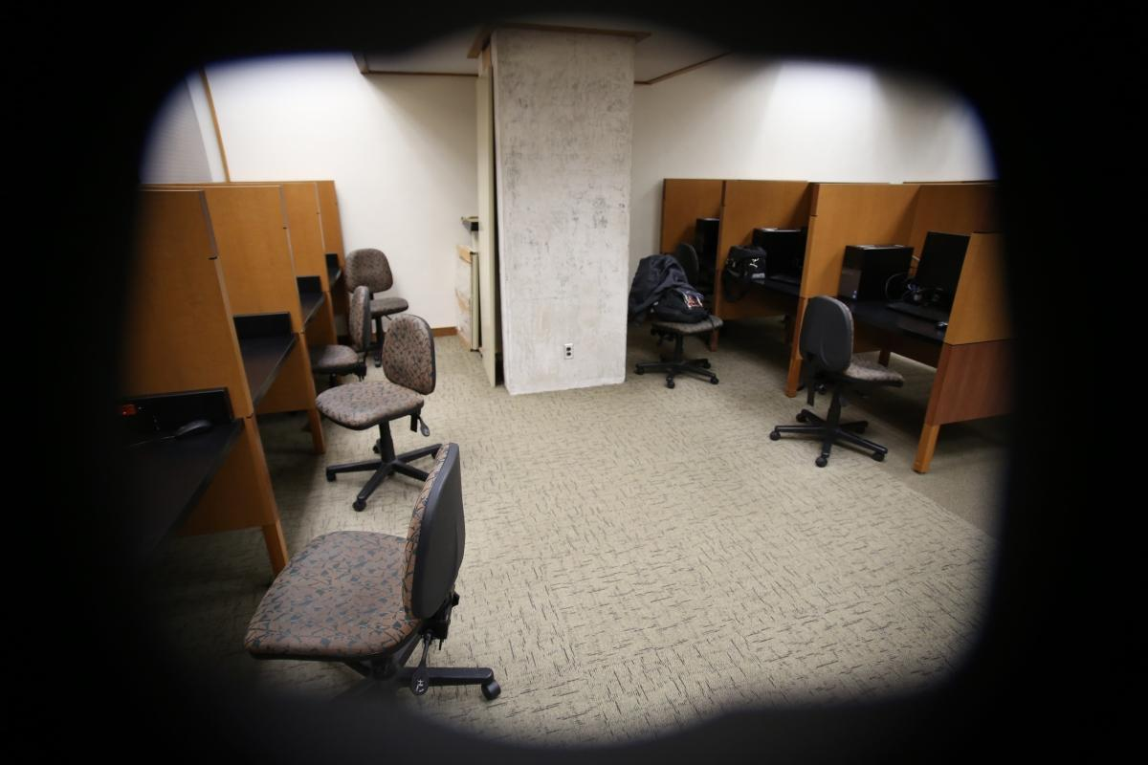

Slide 24
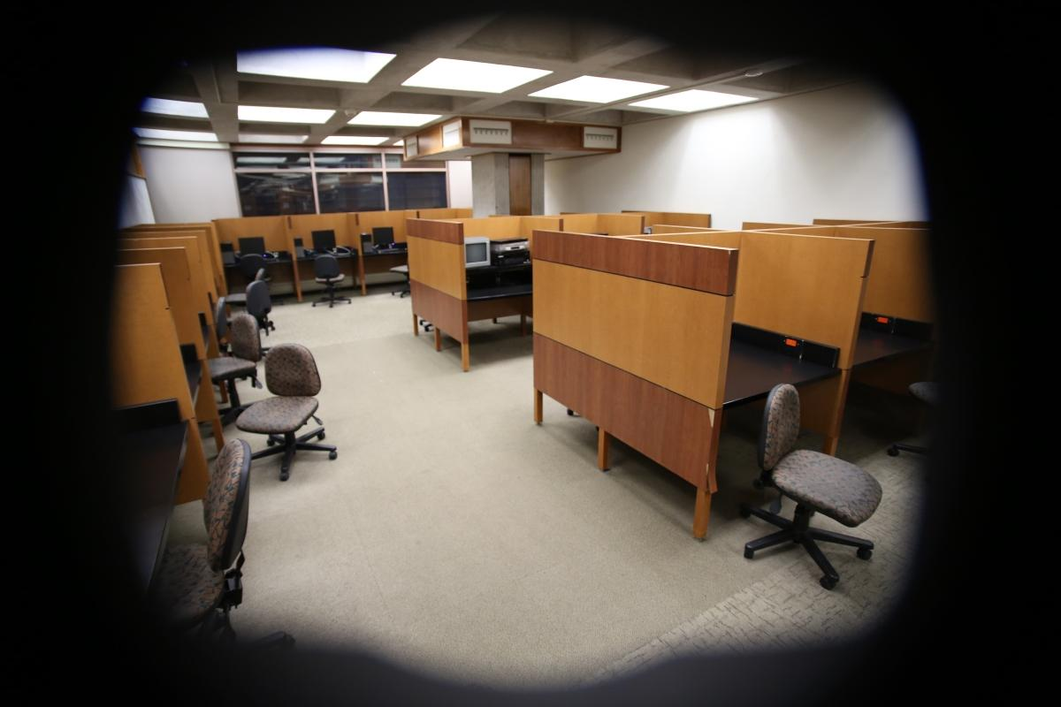

Slide 25
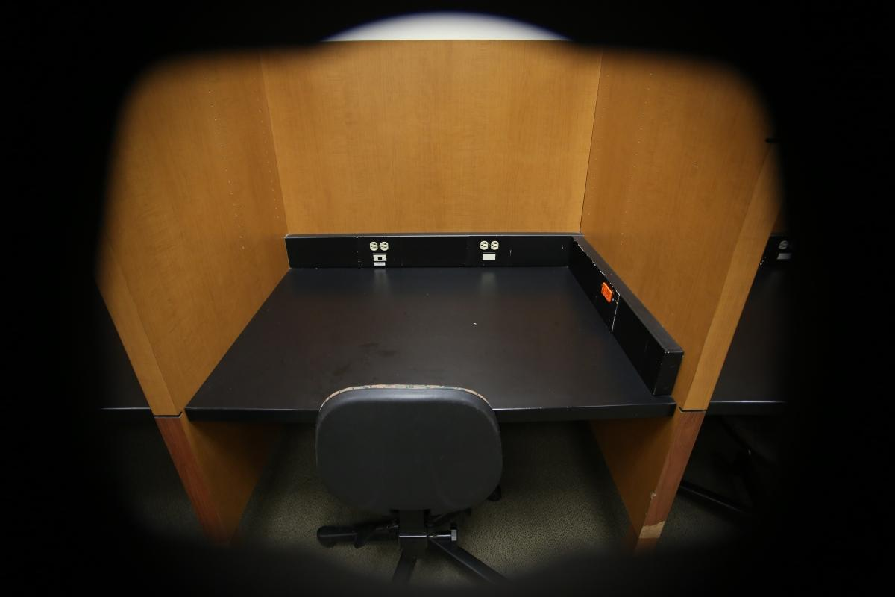

Slide 26
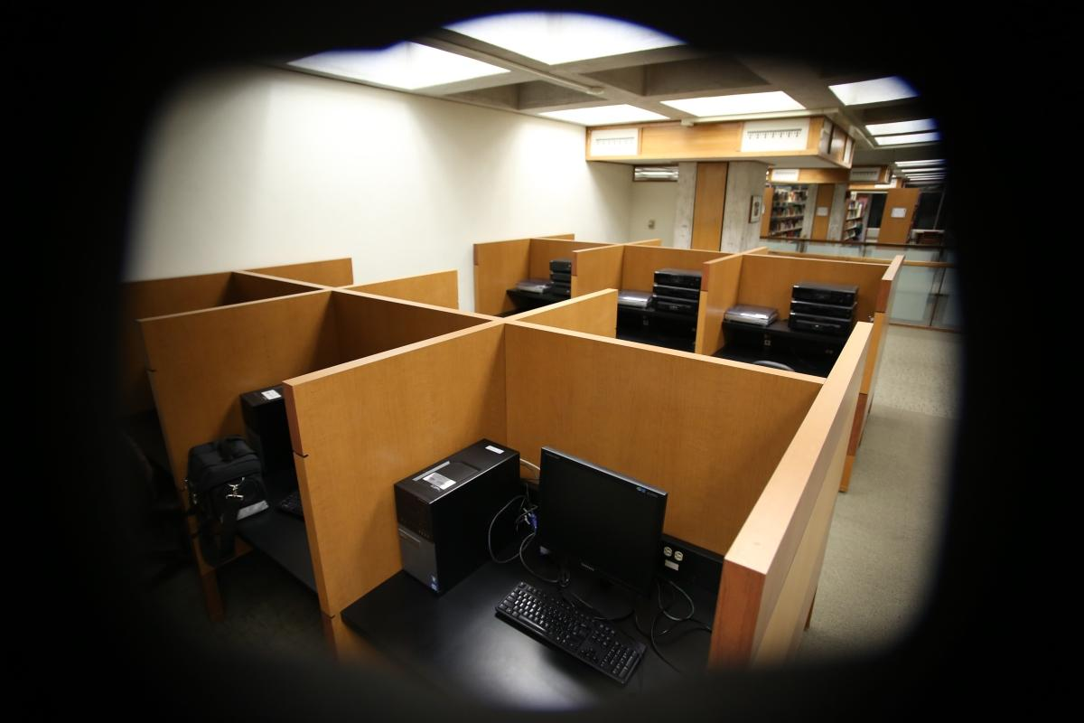

Slide 27
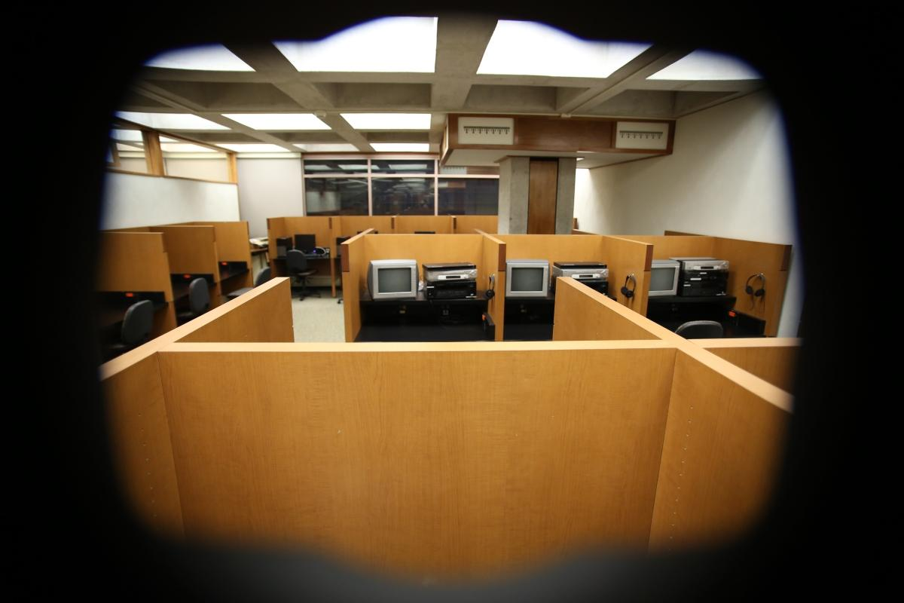

Slide 28
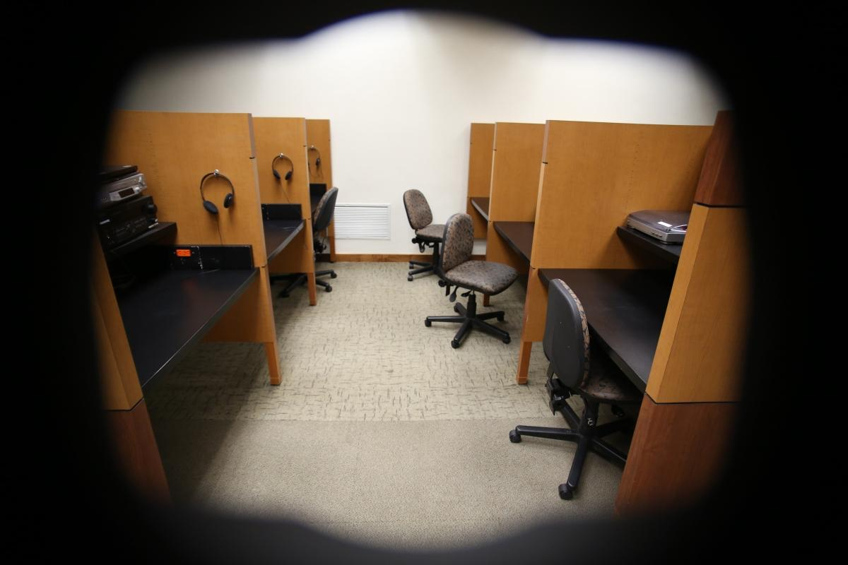

Slide 29
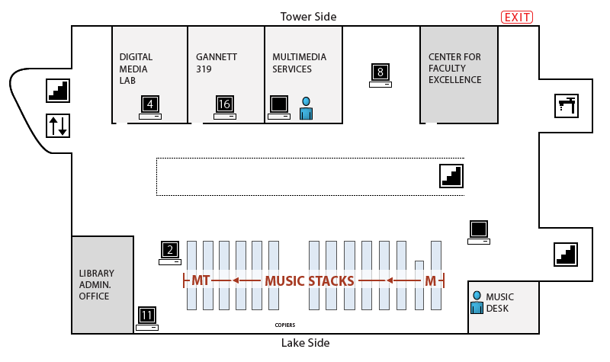
FLOOR MAP

Slide 30
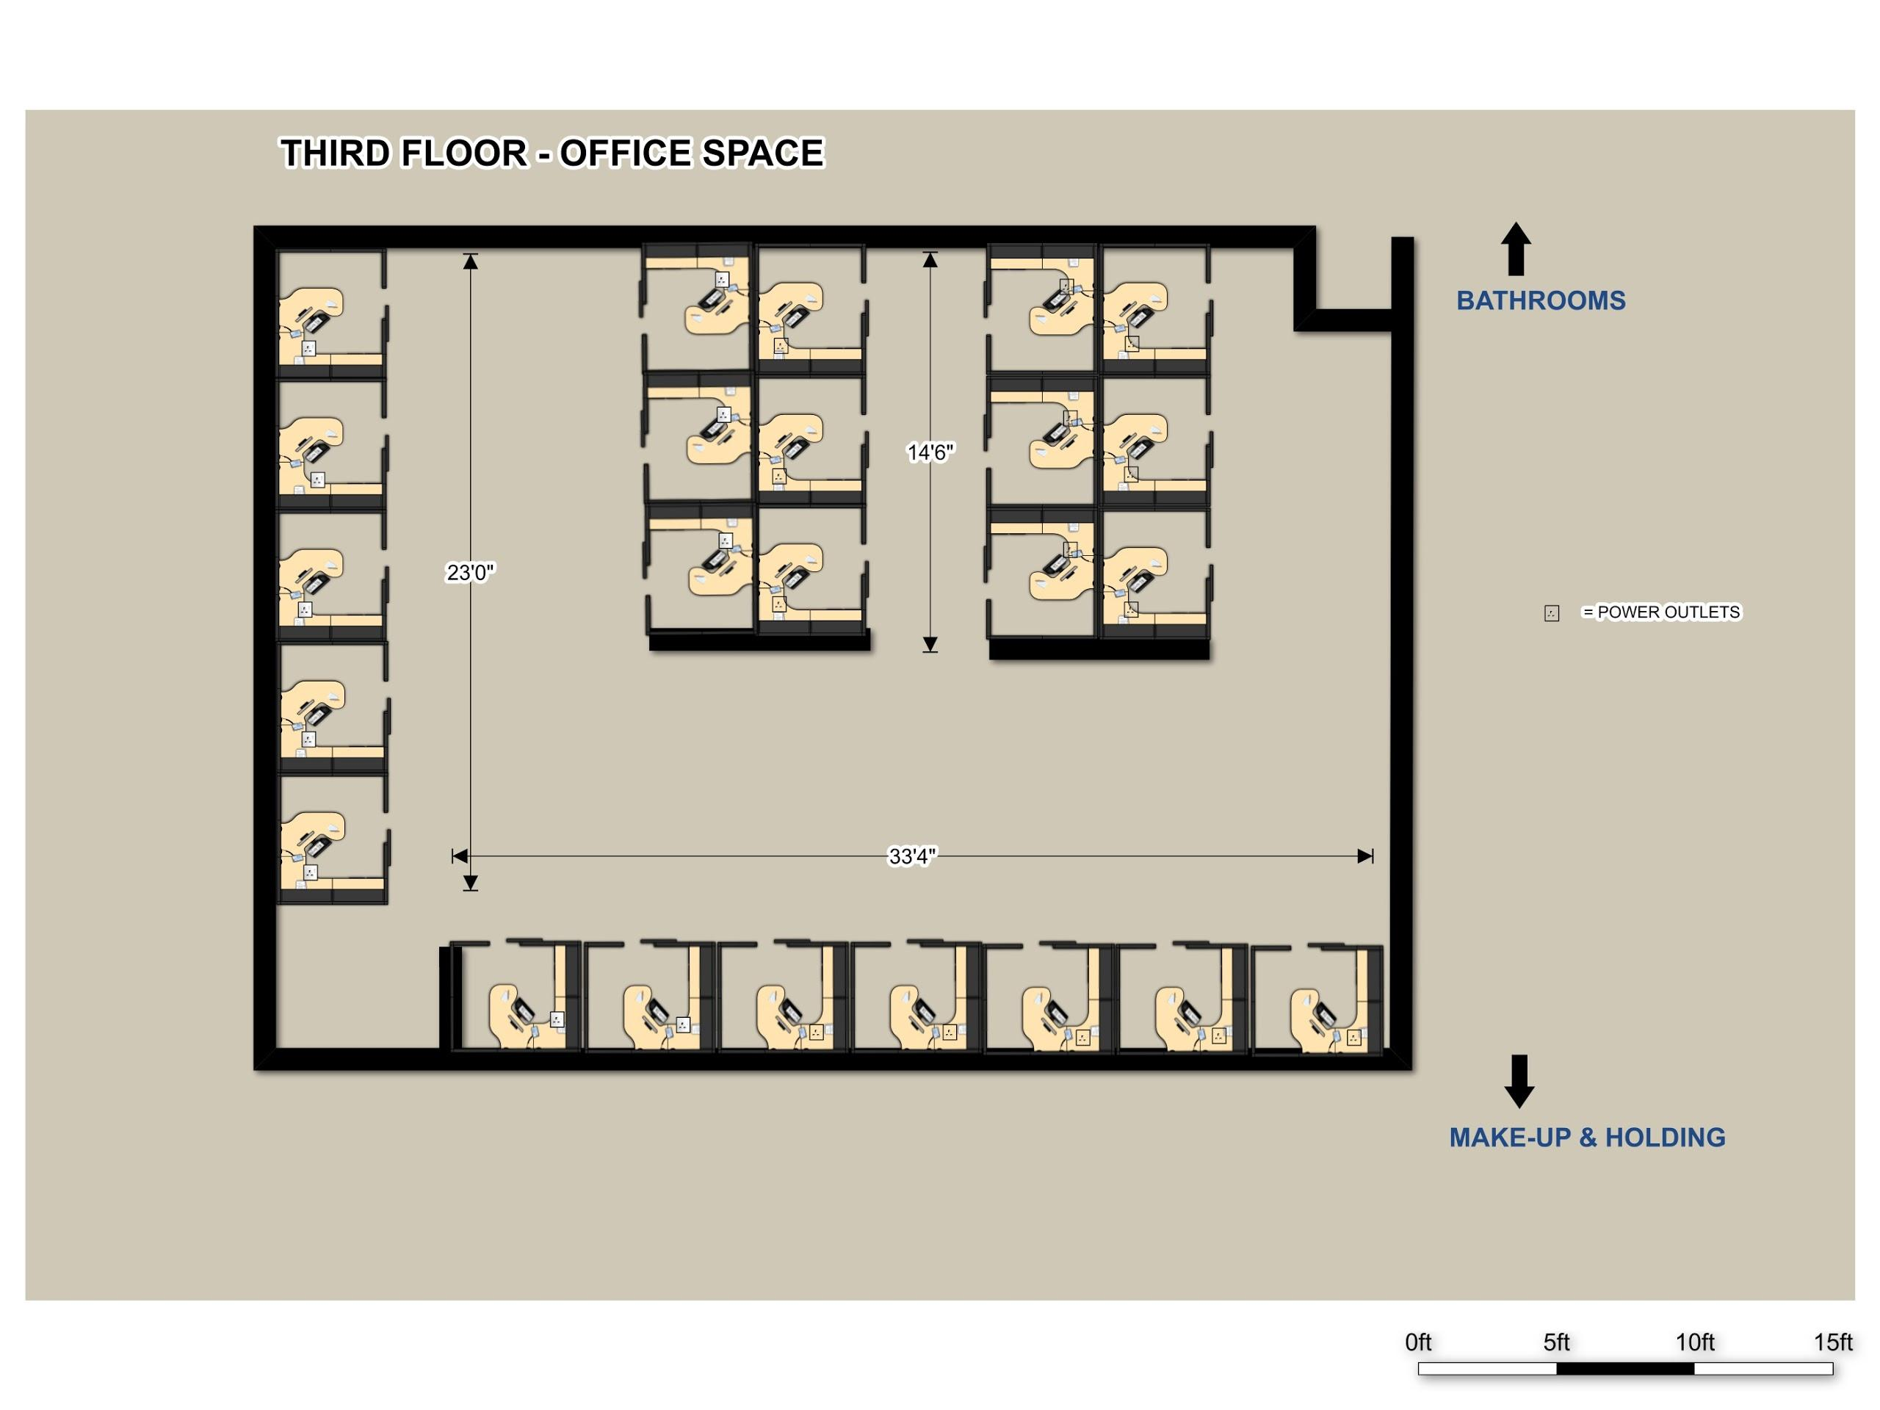

Slide 31
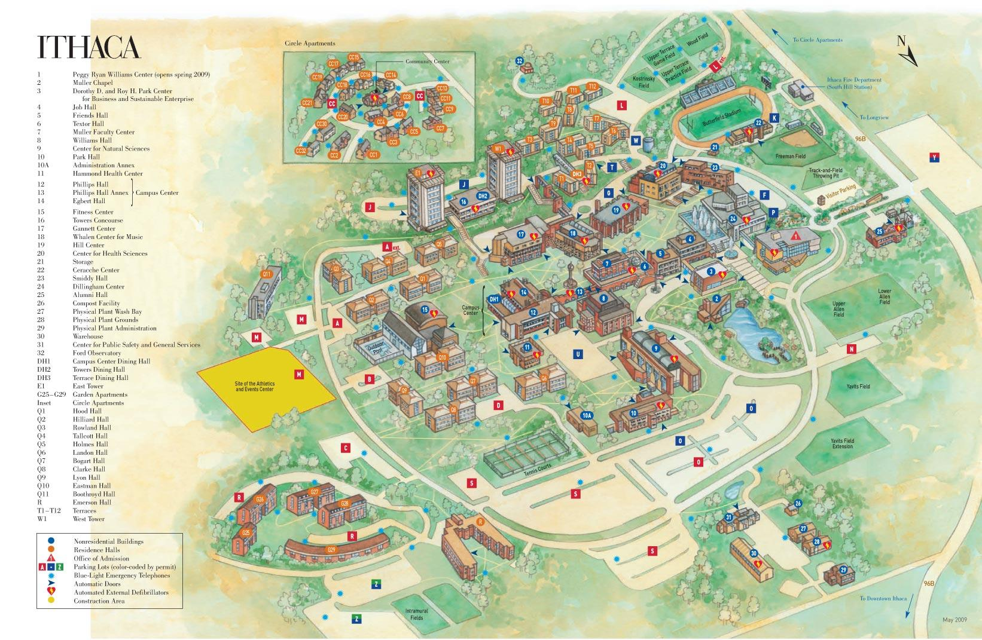

Slide 32
Genre: Office Space Comedy
How many comedies usually include ‘office space’ scenarios? By redressing this location and variating costumes one can transform it to become a lawyer’s office from the 1970s or a police department interior from 2010!
The interior space of the library’s third floor results very accessible, as it is surrounded by spacious rooms available for extras holding, catering and wardrobe. Usually open 24/7 during the week, the building closes early on weekends, allowing for undisturbed shooting time.

